Slide 1
GREEK AND ROMAN MYTHOLOGY:
ANCIENT YET TIMELESS
Susanna Braund
September 18, 2018

Slide 2
Greek and Roman mythology: ancient but timeless
Week 1: Creation stories and theories of myth
Week 2: Goddesses – Great Goddess and matriarchal society – Demeter – Hestia - Hera – Athena – Artemis – Aphrodite
Week 3: Gods – rise of the Olympian regime: Zeus, Poseidon, Hades; Apollo, Hermes, Dionysus
Week 4: Human archetypes, male: different types of hero: Heracles, Perseus, Theseus, Achilles, Odysseus, Jason
Week 5: Human archetypes, female: helpful and helpless princesses including Andromeda, Ariadne, Persephone, Medea; resourceful Penelope
Week 6: Troy and archaeology, Thebes and Oedipus, Mycenae and Agamemnon; the Underworld – topography and symbolism

Slide 3
Myth of Pygmalion
Setting: Cyprus
Goddess: Venus
Offenders: daughters of Propoetus
Devotee: Pygmalion, a sculptor
Source: Ovid Metamorphoses Book 10
(Latin poet, 1st century CE)

Slide 4
Daughters of Propoetus dare to deny that Venus is a goddess. Her revenge: she makes them the first prostitutes; they lose power to blush, then turn into hard flints. Pygmalion (sculptor) offended by their wickedness, lives as bachelor. But he carves beautiful female figure from ivory and falls in love with it–kisses it, speaks to it; brings it gifts–shells, pebbles, flowers, beads; dresses it with clothing and jewellery; puts it on his bed. On day of Venus’s festival, Pygmalion makes offering and asks for a bride like his ivory girl. Goes home to the statue on his couch and kisses it: she feels warm! Kisses her again, caresses her. The ivory has become flesh! He thanks Venus. Girl feels his kisses, blushes, looks up. Venus attends marriage and nine months later a child is born, called Paphos, from whom the city gets its name.

Slide 5
Edward Burne-Jones
(1833-1898)
Pygmalion and the Image

Slide 6
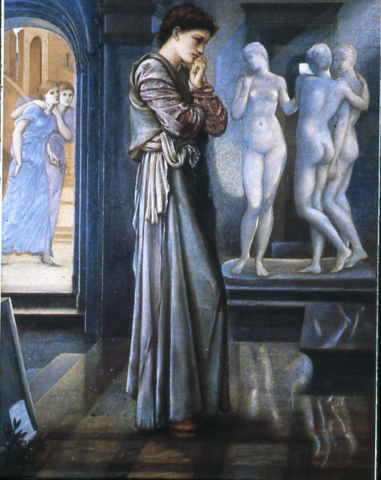
The Heart Desires

Slide 7
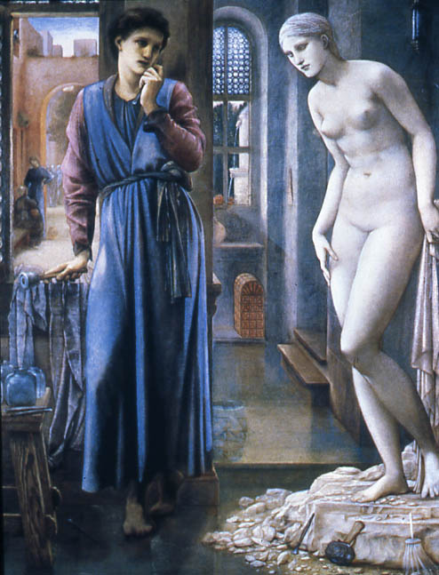
The Hand Refrains

Slide 8
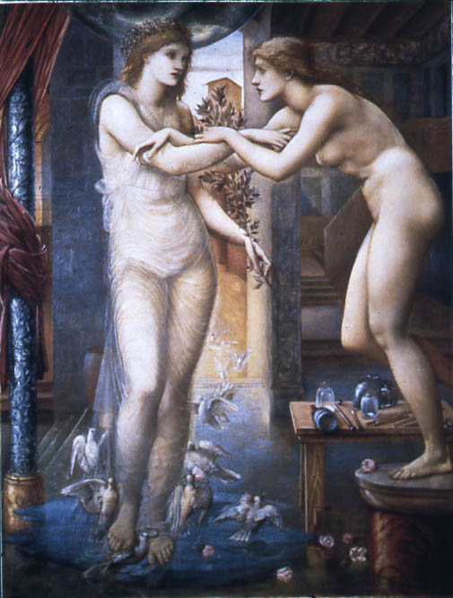
The Godhead Fires

Slide 9
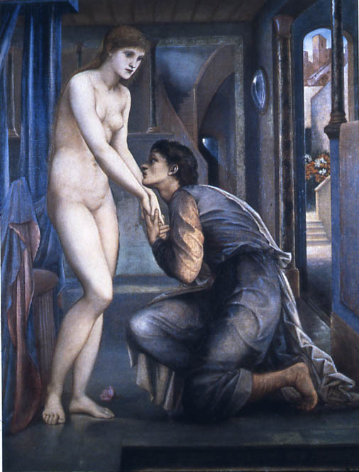
The Soul Attains

Slide 10
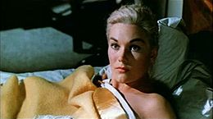
Kim Novak in Hitchcock’s Vertigo (1958)

Slide 11

Mira Sorvino in Woody Allen’s
Mighty Aphrodite (1995)

Slide 12
George Bernard Shaw Pygmalion 1912/1914
Eliza Doolittle
Professor Henry Higgins
Film version 1938
Play adapted as musical My Fair Lady 1956
Film version 1964
Audrey Hepburn
Rex Harrison

Slide 13
And then…
Educating Rita, play by Willy Russell 1980,
movie 1983 Julie Walters, Michael Caine
Pretty Woman 1990, Julia Roberts, Richard Gere
She’s All That 1999
Miss Congeniality 2000
See Paula James, Ovid's Myth of Pygmalion on Screen: in Pursuit of the Perfect Woman. Continuum studies in classical reception (2011)

