Slide 1
GREEK & ROMAN MYTHOLOGY:
ANCIENT YET TIMELESS
Susanna Braund
Lecture 2, October 3rd 2018

Slide 2
PRODUCTS MARKETED WITH NAMES FROM CLASSICAL MYTHOLOGY

Slide 3
Recap of Lecture 1
Ancient Greek creation myths
Asexual and sexual creation
Violence and deceit
Hesiod’s view of humans is one of decline from Golden Age to Iron Age (= now)
BUT
the myth of the Titan Prometheus offers model of human progress through technology

Slide 4
Recap of Lecture 1
Understanding myth:
Externalist theories: nature myths, ritualists, charter theory, etiology
Internalist theories: psychology, structuralism, narratology, feminism, neurological theories

Slide 8
THE GREAT GODDESS

Slide 9
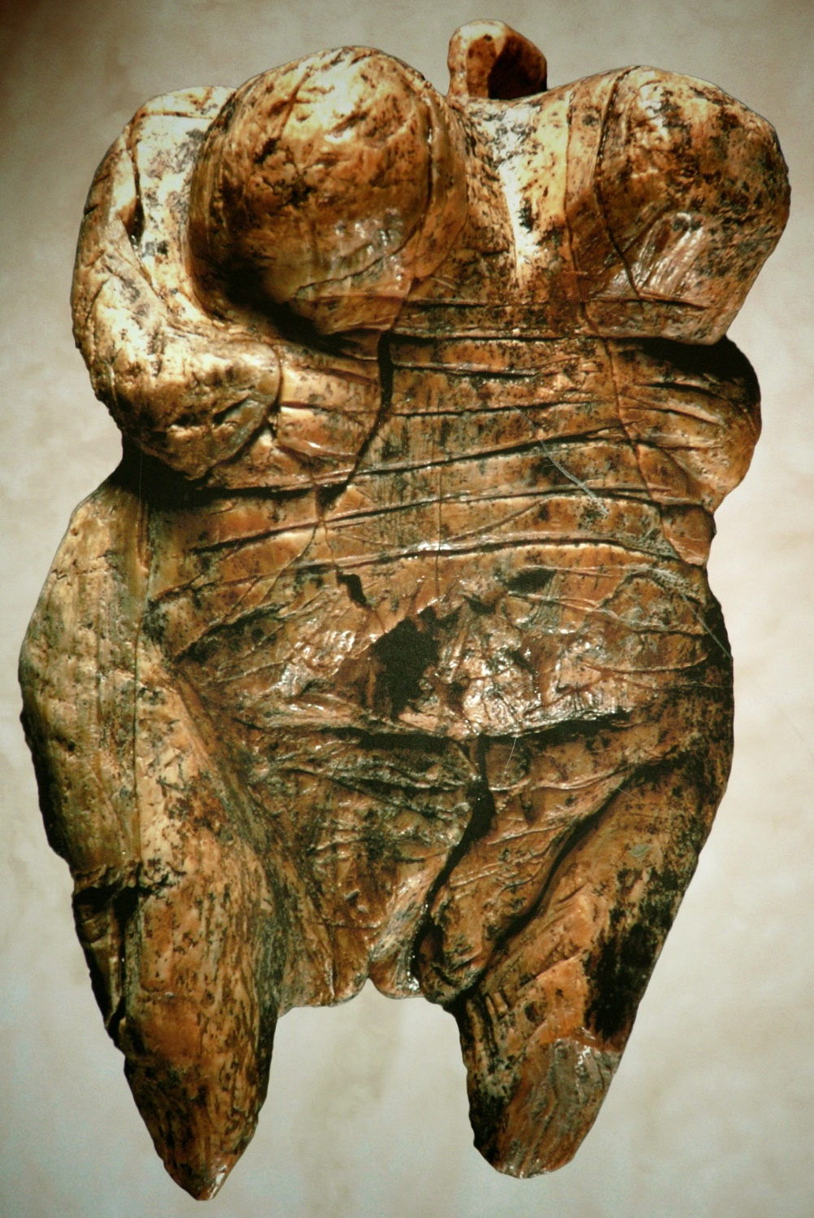
Hohle Fels Figure (ca. 35,000 BCE)

Slide 10
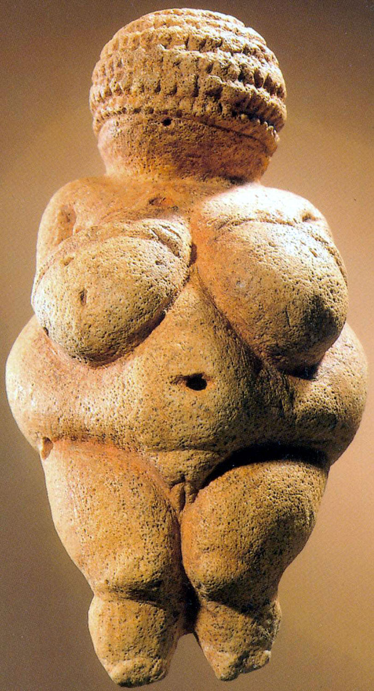
Venus of Willendorf, (c. 24,000-22,000 BCE)

Slide 11
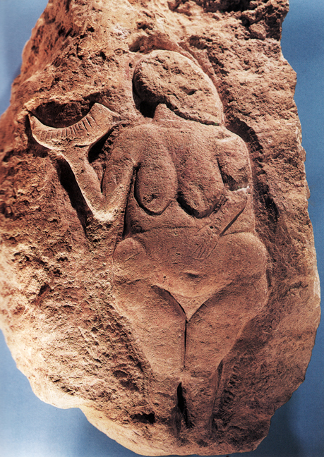
Great Goddess of Laussel (c. 20,000 BCE)

Slide 12
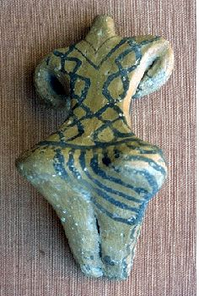
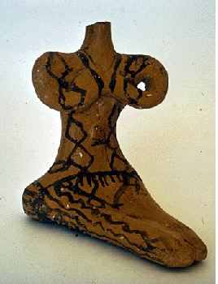
Female Neolithic figurines from Franchthi Cave in the Argolid, Peloponnese.

Slide 13
Marija Gimbutas The Language of the Goddess (1989)

Slide 14
LIFE | DEATH | RENEWAL

Slide 15
LIFE | DEATH | RENEWAL
HEAVEN | EARTH | UNDERWORLD

Slide 16
LIFE | DEATH | RENEWAL
HEAVEN | EARTH | UNDERWORLD
Pre-fertile | fertile | Post-fertile

Slide 17
LIFE | DEATH | RENEWAL
HEAVEN | EARTH | UNDERWORLD
Pre-fertile | fertile | Post-fertile
maiden | mother | crone

Slide 18
Matriarchal society?

Slide 19
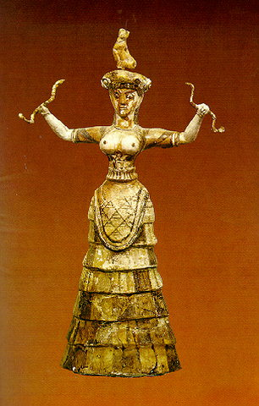
Minoan figure of female goddess with snakes (1700-1300 BCE)

Slide 20
Location of Crete

Slide 21
The Bronze Age
3000-2000 BCE Early Bronze Age
2000-1600 BCE Middle Bronze Age
1600-1100 BCE Late Bronze Age
Minoan civilization (named for King Minos) flourished on Crete during Middle Bronze Age
Palace of Cnossus/Knossus (mod. Heraklion), excavated from 1899 onwards by Sir Arthur Evans

Slide 22
Mycenaean Age
Invaders from N and/or E arrived in Greek mainland during Middle Bronze Age, spoke early form of Greek (Linear B tablets)
Mycenaean civilization (named for town Mycenae in Peloponnese) flourished in Greece during Late Bronze Age (1600-1100 BCE)
Mycenae excavated by Heinrich Schliemann 1876 onwards (he also excavated Troy)

Slide 23
Matriarchy gives way to patriarchy?
Minoans worshipped fertility mother goddess of the Earth, parallels in Near Eastern in Stone Age and Neolithic Age
Mycenaeans worshipped male sky god, parallels in other Indo-European cultures
Does myth of establishment of Olympian gods, led by Zeus, reflect shift from matriarchy to patriarchy?
Cyclical view of time gives way to linear view of time?

Slide 24
Minoan figure of female goddess with snakes (1700-1300 BCE)

Slide 25
Genesis 3: 1-5
Now the serpent was more crafty than any beast of the field which the LORD God had made. And he said to the woman, “Indeed, has God said, ‘You shall not eat from any tree of the garden’?” ² The woman said to the serpent, “From the fruit of the trees of the garden we may eat; ³ but from the fruit of the tree which is in the middle of the garden, God has said, ‘You shall not eat from it or touch it, or you will die.’” ⁴ The serpent said to the woman, “You surely will not die! ⁵ For God knows that in the day you eat from it your eyes will be opened, and you will be like God, knowing good and evil.”

Slide 26
Homeric Hymn to Earth
About Earth, I will sing, all-mother, deep-rooted and eldest, who nourishes all that there is in the world: all that go on the divine land, all that sail on the sea and all that fly–these she nourishes from her bounty. From you, reverend lady, mortal humans have abundance in children and in crops, and it is up to you to give them their livelihood or take it away. Rich and fortunate are those whom you honor with your kind support. To them all things are abundant, their fields are laden with produce, their pastures are covered with herds and flocks, and their homes are filled with plenty. These rule with good laws in cities of beautiful women and much happiness and wealth attend them. Their sons glory in exuberant joy and their daughters, with carefree hearts, play in blossom-laden choruses and dance on the grass over the soft flowers. These are the fortunate whom you honor, holy goddess, bountiful deity.
Hail, mother of the gods, wife of starry Uranus. Kindly grant happy sustenance in return for my song and I will remember both you and another song too.

Slide 27
EARTH GODDESS names and manifestations
GAIA
THEMIS
RHEA
APHRODITE
CYBELE
HECATE
HERA
DEMETER
ARTEMIS

Slide 28
LIFE | DEATH | RENEWAL
HEAVEN | EARTH | UNDERWORLD

Slide 29
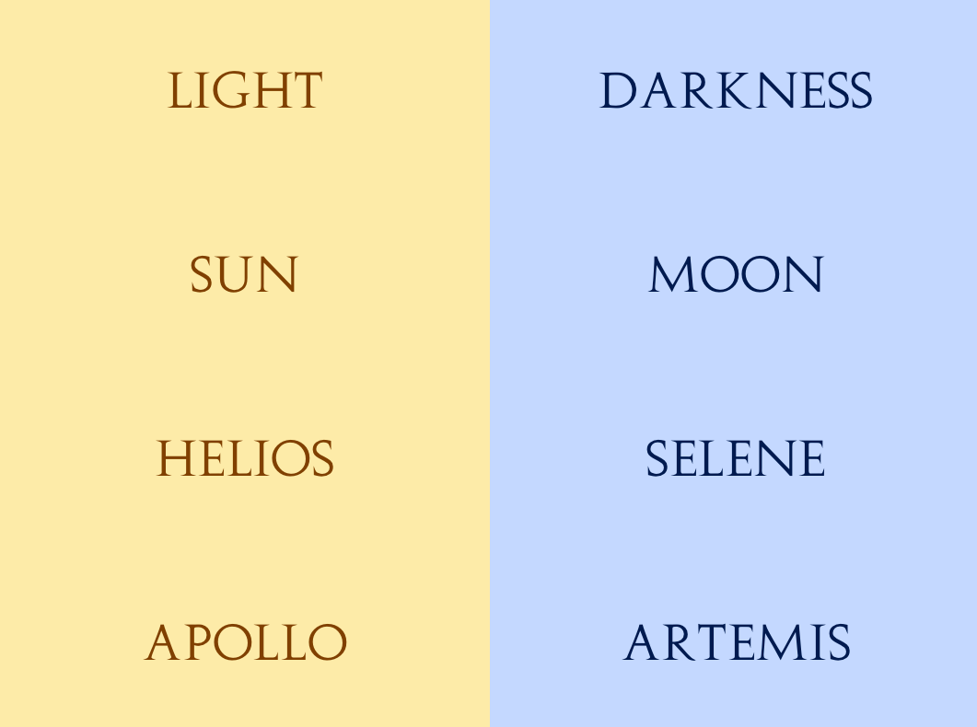

Slide 30
DEMETER
DE + METER
Proto-Indo-European METER = mother
DE ?= GE = earth (Greek)
or
DEA = barley (Cretan)
or
DEM = home (PIE)
Her daughter KORE (virgin) = PERSEPHONE

Slide 31
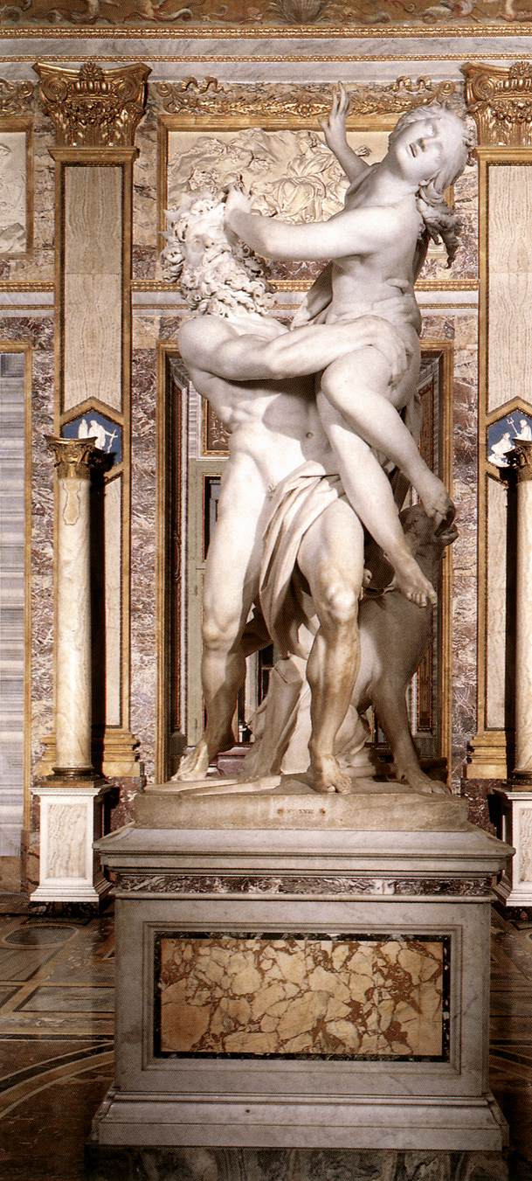
Abduction of Persephone by Bernini (1621-2)

Slide 32
Homeric Hymn to Demeter
Persephone abducted by Hades while picking flowers - Zeus her father has given her to Hades
D searches everywhere, grieving, not eating
Helios tells her what happened
D goes to Eleusis – insert story explains worship
of D at Eleusis
D withholds harvest to hurt humans and gods
Zeus commands her to desist; she refuses
Zeus sends Hermes to bring Persephone back
Hades has her eat pomegranate to ensure her return
8 months on earth; 4 months in Underworld

Slide 33
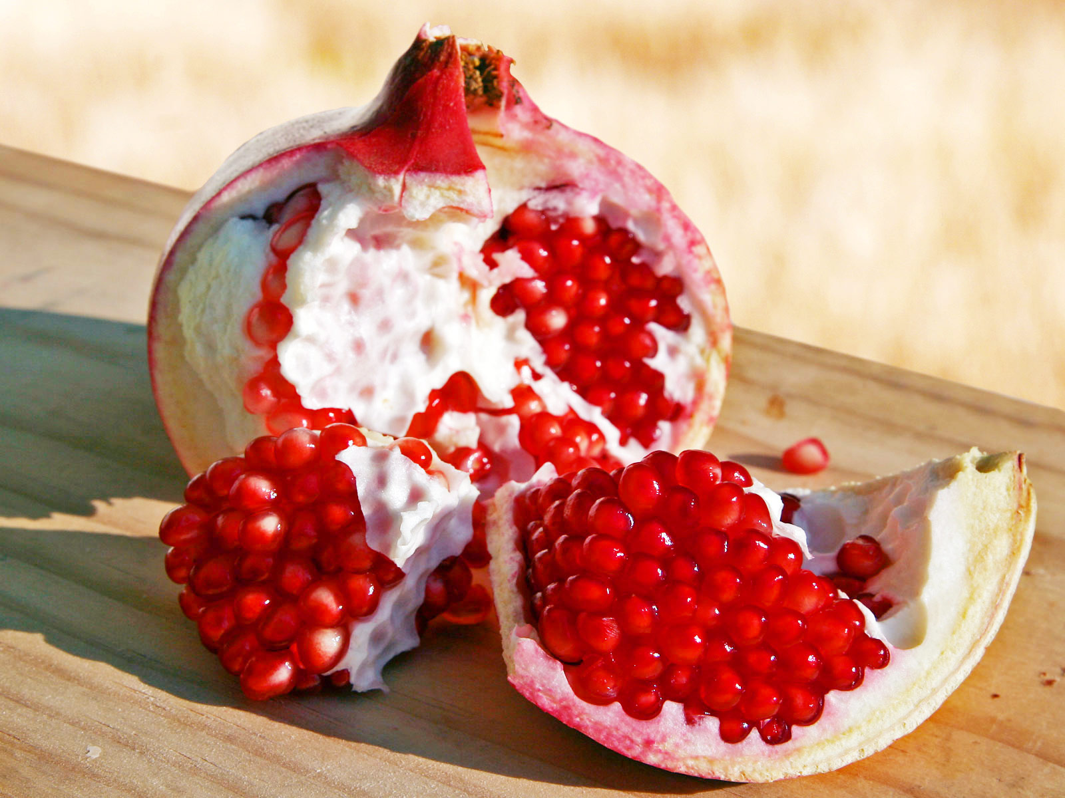

Slide 34
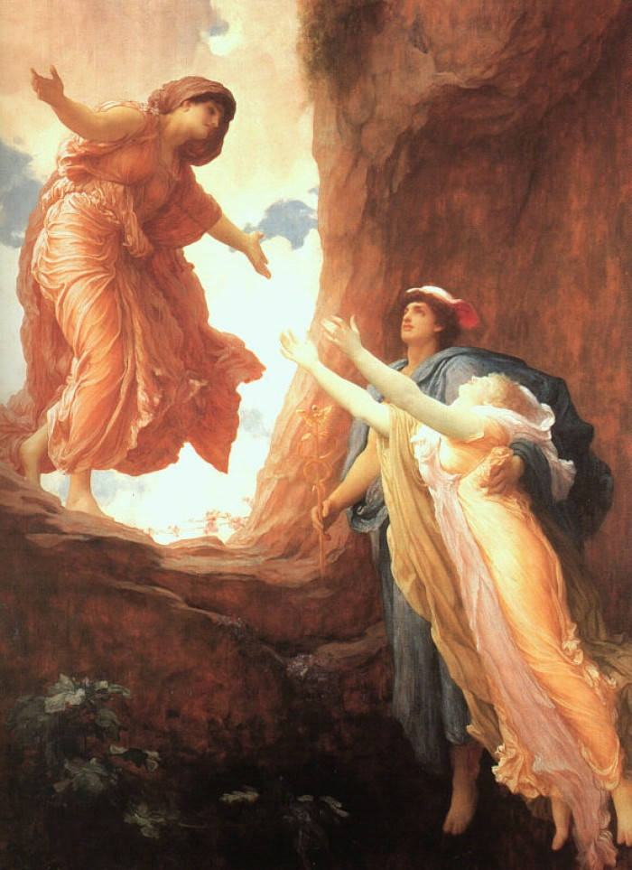
The Return of Persephone by Leighton (1891)

Slide 35
Recap of Lecture 1
Understanding myth:
Externalist theories: nature myths, ritualists, charter theory, etiology
Internalist theories: psychology, structuralism, narratology, feminism, neurological theories

Slide 36
Interpretation:
Etiology – of seasons, of agriculture
Archetypes – virgin-mother-crone
mother-daughter bond
Social charter – marriage as legalized rape
Structuralist – life-death binary mediated

Slide 37
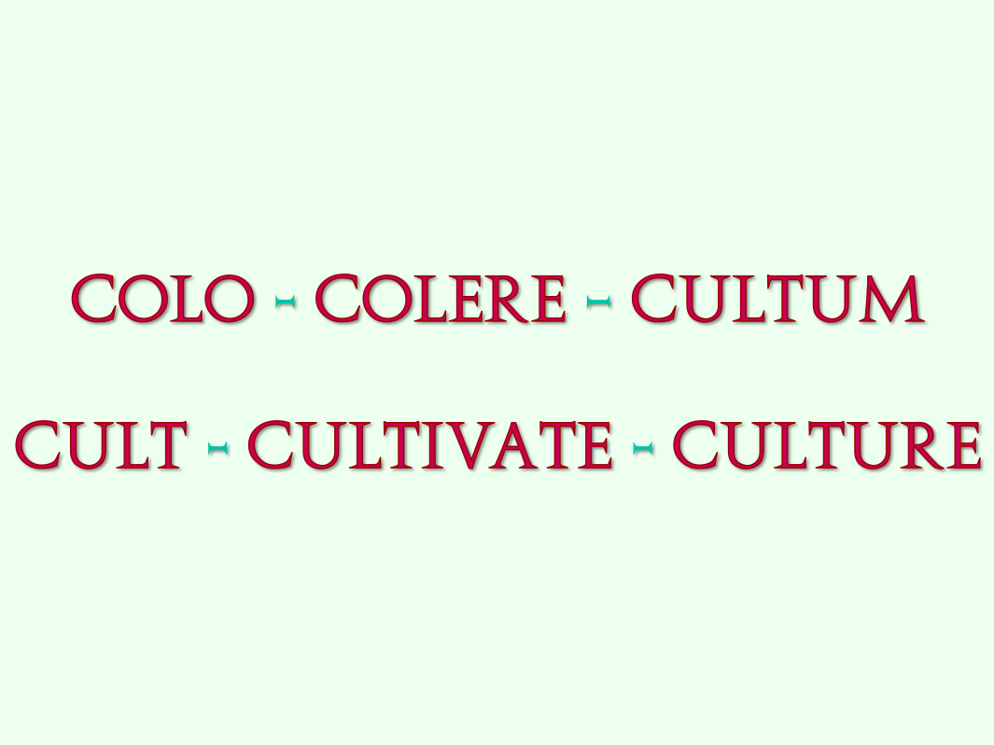
COLO - COLERE – CULTUM
CULT - CULTIVATE - CULTURE

Slide 38
Jared Diamond
Guns, Germs, and Steel: The Fates of Human Societies (1997)
Collapse: How Societies Choose to Fail or Succeed (2005)

Slide 39
Repeating patterns
Uranus pushed Gaia’s children inside her
Uranus castrated
Cronus swallowed Rhea’s children
Cronus tricked
Hades abducts Demeter’s daughter to the Underworld (with Zeus’ permission)
Demeter withholds harvest and makes a deal with Zeus

Slide 40
Eavan Boland ‘The Pomegranate’ In A Time of Violence, 1994
The only legend I have ever loved is
the story of a daughter lost in hell.
And found and rescued there.
Love and blackmail are the gist of it.
Ceres and Persephone the names.
And the best thing about the legend is
I can enter it anywhere. And have.
As a child in exile in
a city of fogs and strange consonants,
I read it first and at first I was
an exiled child in the crackling dusk of
the underworld, the stars blighted. Later
I walked out in a summer twilight
searching for my daughter at bed-time.
When she came running I was ready
to make any bargain to keep her.

Slide 41
I carried her back past whitebeams
and wasps and honey-scented buddleias.
But I was Ceres then and I knew
winter was in store for every leaf
on every tree on that road.
Was inescapable for each one we passed.
And for me.
It is winter
and the stars are hidden.
I climb the stairs and stand where I can see
my child asleep beside her teen magazines,
her can of Coke, her plate of uncut fruit.
The pomegranate! How did I forget it?
She could have come home and been safe
and ended the story and all
our heart-broken searching but she reached
out a hand and plucked a pomegranate.

Slide 42
She put out her hand and pulled down
the French sound for apple and
the noise of stone and the proof
that even in the place of death,
at the heart of legend, in the midst
of rocks full of unshed tears
ready to be diamonds by the time
the story was told, a child can be
hungry. I could warn her. There is still a chance.
The rain is cold. The road is flint-coloured.
The suburb has cars and cable television.
The veiled stars are above ground.
It is another world. But what else
can a mother give her daughter but such
beautiful rifts in time?
If I defer the grief I will diminish the gift.
The legend will be hers as well as mine.
She will enter it. As I have.
She will wake up. She will hold
the papery flushed skin in her hand.
And to her lips. I will say nothing.

Slide 43
SuzieQ

Slide 44
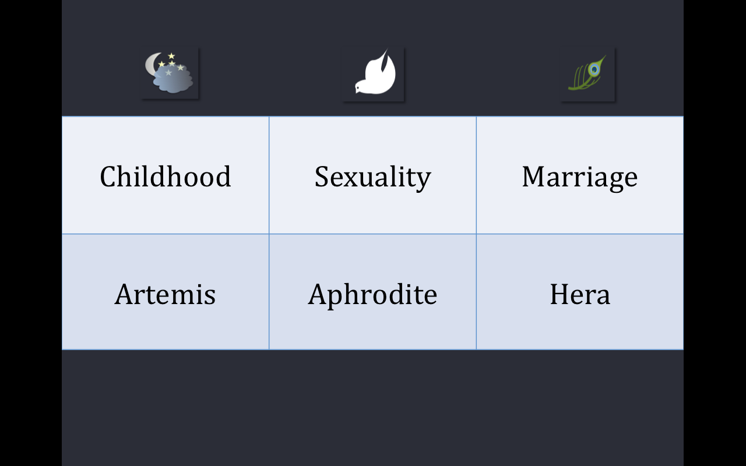
Childhood | Sexuality | Marriage
Artemis | Aphrodite | Hera

Slide 45
Artemis
Roman copy of Greek bronze, late C4th BCE

Slide 46
ARTEMIS
Daughter of Zeus and Leto
Sister of Apollo
Born on Delos
Bow & arrows
Shot Niobe’s seven daughters
Moon, hunting, virginity
Artemis narratives:
Her follower Callisto turned into a constellation
Actaeon punished for seeing her naked

Slide 47
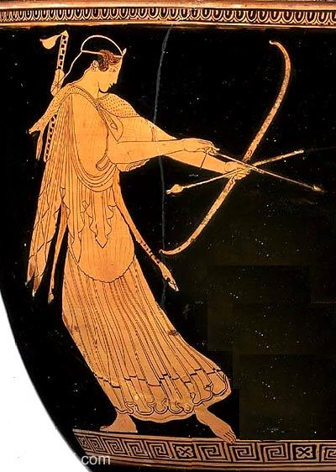
Artemis draws her bow
Attic red figure krater
c. 470 BCE,
MFA Boston,
detail

Slide 48
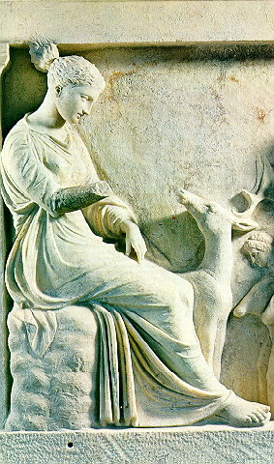
Votive relief of the goddess (4th century BCE)

Slide 49
CALLISTO, follower of ARTEMIS
ARCAS (>ARCADIANS)
URSA MAJOR (ARKTOS/ARCTUS)
URSA MINOR

Slide 50
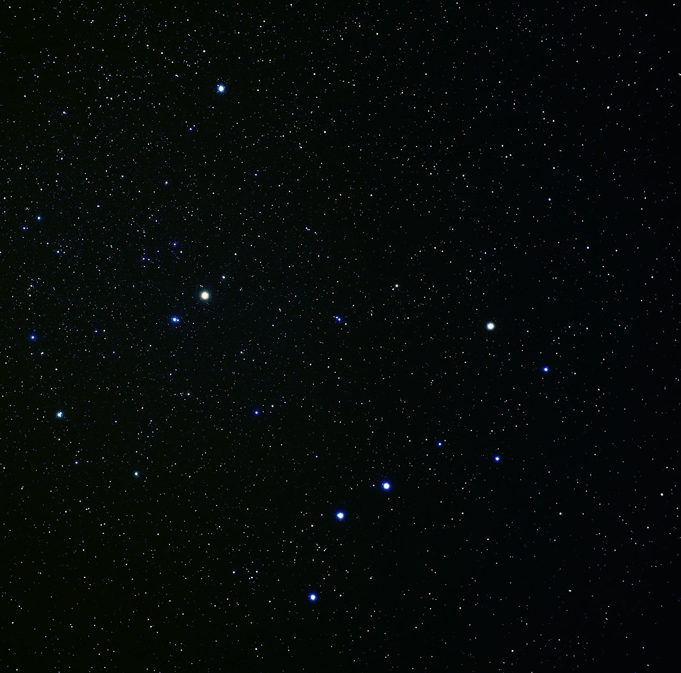
Ursa minor and Ursa major

Slide 51
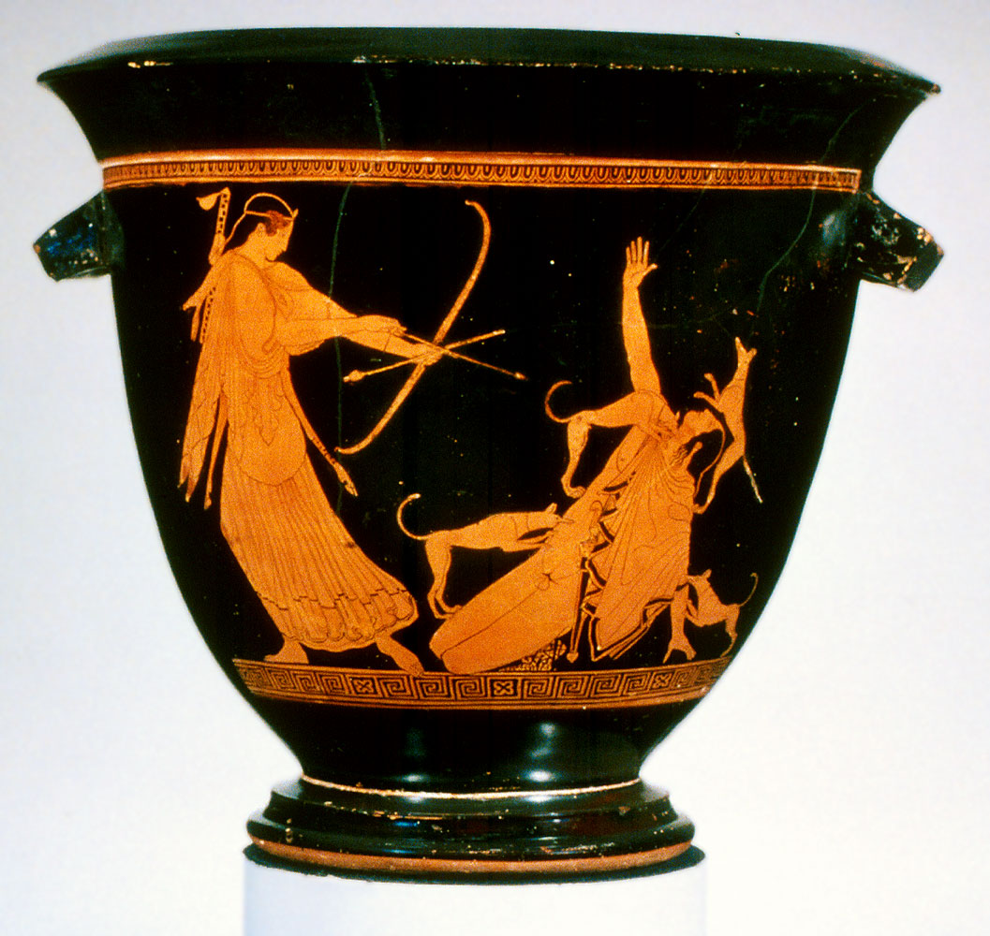
Artemis and Actaeon
Attic red figure krater, c. 470 BCE,
MFA Boston

Slide 52
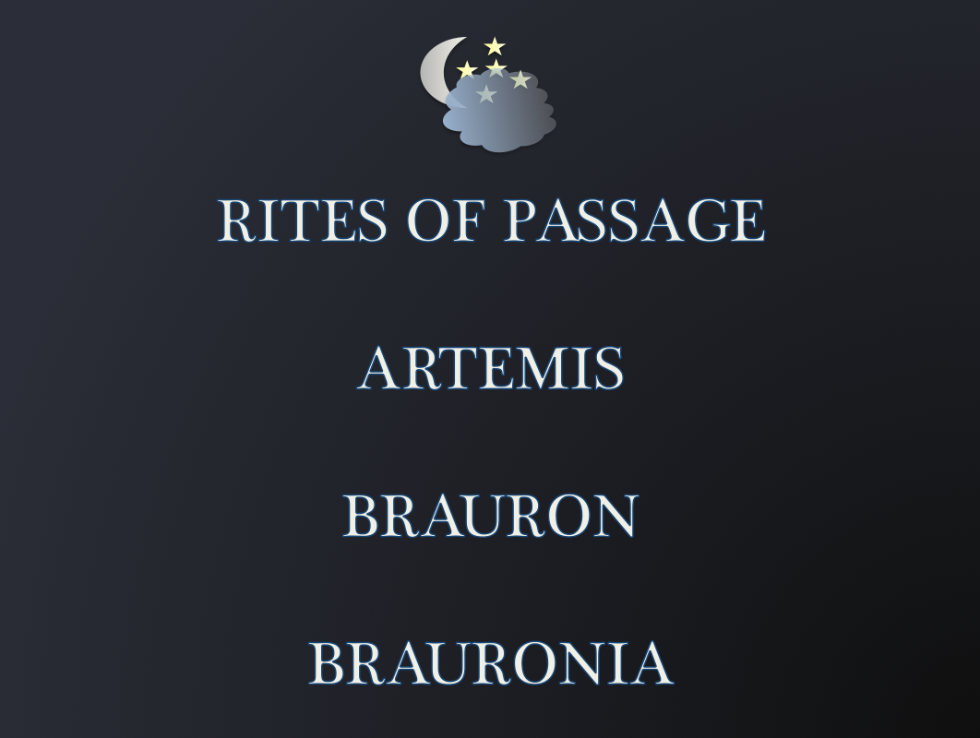
RITES OF PASSAGE
ARTEMIS
BRAURON
BRAURONIA

Slide 53
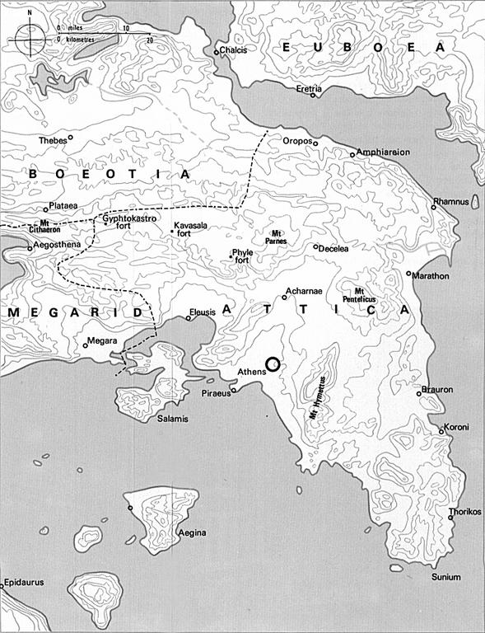

Slide 54
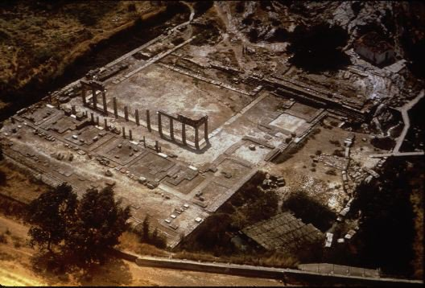
Aerial view of the shrine

Slide 55
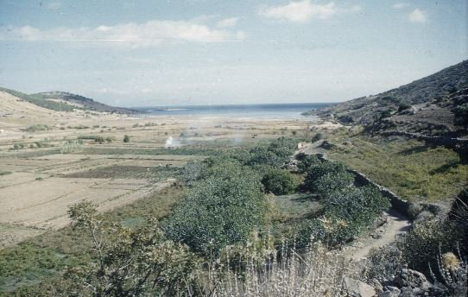
View from the shrine of Artemis Brauron to the sea

Slide 56
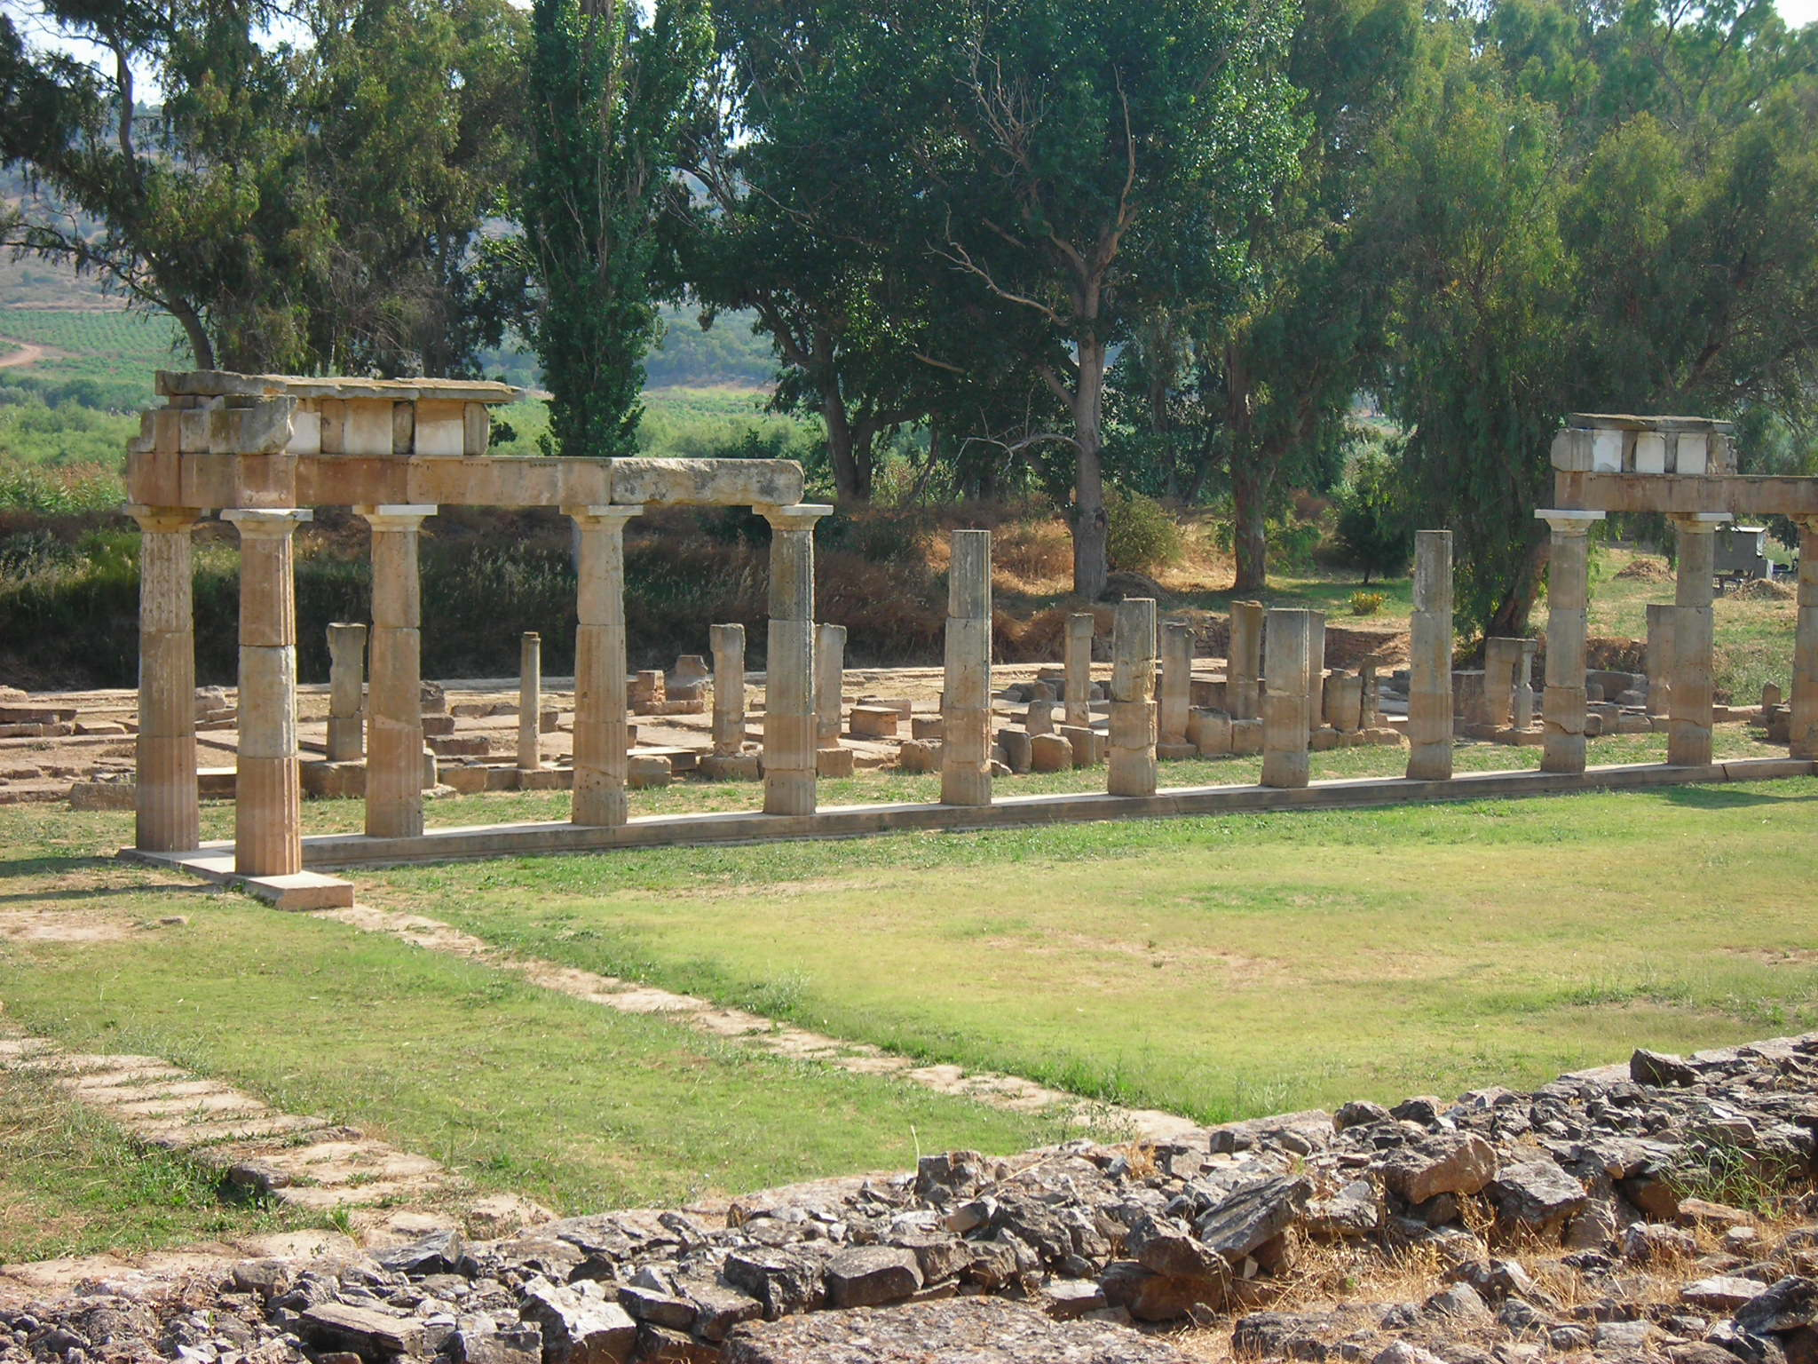
Brauron: Doric stoa; built between 425 and 415 B.C. It framed the big closed interior courtyard which opened toward the temple of Artemis

Slide 57
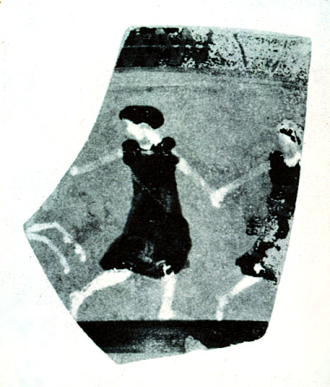
Dancing arktoi (bears) from a fragment of a pottery cup at Brauron

Slide 58
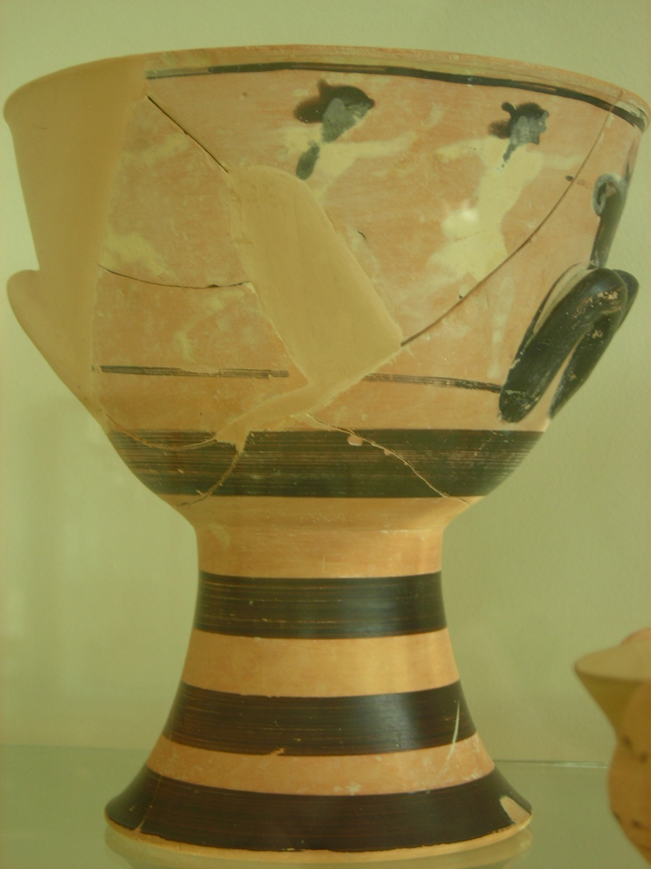
Cup showing footraces

Slide 59
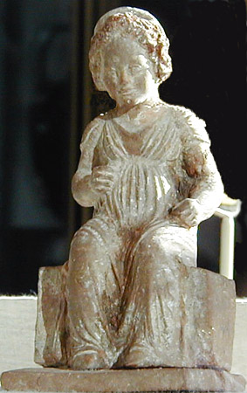
Seated girl; probably one of the arktoi at Brauron (c. 325 BC)

Slide 60
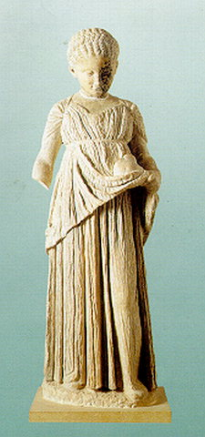
Statue of an “arktos.” The young girl is represented clad in a chiton and himation and holding a rabbit in her hand (C4th BCE)

Slide 61
Pierre Vidal-Naquet Formes de Pensées et Formes de Société dans le Monde Grec (Paris, 1981)196
"The myth is not difficult to explain: in exchange for the very advance of culture implied by the killing of wild animals, an advance for which men are responsible, the girls are obliged before marriage-indeed before puberty- to undergo a period of ritual 'wildness'.”

Slide 62
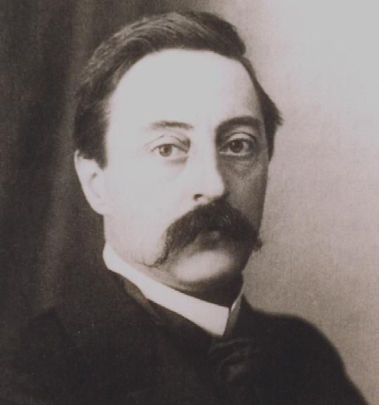
Arnold Van Gennep (1873-1957)
The Rites of Passage (Chicago, 1909)

Slide 63
Marginal/liminal stage
Rites of separation
Rites of incorporation
Status A
Status B

Slide 64
Iphigenia, daughter of Agamemnon, is dragged to the altar at Aulis Etruscan painted terra-cotta slab 7th – 6th Century BCE

Slide 65
Sacrifice of Iphigeneia Apulian Volute Krater. 370-355 BCE

Slide 66
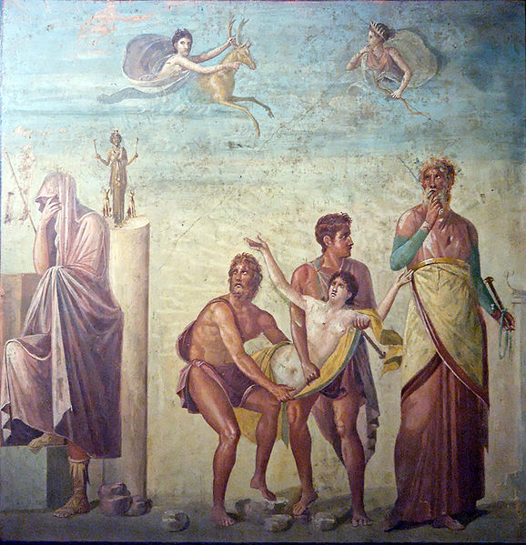
Sacrifice of Iphigenia; Roman wall painting from the House of the Tragic Poet in Pompeii, (c. 62 CE)

Slide 67
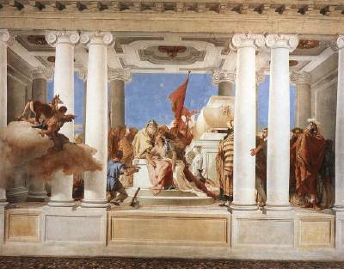
The Sacrifice of Iphigenia by Tiepolo (1757)

Slide 68
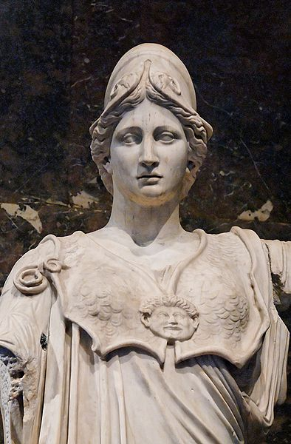
Athena
Athene

Slide 69
Apollodorus, Bibliotheca:
"Zeus slept with Metis, although she turned herself into many forms in order to avoid having sex with him. When she was pregnant, Zeus took the precaution of swallowing her, because she had said that, after giving birth to the daughter presently in her womb, she would bear a son who would gain the lordship of the sky. In fear of this he swallowed her. When it came time for the birth, Prometheus, or Hephaistos, according to some, by the river Triton struck the head of Zeus with an axe, and from his crown Athena sprang up, clad in her armour."

Slide 70
The Birth of Athena
Attic Black Figure kylix, 560 BCE
British Museum

Slide 71
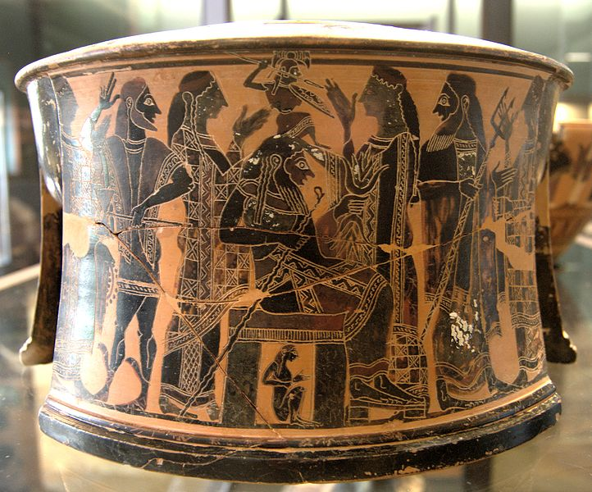
Birth of Athena, Attic black-figure tripod, ca. 570–560 BCE

Slide 72
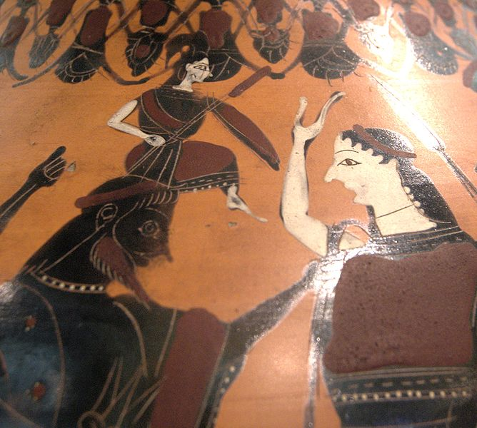
Athena being born from Zeus’ head Attic black-figured amphora, 550–525 BC.

Slide 73
And Athena, daughter of Zeus who holds the aegis, let slip to the floor of her father’s house her soft embroidered robe, which she herself had made and worked with her own hands. And she put on Zeus the cloud-gatherer’s own tunic in its place, then dressed in her armour for the misery of war. Round her shoulders she hung the tasselled aegis, a fearful weapon, set with Panic all round it in a circle: and on it there is Strife, and Power, and chilling Rout, and set there too is the head of the fearful monster Gorgon, a thing of fright and terror, a potent sign from Zeus who holds the aegis. And on her head she placed a golden helmet, set round with horns, four-bossed, and decorated with a hundred cities’ men-at-arms. She stepped into her flaming chariot, and took up her spear, the huge, heavy, massive spear with which she lays low the ranks of men…
Homer, Iliad Book 7.

Slide 74
Apollodorus, Bibliotheca:
"Kekrops, a son of the soil, was the first king of Attika . . . In his time, they say, the gods resolved to take possession of cities in which each of them should receive his own peculiar worship. So Poseidon was the first that came to Attika, and with a blow of his trident on the middle of the acropolis, he produced a sea. After him came Athena, and, having called on Kekrops to witness her act of taking possession, she planted an olive tree, which is still visible. But when the two strove for possession of the country, Zeus parted them and appointed arbiters. And in accordance with their verdict the country was adjudged to Athena, because Kekrops bore witness that she had been the first to plant the olive. Athena, therefore, called the city Athens after herself, and Poseidon in hot anger flooded the Thriasian plain and laid Attika under the sea."

Slide 75
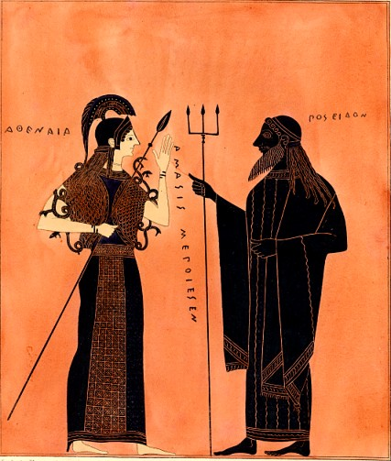
Athena and Poseidon by Amasis (6th century BCE)

Slide 76
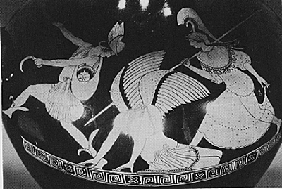
Athena, Perseus and the killing of the Gorgon (Athenian, red figure vase, 5th century BCE)

Slide 77
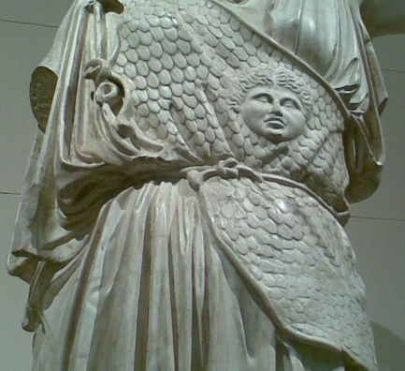
Aegis on Athena Lemnia (5th century BCE)

Slide 78
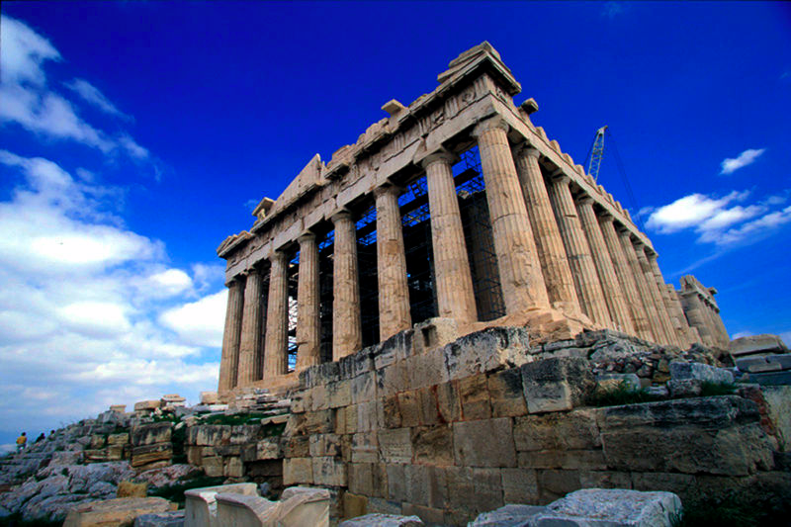
The Parthenon, on the Acropolis, Athens

Slide 79
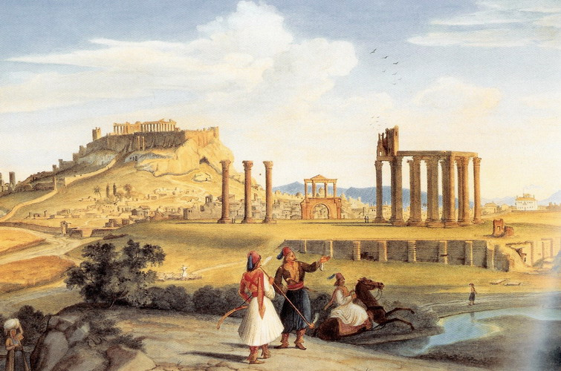
Parthenon in the early 19th century (1833)

Slide 80
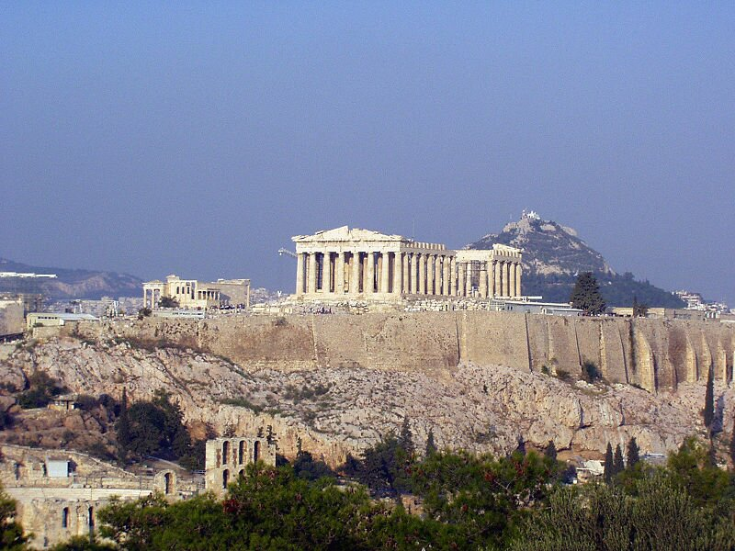

Slide 81
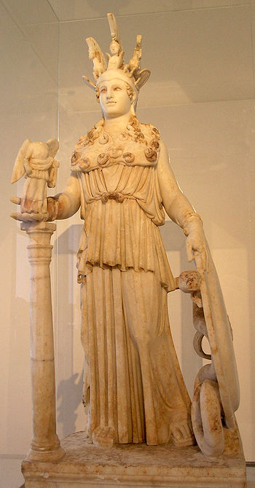
Votive model of the statue of Athena in the Parthenon

Slide 82
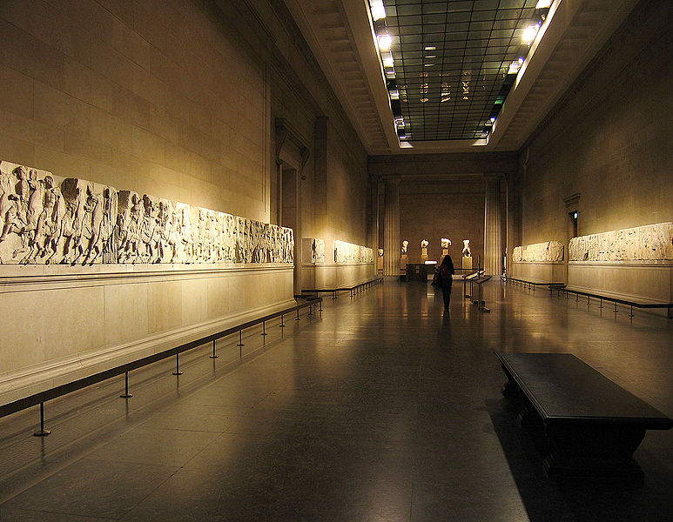
Parthenon frieze – the “Elgin marbles” (British Museum)

Slide 83
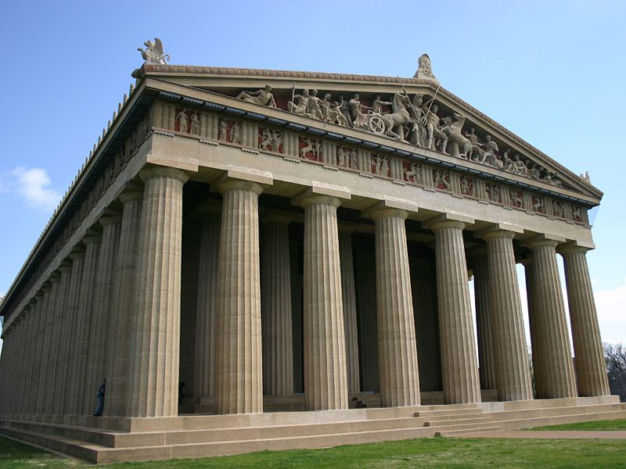
Copy of the Parthenon, Nashville

Slide 84
Reconstruction of Parthenon.
Nashville, Tennessee.

Slide 85
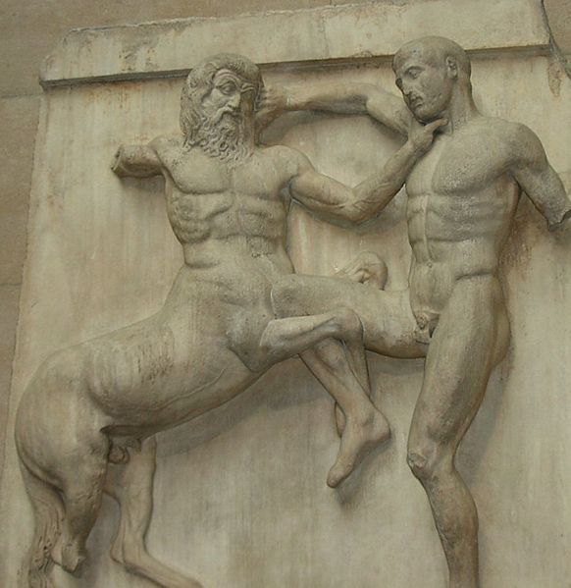
Centaur and Lapith, south metope Parthenon

Slide 86
East Pediment on Reconstructed Parthenon. Nashville, Tennessee

Slide 87
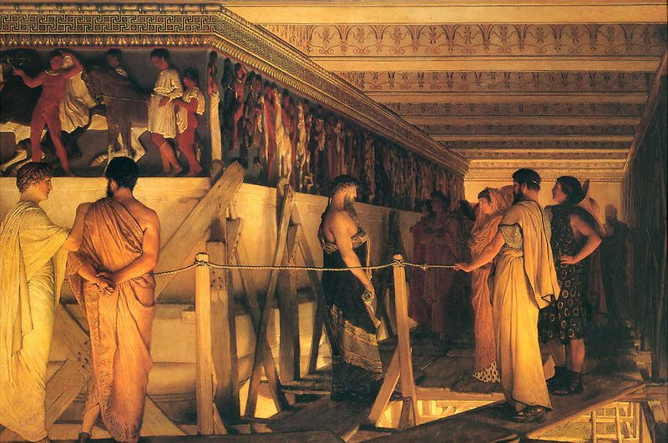
Phidias showing the frieze, Lawrence Alma-Tadema (1868)

Slide 88
FROM GREECE TO ROME

Slide 89
14 Olympian gods | Roman name | Functions, spheres | Symbols
ZEUS | JUPITER | order, justice, weather | eagle, thunderbolt
POSEIDON | NEPTUNE | sea, earthquakes, horses | trident, bull
HADES | PLUTO | underworld
HERA | JUNO | marriage | peacock
DEMETER | CERES | agriculture, fertility | wheatsheaf
HESTIA | VESTA | hearth | fire
ATHENE/ATHENA | MINERVA | wisdom, strategy, technology | aegis, owl
APHRODITE | VENUS | beauty, sex, love | dove
HERMES | MERCURY | travel, trade, trickery | winged sandals
APOLLO | APOLLO | light, healing, music | bow, lyre, sun
ARTEMIS | DIANA | wildlife, hunting | bow, moon
HEPHAESTUS | VULCAN | metalcraft | hammer, anvil
ARES | MARS | violence, war | sword
DIONYSUS | BACCHUS | wine, freedom | grapes, vine

Slide 90
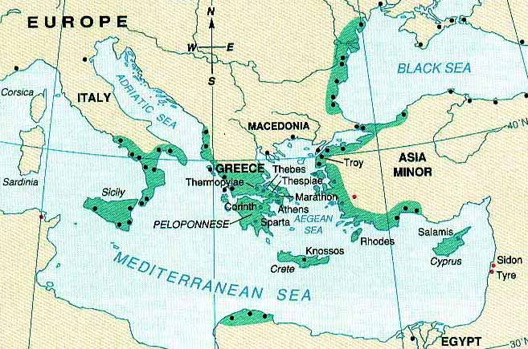

Slide 91
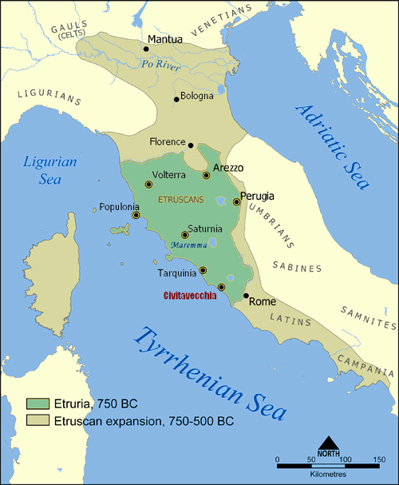

Slide 92
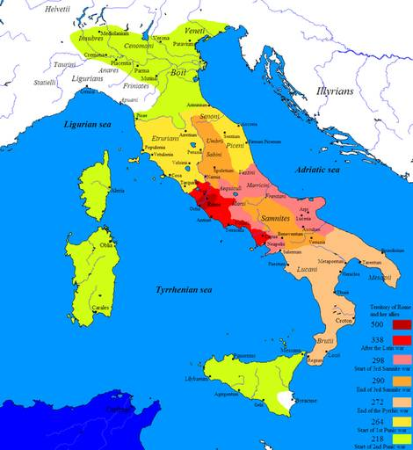

Slide 93
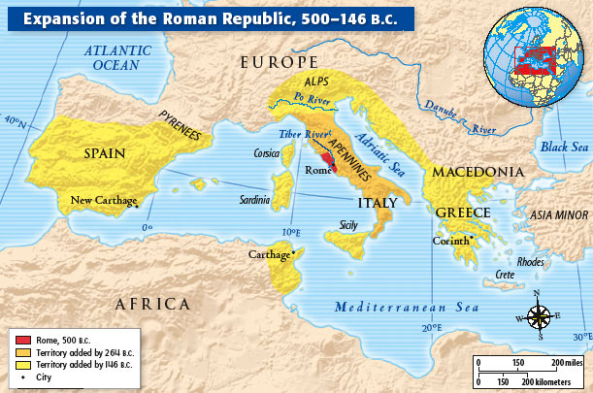

Slide 94
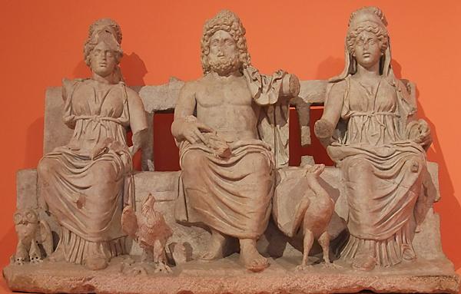
Minerva
Jupiter
Juno
Capitoline triad from Temple of Jupiter Optimus Maximus (2nd century CE)

Slide 95
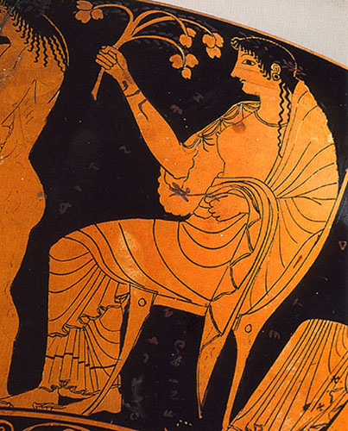
Hestia
Athenian red-figure vase, c.525-475 BCE

Slide 96
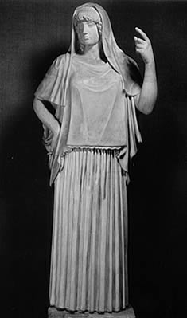
Vesta (Hestia)
Roman version of an original of about 470 BC.

Slide 97
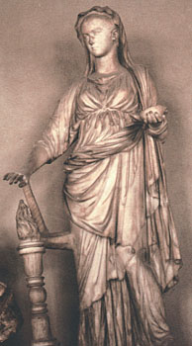
Temple of Vesta on the Forum Romanum and statue of Vesta

Slide 98
Reconstructions of the Temple of Vesta

Slide 99
Specification:
Venus Obsequens
Venus Victrix
Venus Erycina
Venus Libitina
Venus Felix
Venus Genetrix
Venus Cloacina
Venus Verticordia

Slide 100
Temple of Venus (Felix) and Rome (123-135 CE)

Slide 101
Reconstruction of theatre of Pompey the Great with temple of Venus Victrix

Slide 102
Coin with shrine of Venus Cloacina (late 40s BCE) and Mouth of Cloaca Maxima

Slide 103
Venus Verticordia by Dante Gabriel Rossetti (1864-8)
Veneralia: April 1st

Slide 104
www.theoi.com

