Slide 1
GREEK & ROMAN MYTHOLOGY:
ANCIENT YET TIMELESS
Susanna Braund
Lecture 3, October 10th 2018

Slide 2
Place names that use names
from Greek and Roman mythology

Slide 3
The Great Goddess: review
What are the physical features of representations of the Great Goddess of the Stone Age?
Which flourished earlier, the Mycenaean culture or Minoan culture?
Which goddesses in the Greek pantheon may reflect aspects of the Great Goddess?
What effect does the rise of the male sky-god have on the functions of the Great Goddess?
How does Persephone end up dividing her time between earth and the Underworld? What does this part of the myth explain?

Slide 4
14 Olympian gods | Roman name | Functions, spheres | Symbols
ZEUS | JUPITER | order, justice, weather | eagle, thunderbolt
POSEIDON | NEPTUNE | sea, earthquakes, horses | trident, bull
HADES | PLUTO | underworld
HERA | JUNO | marriage | peacock
DEMETER | CERES | agriculture, fertility | wheatsheaf
HESTIA | VESTA | hearth | fire
ATHENE/ATHENA | MINERVA | wisdom, strategy, technology | aegis, owl
APHRODITE | VENUS | beauty, sex, love | dove
HERMES | MERCURY | travel, trade, trickery | winged sandals
APOLLO | APOLLO | light, healing, music | bow, lyre, sun
ARTEMIS | DIANA | wildlife, hunting | bow, moon
HEPHAESTUS | VULCAN | metalcraft | hammer, anvil
ARES | MARS | violence, war | sword
DIONYSUS | BACCHUS | wine, freedom | grapes, vine

Slide 6
Cronus and Rhea, Greek relief

Slide 7
Titanomachy (Battle of the Titans)
The Titan CRONUS is tricked into bringing up the stone and the five children he swallowed, HESTIA, DEMETER, HERA, HADES and POSEIDON
All his children, including ZEUS, wage war on him, assisted by the the Titan Prometheus
CRONUS is supported by all the other TITANS
ZEUS wins and the TITANS are imprisoned in TARTARUS

Slide 8
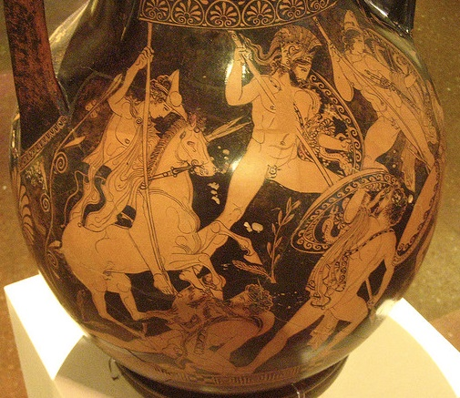
Titanomachy, red-figure pelike c. 400 BCE

Slide 9
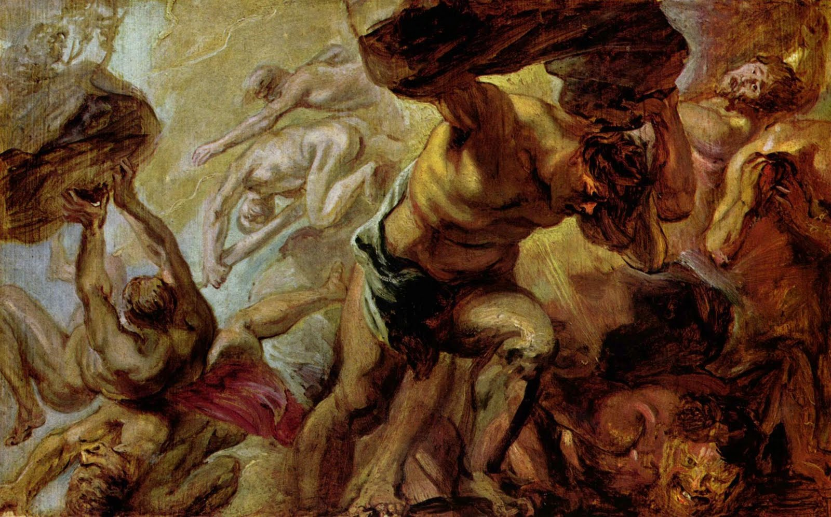
Fall of the Titans, Rubens 1637-8

Slide 10
A succession myth
Zeus overcomes Cronus and the other Titans and imprisons them in Tartarus
[Zeus overcomes Giants and imprisons them under earth]
[Zeus overcomes snaky Typhon and imprisons him in Tartarus]
Zeus punishes Prometheus for helping humans and ties him to a crag in the Caucasus mountains
Cf. other succession myths in Ancient Near East myth

Slide 11
Hesiod Theogony narrative is teleological –
explanation and justification of Zeus’ supreme position
and of the patriarchy he upholds and represents
‘teleological’ from Greek telos = ‘goal, aim, endpoint’

Slide 12
ZEUS
king of the Olympian gods
but he has to share the universe with his
two brothers Poseidon and Hades

Slide 13
POSEIDON: Great though Zeus is, this that he has said is too much, if he will force me against my will, me, I who am his equal in rank, since we are three brothers born by Rhea to Kronos, Zeus, and I, and the third is Hades, lord of dead men. All was divided among us three ways, each given his domain. I when the lots were shaken drew the grey sea to live in forever; Hades drew the lot of the mists and the darkness, and Zeus was allotted the wide sky, in the cloud and the bright air. But earth and high Olympus are common to all three.”
Iliad 15. 185 ff.

Slide 14
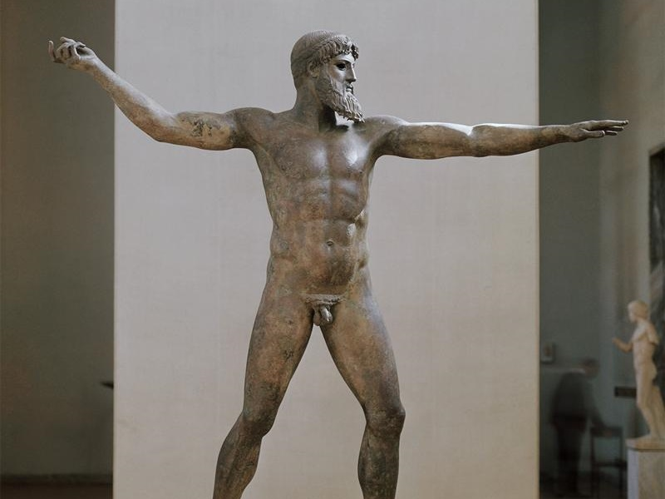
Zeus (or Poseidon) bronze statue from Artemisium (ca. 460 BCE), National Archaeological Museum, Athens

Slide 15
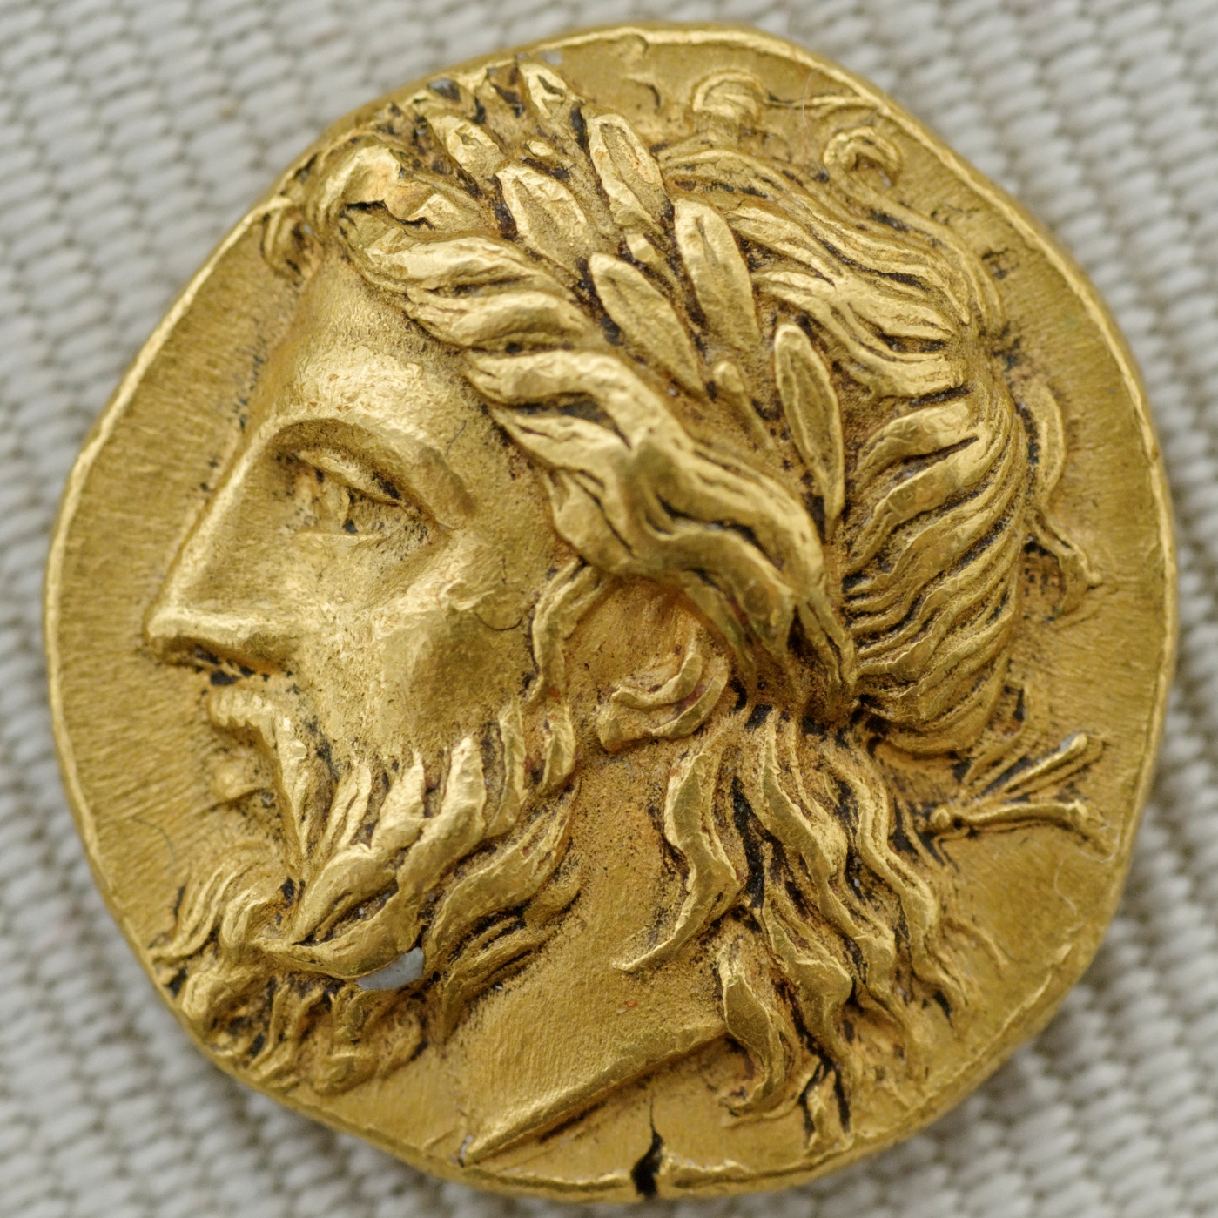
Head of Zeus on gold stater, from Lampsacus (c. 360-340 BCE)

Slide 16
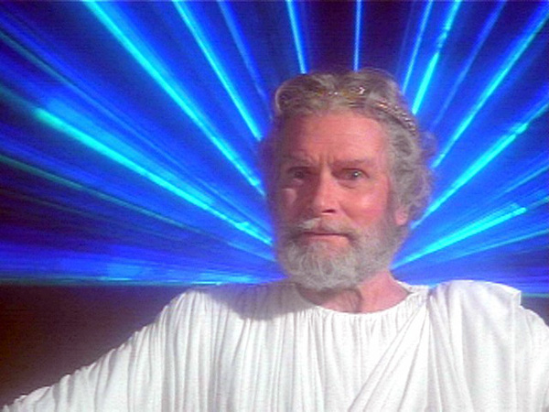
Laurence Olivier as Zeus in Clash of the Titans (1981)

Slide 17
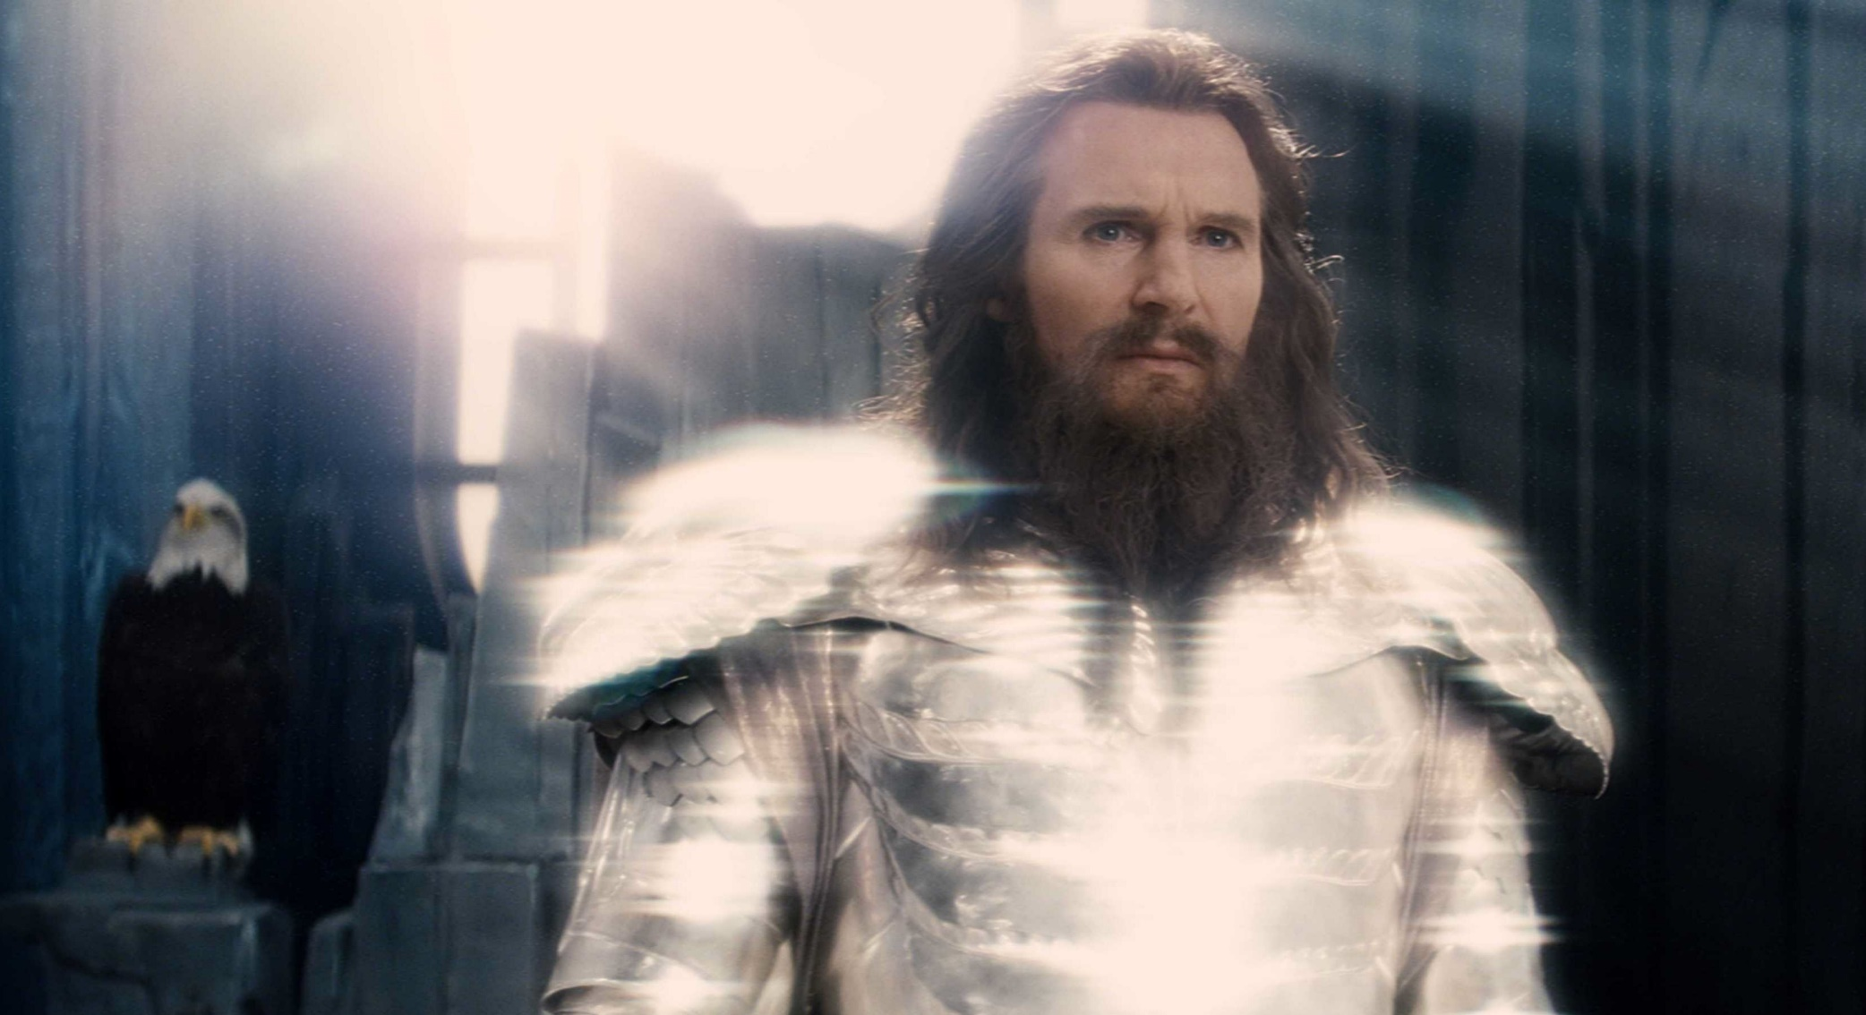
Liam Neeson as Zeus, Clash of the Titans (2010)

Slide 18
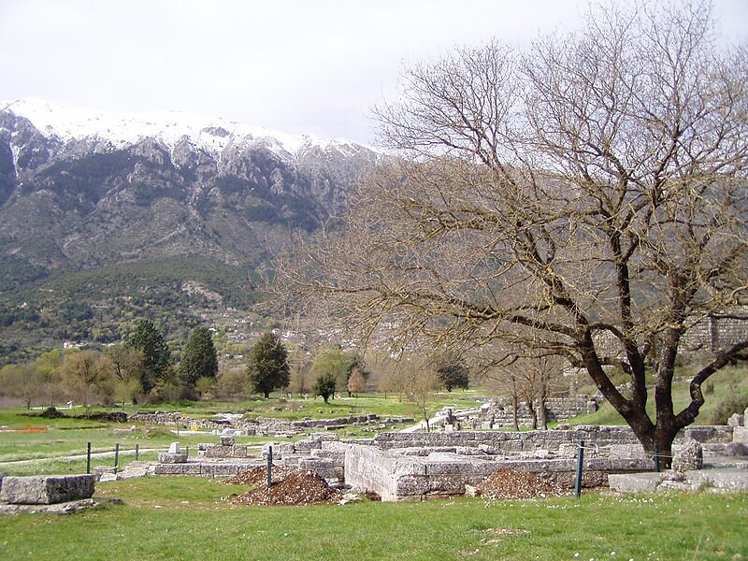
Temple of Zeus at Dodona, Northern Greece

Slide 19
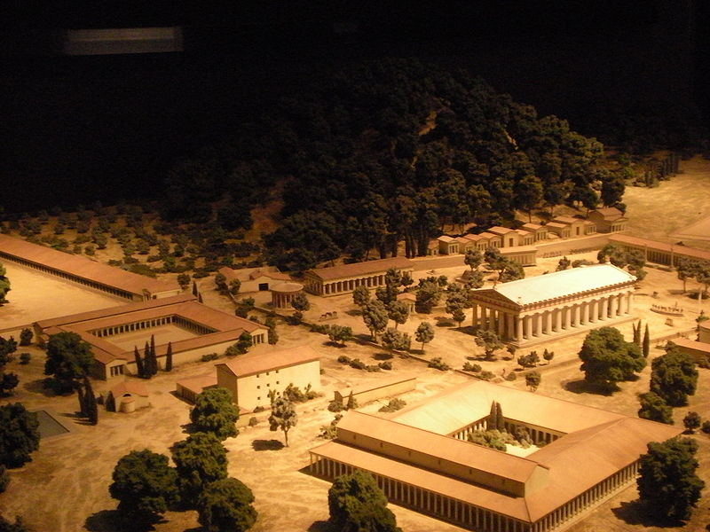
Reconstruction of Temple at Olympia in the Peloponnese, Greece

Slide 20
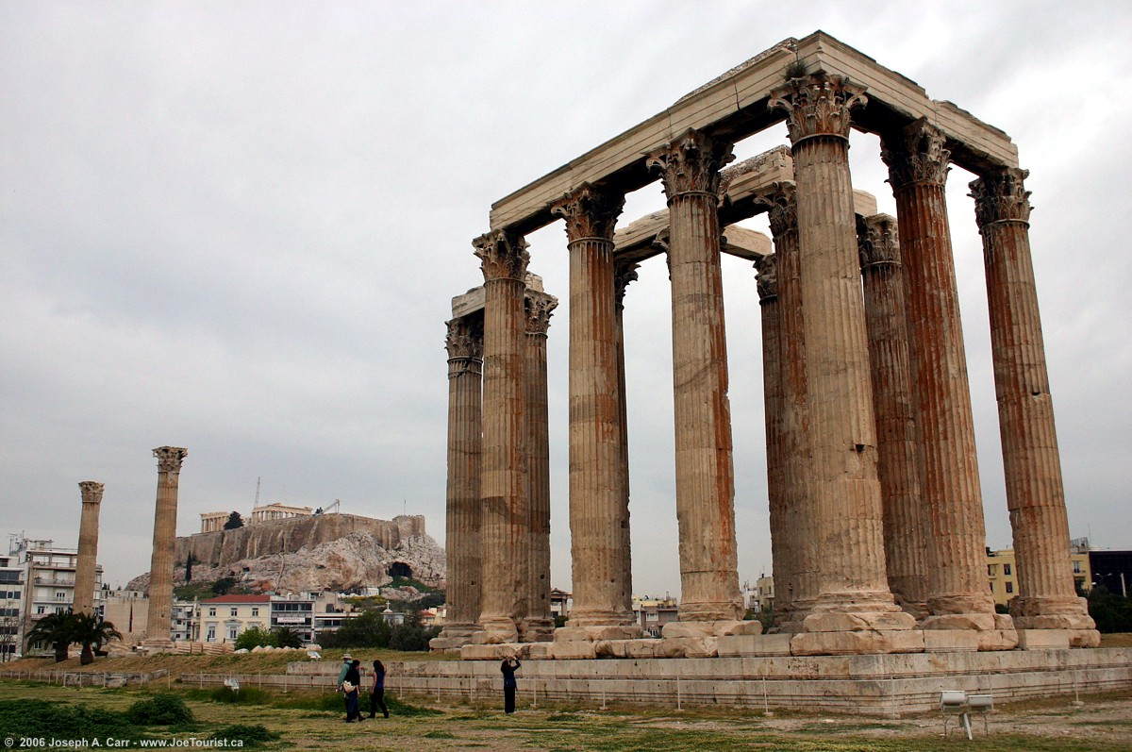
Temple of Olympian Zeus at Athens

Slide 21
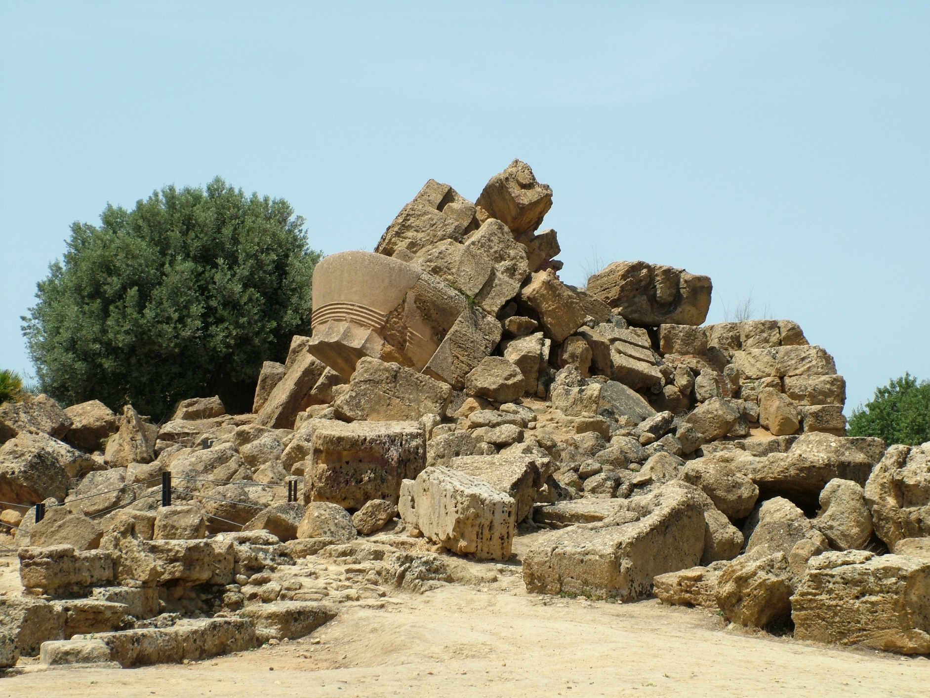
Ruins of the Temple of Olympian Zeus at Agrigento, Sicily

Slide 22
Titles and roles of Zeus
Zeus Ouranios / Aitherios – day / sky
Zeus Ombrios – rain
Zeus Semios – lit. signs = weather
Zeus Xenios – hospitality
Justice and law
Oaths
Kings

Slide 23
Zeus, ‘father of gods and of men’
HERA > HEPHAESTUS, ARES, HEBE, EILEITHYIA
METIS > ATHENA
LETO > APOLLO and ARTEMIS
MAIA > HERMES
DIONE > APHRODITE
DEMETER > PERSEPHONE
and
SEMELE [mortal] > DIONYSUS

Slide 24
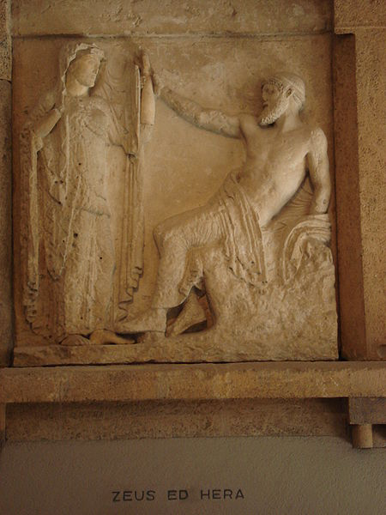
Zeus and Hera from temple at Selinus, Sicily (475-460 BCE)

Slide 25
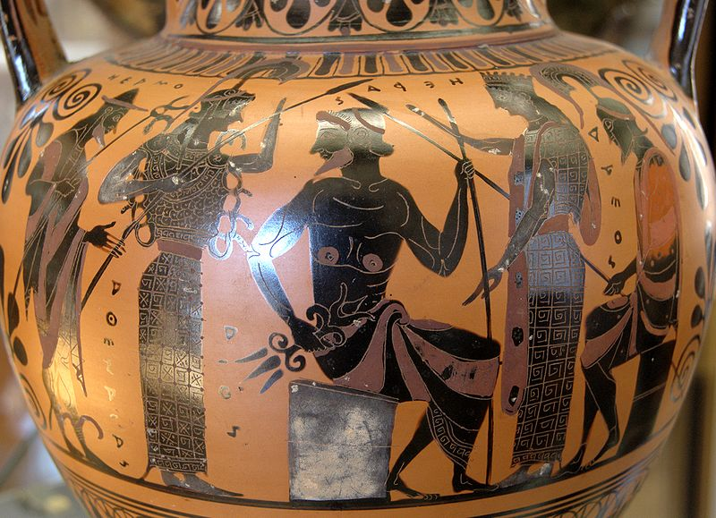
Zeus with Hermes, Athena, Hera and Ares on Attic black-figure neck-amphora (late 6th c. BCE)

Slide 26
Zeus the lover/rapist
IO
EUROPA
CALLISTO
GANYMEDE

Slide 27
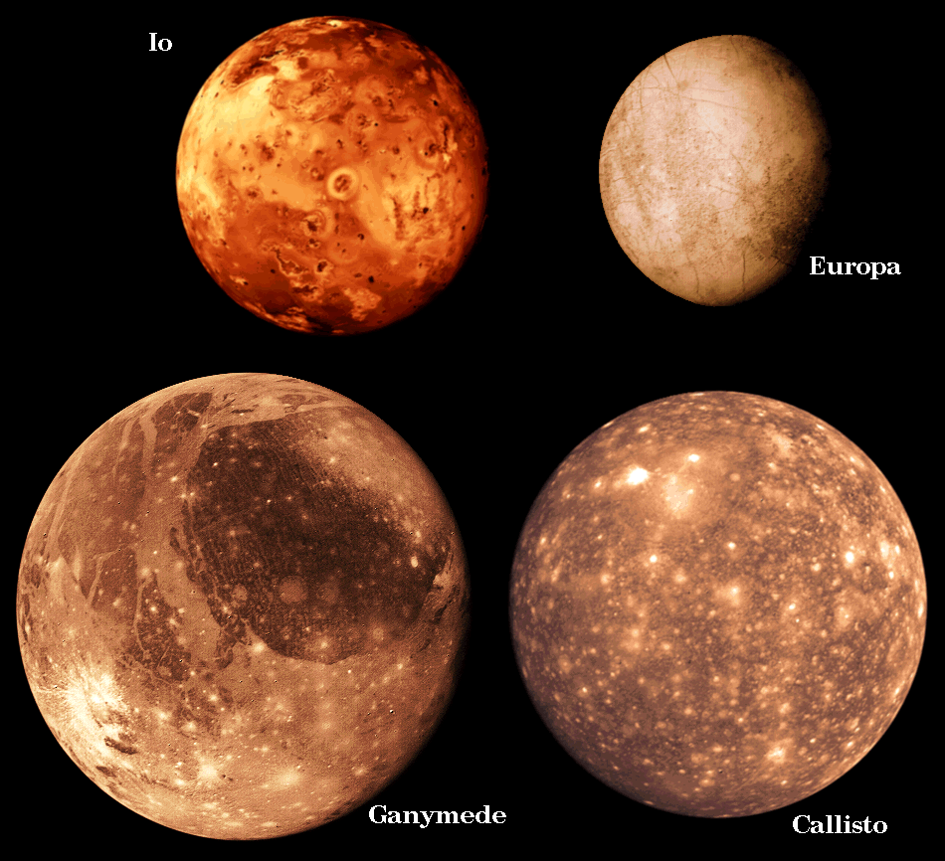
Galilean moons of Jupiter

Slide 28
Zeus’ transformations
Io – cloud [and she is turned into a heifer]
Europa – bull
Callisto - Diana [and she is turned into a bear]
Ganymede – eagle
Leda – swan
Danae – golden shower
Alcmena – disguised as her husband Amphitryon

Slide 29
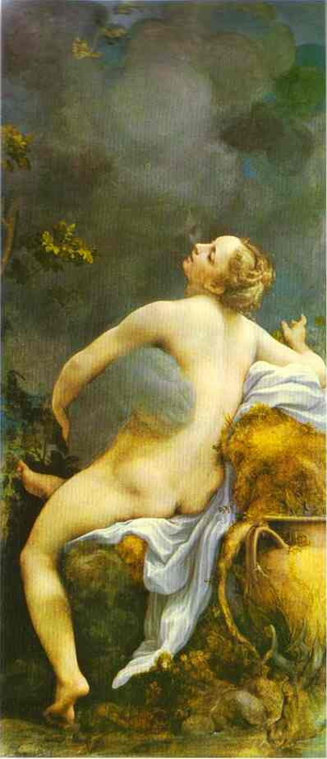
Io and Jupiter by Correggio (1531)

Slide 30
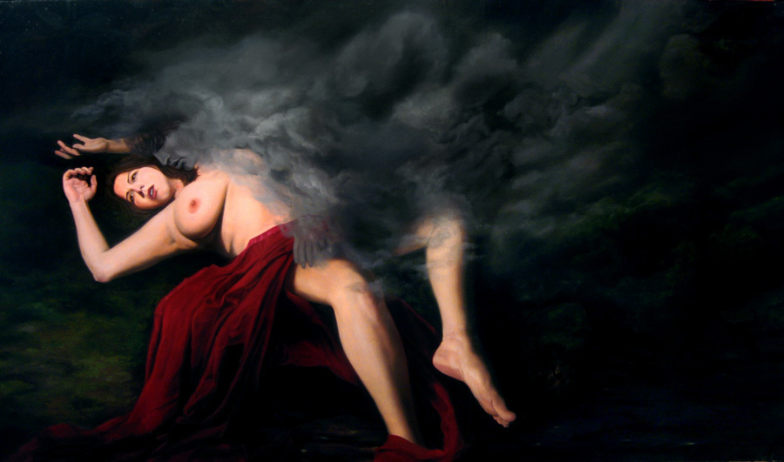
Jupiter and Io by Erik Armusik (2008)

Slide 31
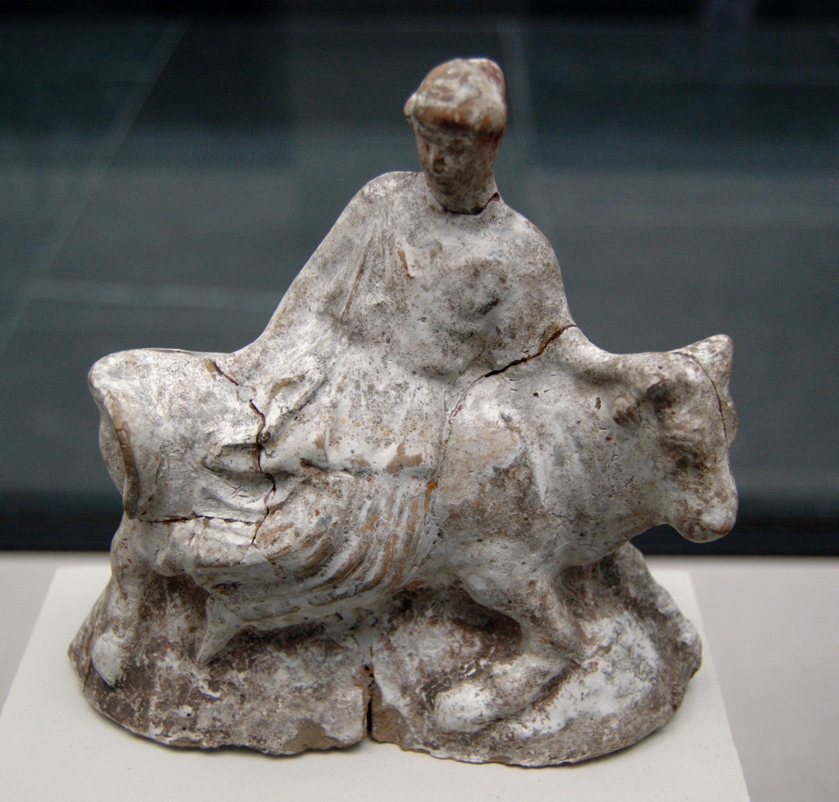
Europa and the Bull, terracotta from Athens (480-460 BCE)

Slide 32
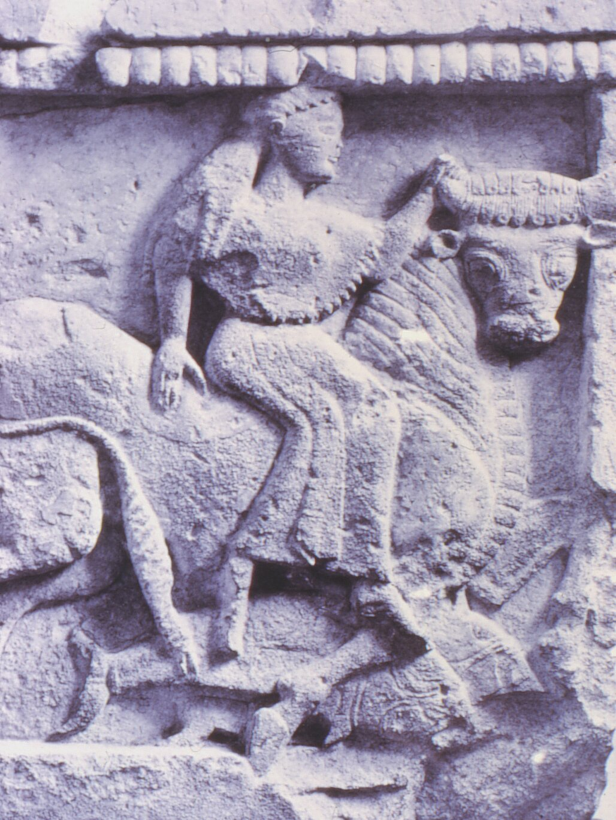
Europa and Zeus from temple at Selinus, Sicily

Slide 33
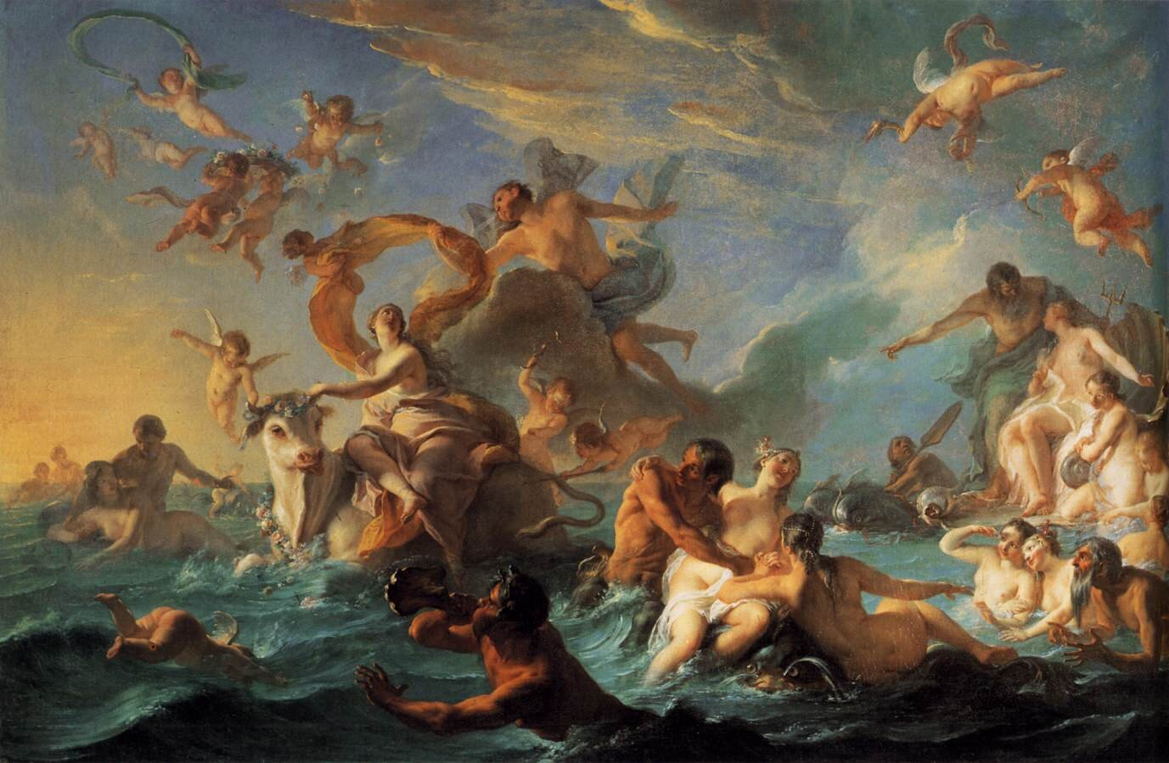
The Rape of Europa by Noel-Nicolas Coypel (18th century )

Slide 34
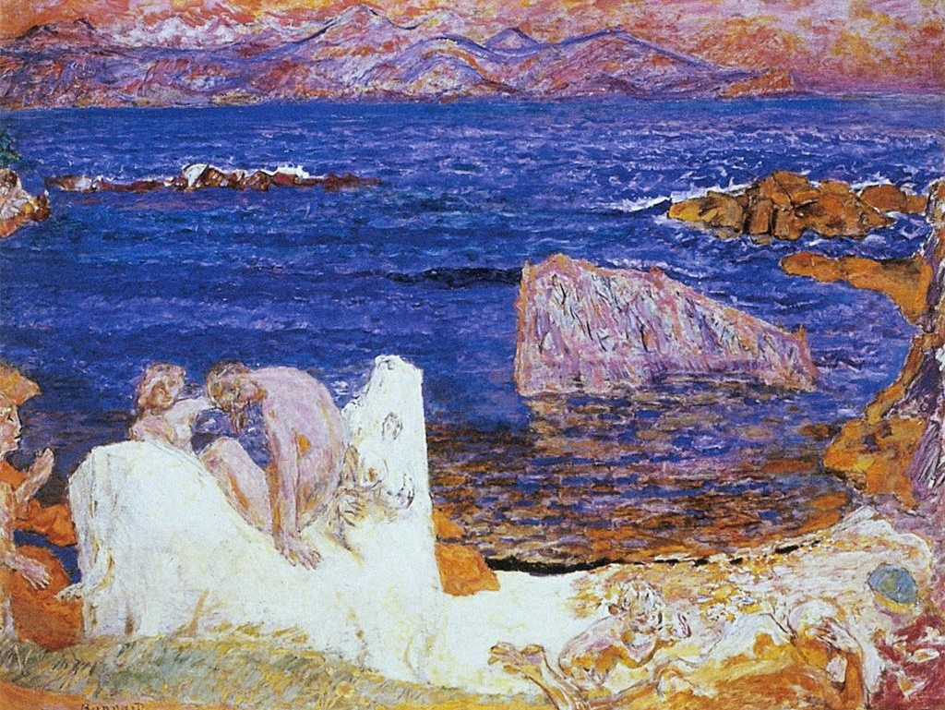
Abduction of Europa by Pierre Bonnard (c. 1919)

Slide 35
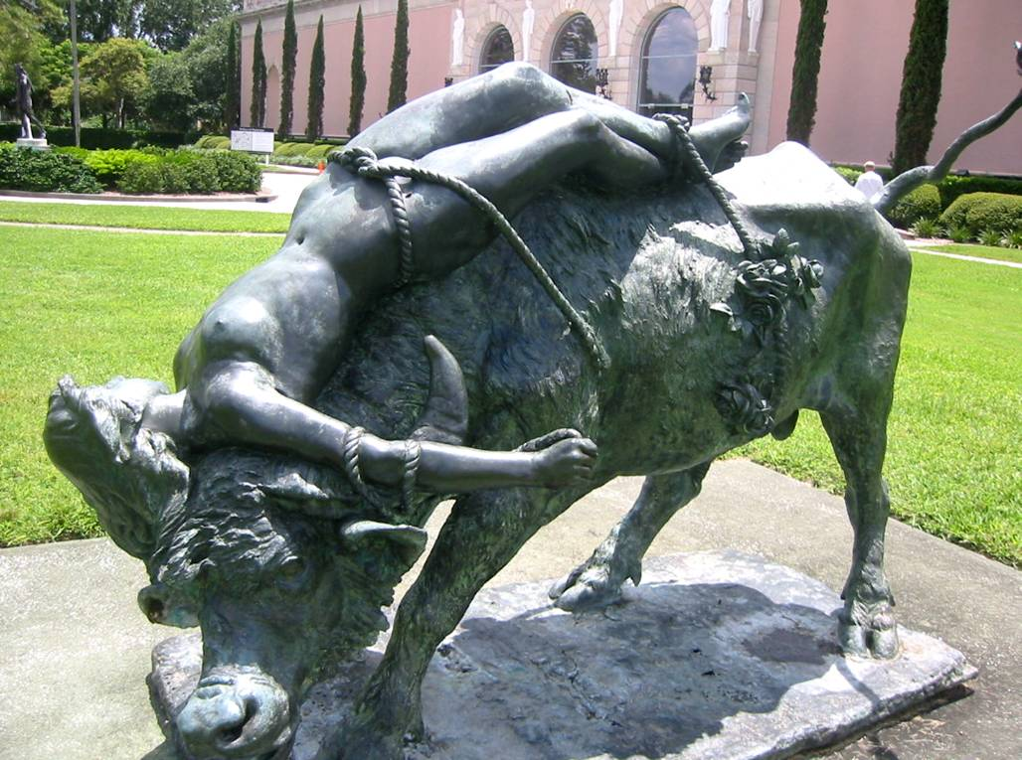
Zeus Abducting Europa, Ringling estate

Slide 36
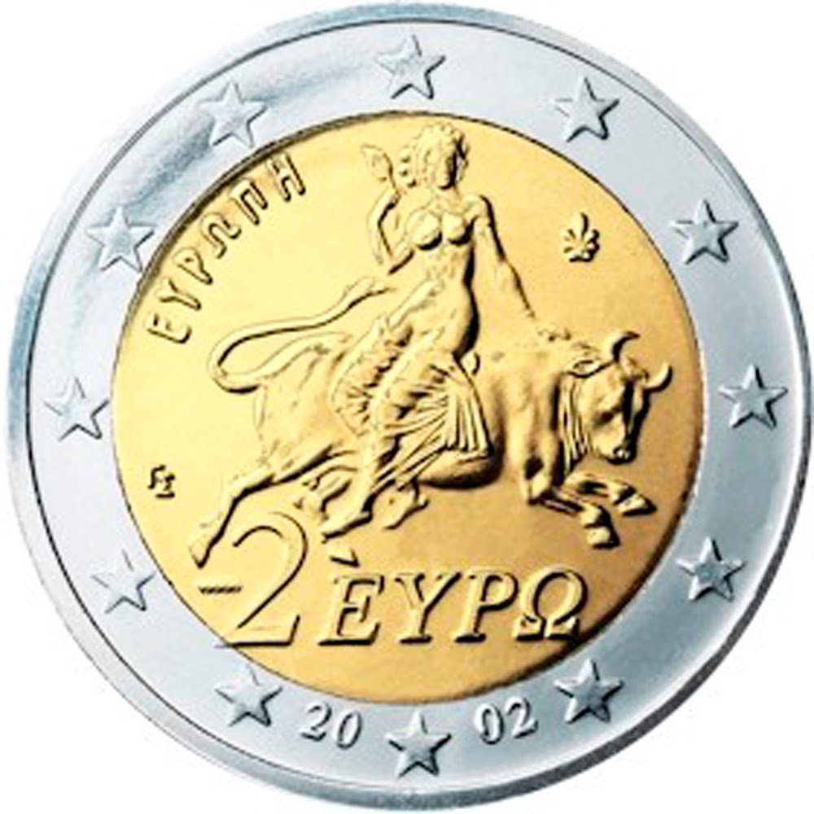
Greek 2 Euro Coin

Slide 37
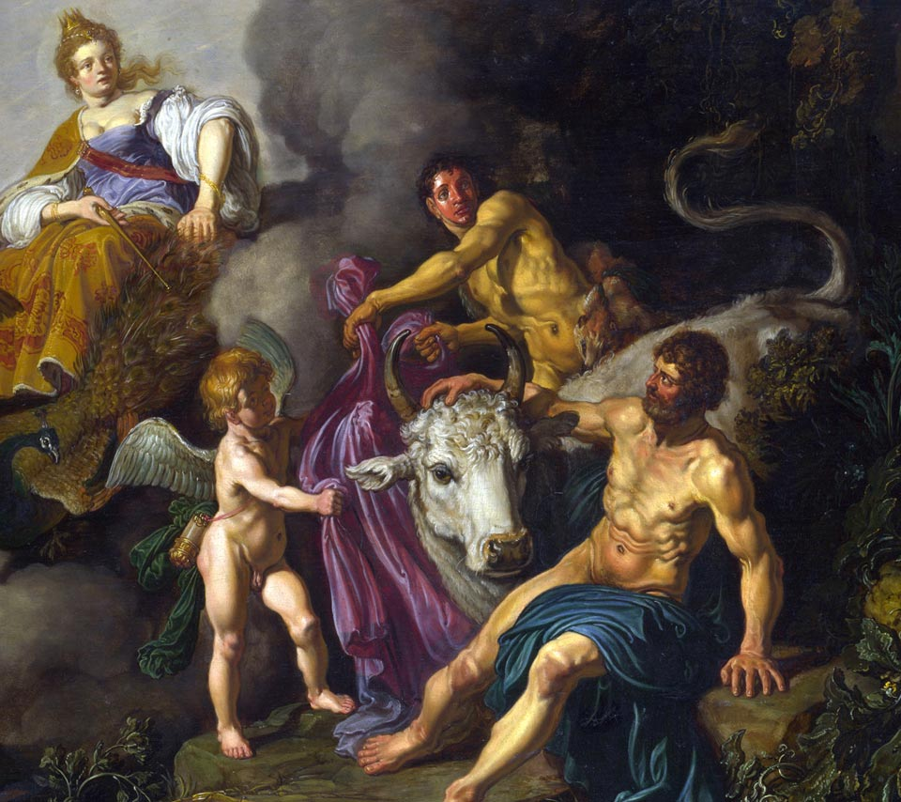
Juno Discovering Jupiter with Io by Pieter Lastman (1618)

Slide 38
CALLISTO, follower of ARTEMIS
ARCAS (>ARCADIANS)
URSA MAJOR (ARKTOS/ARCTUS)
URSA MINOR

Slide 39
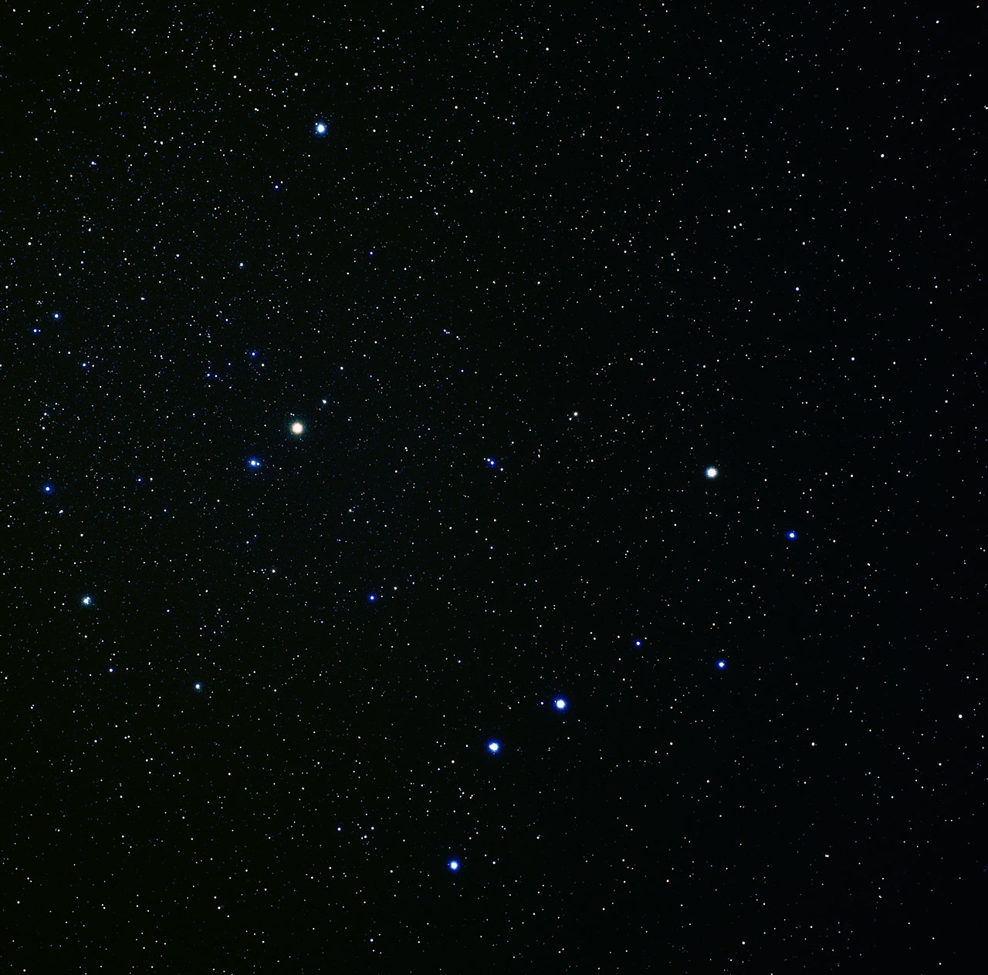
Ursa minor and Ursa major

Slide 40
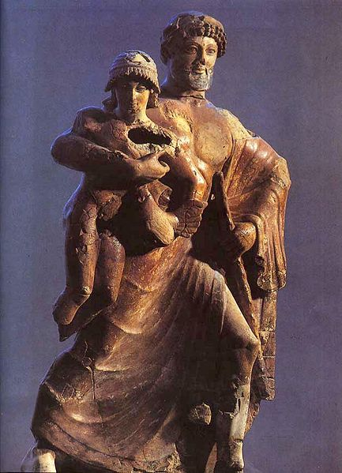
Zeus and Ganymede, Olympia (early 5th century BCE)

Slide 41
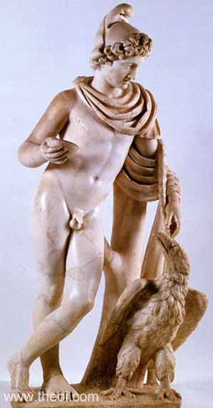
"Ganymedes with the Eagle,” Roman copy of Greek bronze

Slide 42
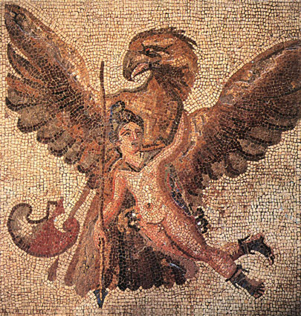
Zeus and Ganymede, Roman mosaic (3rd c. CE)

Slide 43
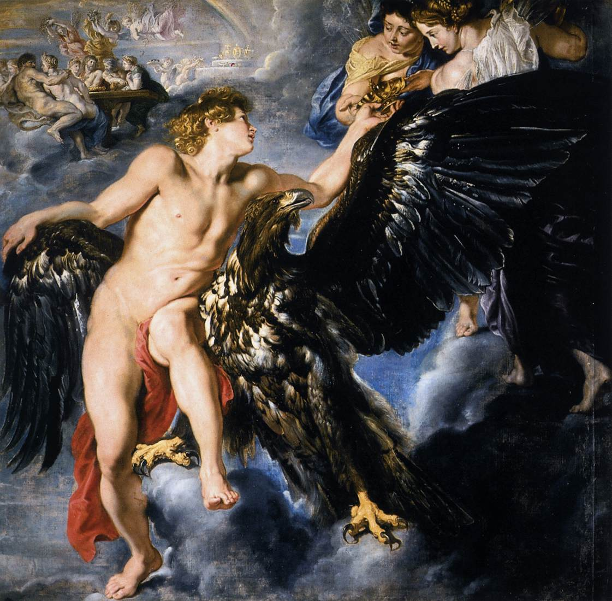
Rape of Ganymede by Peter Paul Rubens (1612)

Slide 44
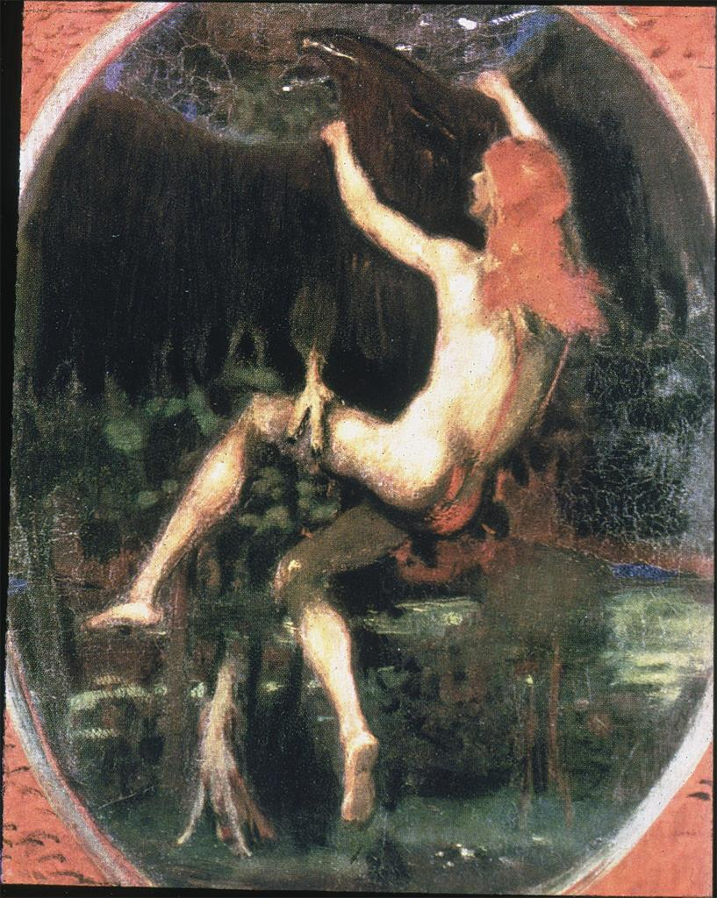
Abduction of Ganymede by Hans von Marees (c. 1887)

Slide 45
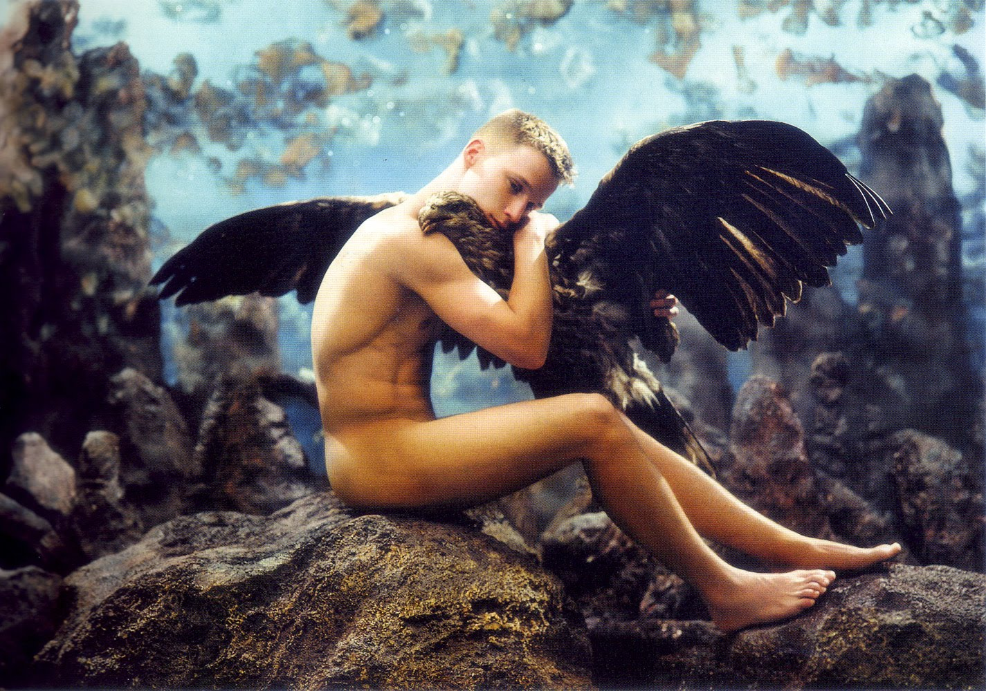
Ganymede and the Eagle by Pierre et Gilles (2000)

Slide 46
LEDA, wife of TYNDAREUS
two eggs
HELEN and CLYTEMNESTRA
CASTOR and POLLUX

Slide 47
W.B. Yeats
‘Leda and the Swan’

Slide 48
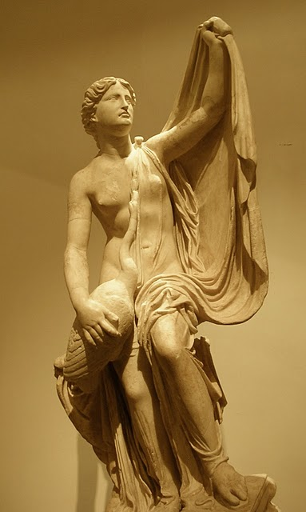
Roman copy of Timotheus’ Leda and the Swan

Slide 49
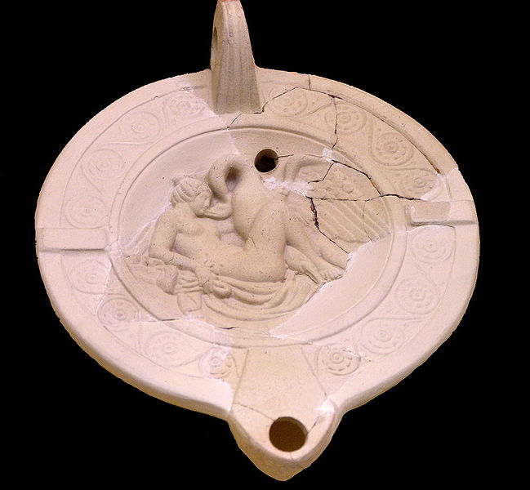
Lamp with Leda and the swan (3rd century CE)

Slide 50
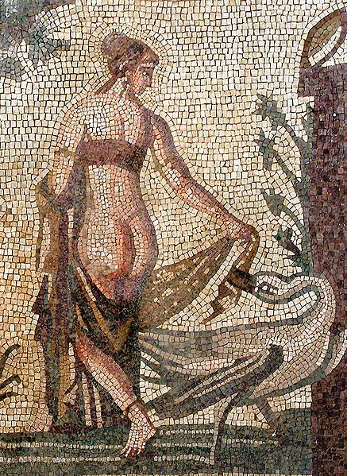
Leda and the Swan, mosaic from Cyprus (3rd century CE)

Slide 51
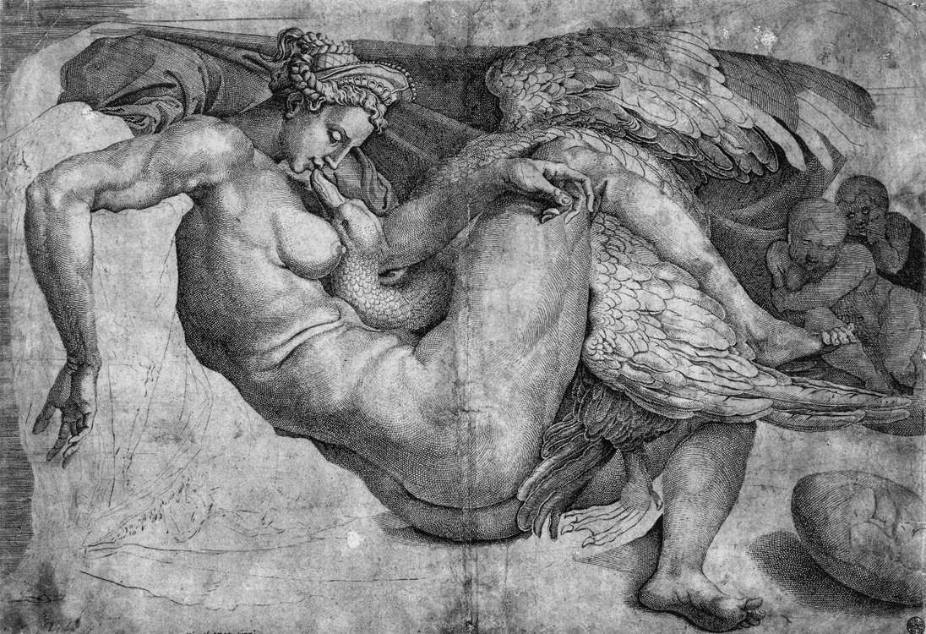
Leda and the Swan by Michelangelo (early 16th c.)

Slide 52
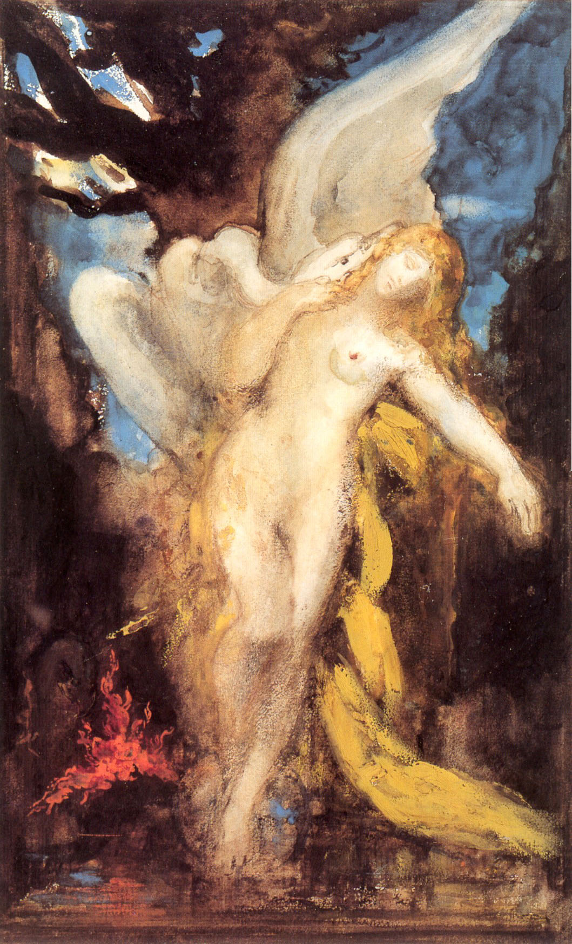
Leda by Gustave Moreau (c. 1875-80)

Slide 53
DANAE, daughter of
ACRISIUS
PERSEUS

Slide 54
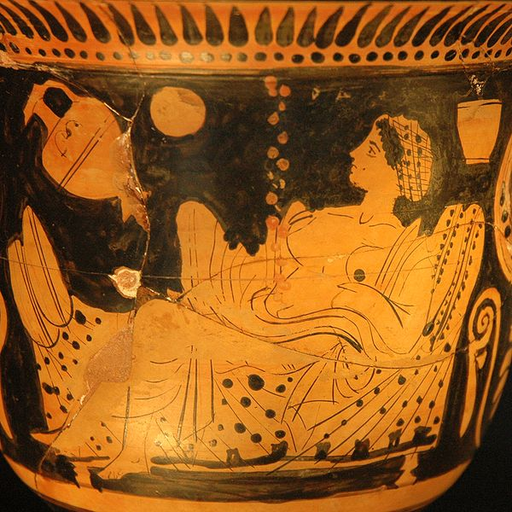
Danaë and the shower of gold, red figure vase (450-25 BCE)

Slide 55
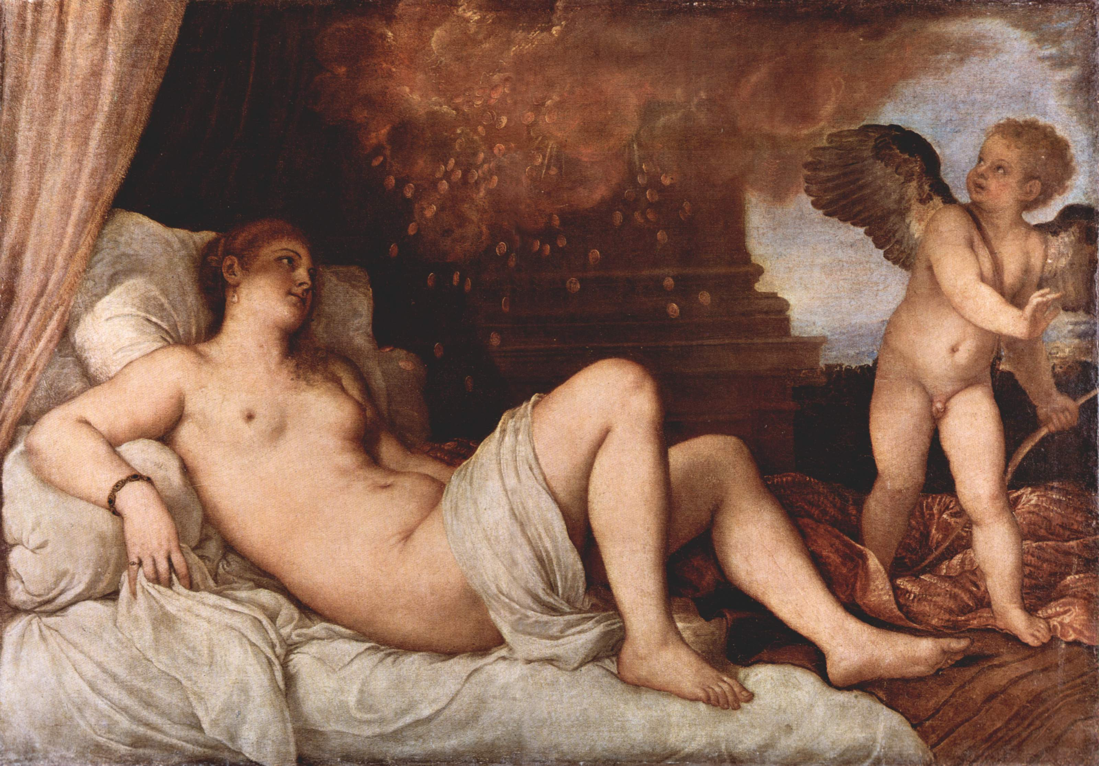
Danaë by Titian, 1545

Slide 56
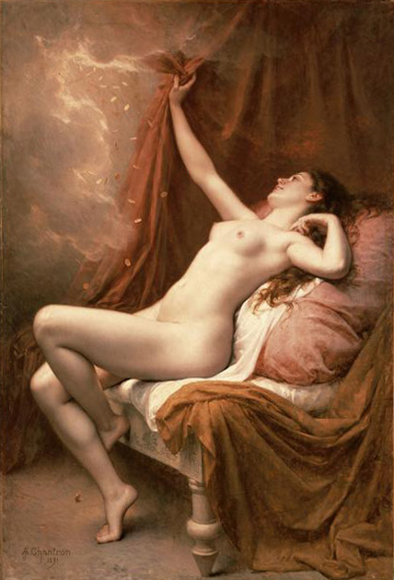
Danaë by Alexandre-Jacques Chantron (1842–1918)

Slide 57
ALCMENA
wife of AMPHITRYON
HERACLES/HERCULES

Slide 58
Junius the pug

Slide 59
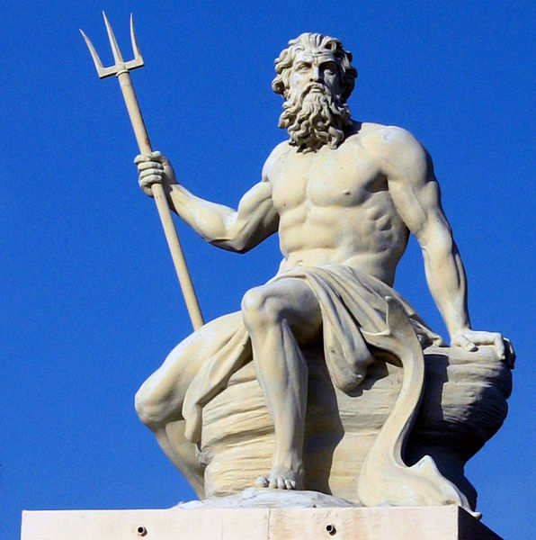
poseidon

Slide 60
Earth-shaker →
enosichthôn, enosigaios
enosis → shaking, quake
chthôn/gê/gaîa → earth

Slide 61
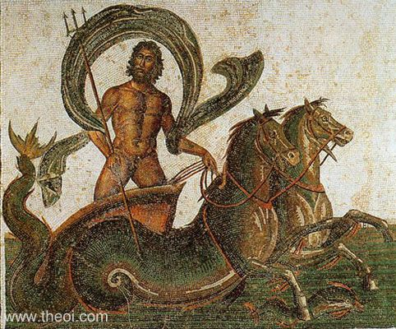
Mosaic from Hadrumetum, 3rd cent CE, modern Tunisia

Slide 62
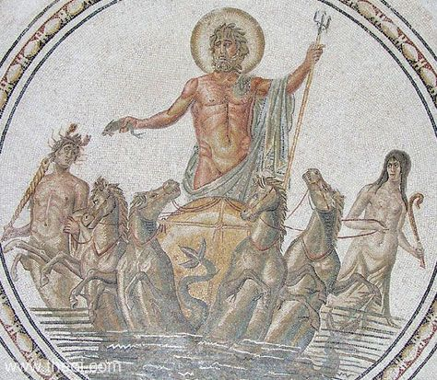
Mosaic from Hadrumetum, 3rd cent CE, modern Tunisia

Slide 63
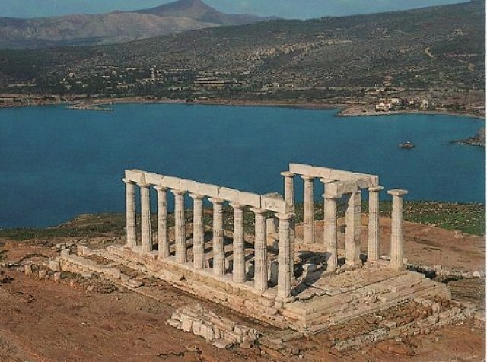
Temple of Poseidon at Sunion, southernmost tip of Attica

Slide 64
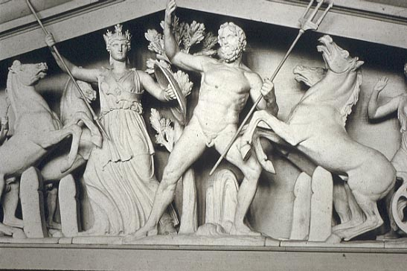
West Pediment of the Parthenon

Slide 65
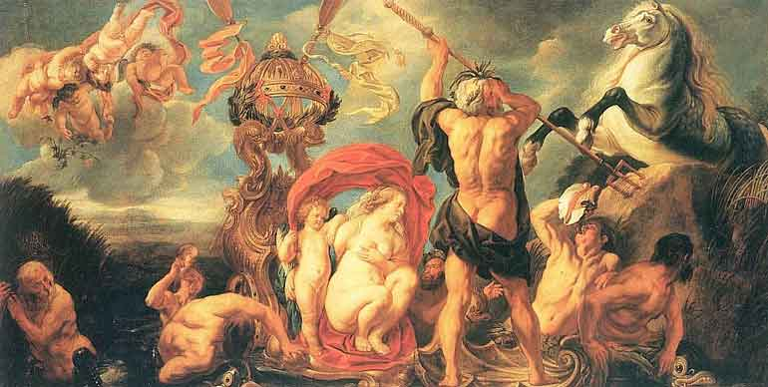
Jacob Jordaens, “Neptune Creates the Horse” c. 1640-1650

Slide 66
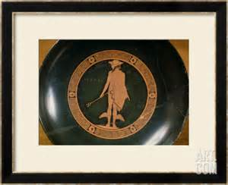
Hermes, c. 460 BCE
Attic red-figure cup

Slide 67
Homeric Hymn to Hermes in a nutshell
Son born to Maia and Zeus.
"He was born at dawn, by midday he was playing the lyre, and in the evening he stole the cattle of far-shooting Apollo."
Makes lyre from tortoise-shell and sheep-gut strings. Goes to Pieria and steals cattle belonging to Apollo. To avoid discovery, he has the cattle walk backwards and he fashions sandals for himself. Drives the oxen to Pylos, where he kills two, and conceals the rest in a cave; he offers sacrifice to the twelve Olympian gods from the cattle he has killed. He returns to his cradle. Apollo has meanwhile discovered the thief and goes to confront him. His mother Maia shows Apollo the child in its cradle.
"Son of Leto, ... do I look like a cattle rustler? That is not my line. I am interested rather in sleep, milk from my mother's breast, baby blankets about my shoulders and warm baths. ... What you say is pretty unlikely. I was born yesterday, my feet are tender, and the ground is rough beneath them. If you wish, I will swear an oath by the head of my father ... that I am not guilty myself ... ."
Apollo doesn't believe him and takes him before Zeus to demand back his cattle. Zeus, adjudicating, commands Hermes to comply, but he at first denies the theft, then takes Apollo to Pylos and offers to give back his cattle. He plays a song for Apollo on his lyre and the novel sound delights Apollo so much that he lets Hermes keep the cattle. Hermes gives Apollo the lyre and the two become firm friends.

Slide 68
Hermes
God of travel: petasus = traveller’s hat or helmet
winged feet or sandals (talaria)
Messenger of gods: caduceus = herald’s wand
Psychopomp = escort of souls to Underworld
i.e. crosser of boundaries, intermediary
Hence, god of trade, commerce
God of cleverness, trickery, theft
Cf. Prometheus, the trickster

Slide 69
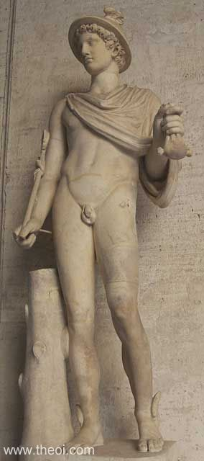
Physical characteristics
of Hermes:
petasus (hat or helmet)
bag of coins
caduceus (herald’s wand)
winged feet or sandals
(talaria)

Slide 70
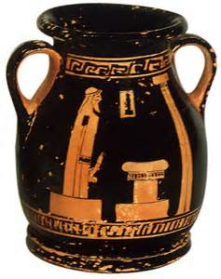
Herm, herms:
ithyphallic statues outside houses in Athens
ancient fertility symbols?
guardians of household boundaries?

Slide 71
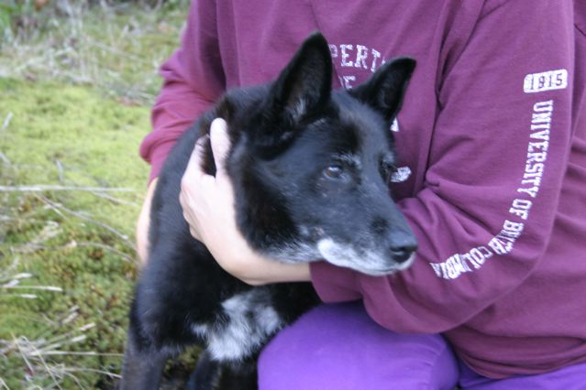
Reno – rescued from Langley Animal Protection Society

Slide 72
Apollo

Slide 73
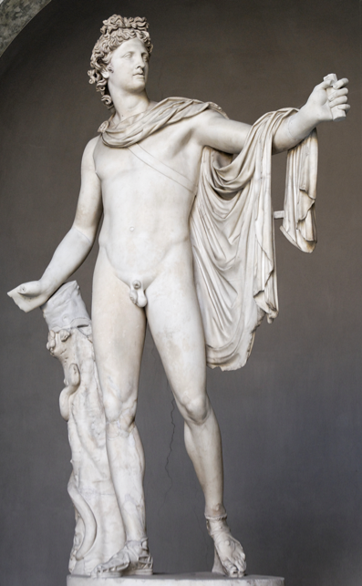
Belvedere Apollo, marble Roman copy of 330-320 BCE original (130-140 CE)

Slide 74
Apollo, from the west pediment of the temple of Zeus at Olympia, C5 BCE

Slide 76
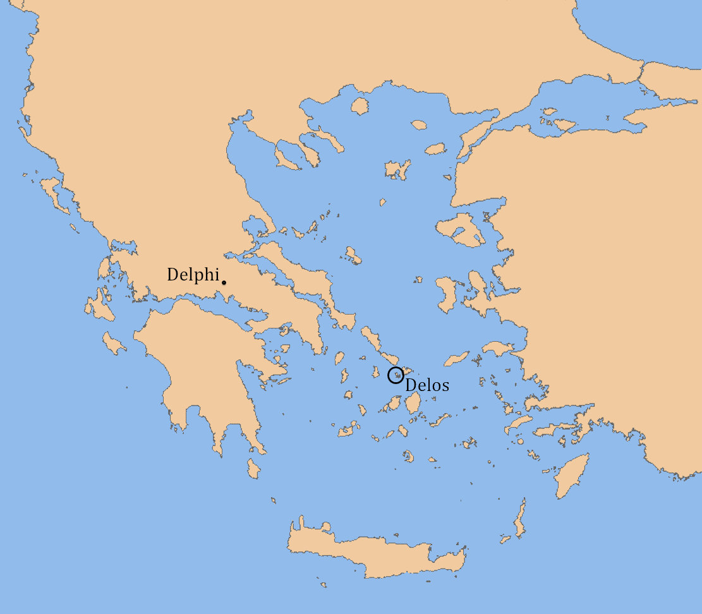

Slide 77
Temple of Apollo, Delos

Slide 78
Apollo’s names and attributes
Phoebus Apollo – the Sun
Apollo the Far-Shooter – bow – death, plague
Apollo Loxias – prophecy
Pythian Apollo – Delphic oracle
Apollo Kitharoidos – music, poetry
Apollo Iatros – healing

Slide 80
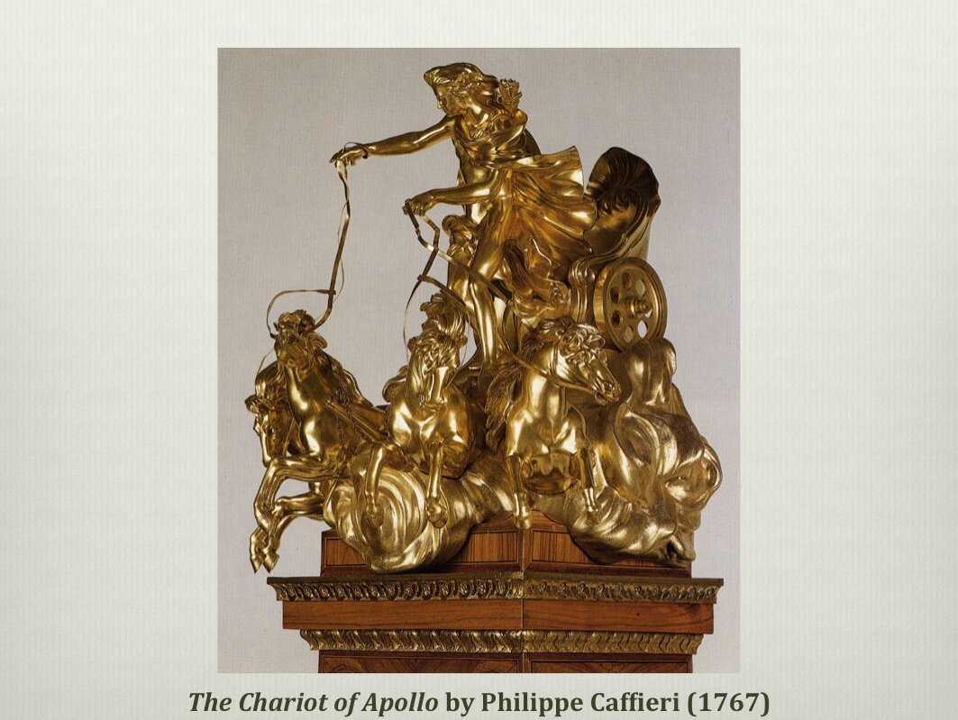

Slide 81
Apollo’s names and attributes
Phoebus Apollo – the Sun
Apollo the Far-Shooter – bow – death, plague
Pythian Apollo – Delphic oracle
Apollo Kitharoidos – music, poetry
Apollo Iatros – healing

Slide 83
Apollo, Attic red-figure by the Andocides painter (ca. 525 BCE)

Slide 84
Apollo and Artemis kill Niobe and her children
Niobe (7 daughters and 7 sons) boasts she deserves more respect than Leto (one daughter and one son)
Leto is insulted, complains to her children
Apollo kills Niobe’s seven sons
Artemis kills Niobe’s seven daughters
Niobe turned to stone > Mt Sipylus in Asia Minor

Slide 85
The Weeping Rock, Manisa, Turkey

Slide 86
Niobe protecting her last child
2nd C Roman copy of Greek original, Uffizi gallery

Slide 87
Johann König (1586-1642) ‘The Death of Niobe’s Children’

Slide 88
Homer Iliad Book 1, tr. Samuel Butler
Sing, O goddess, the anger of Achilles son of Peleus, that brought countless ills upon the Achaeans. Many a brave soul did it send hurrying down to Hades, and many a hero did it yield a prey to dogs and vultures, for so were the counsels of Jove fulfilled from the day on which the son of Atreus, king of men, and great Achilles, first fell out with one another. And which of the gods was it that set them on to quarrel? It was the son of Jove and Leto; for he was angry with the king and sent a pestilence upon the host to plague the people, because the son of Atreus had dishonoured Chryses his priest. Now Chryses had come to the ships of the Achaeans to free his daughter, and had brought with him a great ransom: moreover he bore in his hand the sceptre of Apollo wreathed with a suppliant's wreath and he besought the Achaeans, but most of all the two sons of Atreus, who were their chiefs.

Slide 89
Apollo’s names and attributes
Phoebus Apollo – the Sun
Apollo the Far-Shooter – bow – death, plague
Pythian Apollo – Delphic oracle
Apollo Kitharoidos – music, poetry
Apollo Iatros – healing

Slide 90
Pythian apollo:
Apollo as defeater of Python

Slide 91
Apollo kills Python at Delphi, Ovid Metamorphoses Book 1:
The archer god, with lethal shafts that he had only used before on fleeing red deer and roe deer, with a thousand arrows, almost emptying his quiver, destroyed the creature, the venom running out from its black wounds. Then he founded the sacred Pythian games, celebrated by contests, named from the serpent he had conquered.

Slide 94
Apollo’s names and attributes
Phoebus Apollo – the Sun
Apollo the Far-Shooter – bow – death, plague
Pythian Apollo – Delphic oracle
Apollo Kitharoidos – music, poetry
Apollo Iatros – healing

Slide 97
Ovid Metamorphoses Book 6
Another storyteller remembered the satyr, Marsyas, whom Apollo, Leto’s son, had defeated, playing on the flute, that Minerva invented. He had exacted punishment. Marsyas cried ‘Why do you peel me out of myself? ‘Aah! I repent’, he screamed in agony. ‘Aah! Music is not worth this pain!’ As he screams, the skin is flayed from the surface of his body, no part is untouched. Blood flows everywhere, the exposed sinews are visible, and the trembling veins quiver, without skin to hide them: you can number the internal organs, and the fibres of the lungs, clearly visible in his chest. The woodland gods, and the fauns of the countryside, wept, and his brother satyrs, and the nymphs, and all who pastured their fleecy sheep and horned cattle on those mountains. The fertile soil was drenched, and the drenched earth caught the falling tears, and absorbed them into its deep veins. It formed a stream then, and sent it into the clear air. From there it ran within sloping banks, quickly, to the sea, the clearest river of Phrygia, taking Marsyas’s name.

Slide 98
Marsyas, Roman copy of Hellenistic original (1st-2nd c CE)

Slide 100
Myth of Apollo and Marsyas by Richard Willenbrink (2010)

Slide 101
Apollo’s names and attributes
Phoebus Apollo – the Sun
Apollo the Far-Shooter – bow – death, plague
Pythian Apollo – Delphic oracle
Apollo Kitharoidos – music, poetry
Apollo Iatros – healing

Slide 102
Apollo iatros:
Apollo as god of healing

Slide 103
Father of Aesculapius, rescued
from womb of mother Coronis,
killed by Apollo for being unfaithful
AESCULAPIUS = ASCLEPIUS
sanctuary of Asclepius at Epidaurus, Peloponnese, Greece
includes theatre, tholos, sanctuary, stadium
UNESCO World Heritage Site

Slide 104
Aesculapius, Roman sculpture in marble, 2nd century

Slide 107
APOLLO AND DAPHNE
attempted rape
unsuccessful but…
she becomes his emblem
LAUREL TREE

Slide 109
Apollo and Daphne by Gian Lorenzo Bernini (1622-5)

Slide 110
detail, Apollo and Daphne by Gian Lorenzo Bernini (1622-5)

Slide 111
A Laurel Tree

Slide 112
Question:
In what ways is Dionysus the antithesis of Apollo?
Dionysus
Roman copy of Hellenistic Statue
2nd century CE

Slide 114
Friedrich Nietzsche (1844 –1900)
German philosopher & classical philologist (professor at Basel aged 24) existentialism, nihilism and postmodernism
The Birth of Tragedy (1872)

Slide 115
RATIONALITY INTELLECT SELF-CONTROL SHAPE, FORM | SENSUALITY EMOTION LIBERATION, ABANDON FORMLESSNESS
LYRE PAEAN | TIMBREL DITHYRAMB
?CULTURE? | ?NATURE?

Slide 116
Dionysus on Vesuvius
Fresco
Imperial Roman
Pompeii

Slide 117
Birth of Dionysus
Son of Zeus and Semele, daughter of Cadmus
Semele consumed by lightning when Zeus reveals himself to her in his full form
Zeus rescues foetus from incinerated corpse of Semele
Sews it into his thigh till it is ready to be born

Slide 118
The Birth of Dionysus
Attic Red Figure
470-460 BCE
Museum of Fine Arts, Boston

Slide 119
Semele
Birth of Dionysus
Proto-Apulian Red-Figure
Late 5th/Early 4th century BCE
Museo Nazionale, Taranto

Slide 120
Silenus with Baby Dionysus
Roman Copy of Greek statue
ca. 310 BCE
Munich, Germany

Slide 121
Dionysus
Kleophrades Painter; Red Figure
Late 5th century BCE
Munich, Germany

Slide 122
Dionysus and Satyr
Makron Painter
ca. 490-480 BCE
Berlin, Germany

Slide 123
Dionysus and Satyrs
Myson Painter
ca. 490-480 BCE
Wurzburg, Germany

Slide 125
Dionysus and Retinue
Curti Painter; Attic Red Figure
ca. 440-430 BCE
Harvard University Art Museum

Slide 126
Dionysus Riding a Panther with Silenus A Satyr, and Maenad
Red Figure Vase
ca. 370-360 BCE
Musee de Louvre

Slide 127
Procession of Dionysus
Mosaic
3rd century CE
House of Virgil, Tunisia

Slide 128
thyrsus
Furious Maenad
Brygos Painter; Attic White-Ground
490-480 BCE
Vulci, Italy

Slide 129
Death of Pentheus
Red Figure Vase
ca. 480 BCE

Slide 130
Ariadne
Minos
Crete
Theseus
labyrinth
Minotaur
Naxos
Dionysus and Ariadne
Red Figure Vase
ca. 5th century BCE
Archaeological Museum, Naples

Slide 131
Dionysus and Ariadne
Lucanian Red Figure
380-360 BCE
Toledo Museum of Art, Ohio

Slide 132
Dionysus and Ariadne
Wall Painting
ca. 370-360 BCE
Pompeii

Slide 133
Silenus
The Vatican Museum

Slide 134
King Midas
Ovid Metamorphoses 11:
Silenus, the elderly foster-father of Bacchus, was one day so drunk that he lost his way and was captured by Phrygian peasants and taken to their king. Midas recognized the old man and entertained him generously with ten days of revelry before returning him to Bacchus. The god was delighted to have Silenus back safe and sound, and granted the king one wish. Midas asks for the power to turn everything he touches to gold. Bacchus sadly grants his wish. Midas finds that everything he touches does really turn to gold: a twig, a stone, a clod of earth, ears of wheat, an apple and so on. Filled with dreams of untold wealth, he sits down to a meal. But now he discovers that bread and meat and water and wine also turn to gold and that he cannot relieve his hunger or his thirst. Wretchedly he prays to Bacchus, admitting his terrible mistake and begging to be freed from this torment. Bacchus tells him that he must wash away his golden touch by bathing in the river Pactolus. When he does so, the river takes on Midas’ golden power and from that day, its sands and the surrounding land were rich in gold.

Slide 135
Carol Ann Duffy
Scottish poet,appointed British Poet Laureate in 2009
First woman (and first openly bisexual) to be Poet Laureate
Feminist, pacifist, social justice
Poems assigned as school set texts
The World’s Wife, 1999:
she imagines the unspoken stories of the invisible wives of famous men of myth, fiction and history in poems called ‘Queen Herod’, ‘from Mrs Tiresias’, ‘Mrs Darwin’, ‘Mrs Faust’, ‘Queen Kong’, ‘The Devil’s Wife’, ‘Frau Freud’, and more
‘Mrs Midas’

Slide 136
Dionysus and the Tyrrhenian Pirates
Red Figure Vase
6th century BCE
Museum of Fine Arts, Boston

