Slide 1
Greek & Roman Mythology:
Ancient yet Timeless
Susanna Braund
Lecture 4, October 17 2018

Slide 2
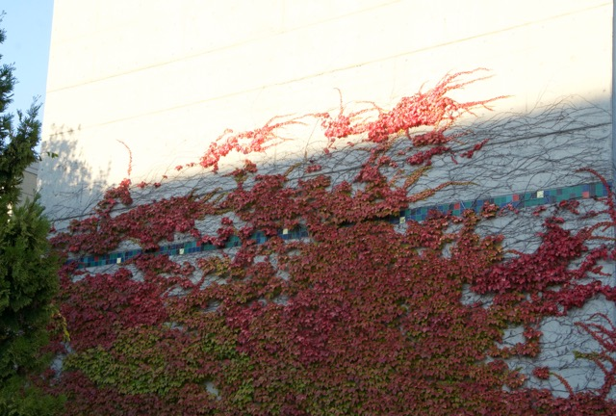

Slide 3
The heroic archetype
Perseus
Heracles
Theseus
Jason

Slide 4
The heroic archetype according to Lord Raglan (1885-1964)
The Hero: A Study in Tradition, Myth and Dreams (1936)
Hero’s mother is royal virgin and father a king
Reputed to be son of a god
Circumstances of birth unusual
Attempt by father or grandfather to kill him at birth
He is spirited away
Reared by foster parents elsewhere
On maturity, travels to his future kingdom
Journeys to Underworld
Triumphs over king/giant/dragon/beast
Marries a princess
Becomes king
Loses favour with gods or subjects
Dies mysteriously
His children do not succeed him
His body is not buried
He is honoured with one or more shrines
Notes:
Soldier, beekeeper, farmer, independent scholar

Slide 5
PERSEUS
Born to Danaë, daughter of Acrisius
Son of Zeus, golden shower
Mother and child placed in chest and set afloat on sea
Chest washes up on island of Seriphos and found by a fisherman called Dictys, brother of king
King of Seriphos sends grown Perseus away on an impossible task

Slide 6
The heroic archetype:
Hero’s mother is royal virgin and father a king
Reputed to be son of a god
Circumstances of birth unusual
Attempt by father or grandfather to kill him at birth
He is spirited away
Reared by foster parents elsewhere
On maturity, travels to his future kingdom
Journeys to Underworld
Triumphs over king/giant/dragon/beast
Marries a princess
Becomes king
Loses favour with gods or subjects
Dies mysteriously
His children do not succeed him
His body is not buried
He is honoured with one or more shrines

Slide 7
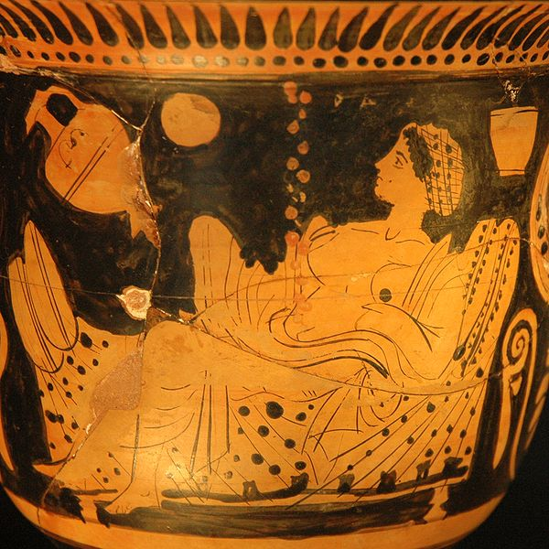
Danae and the shower of gold, red figure vase (450-25 BCE)

Slide 8
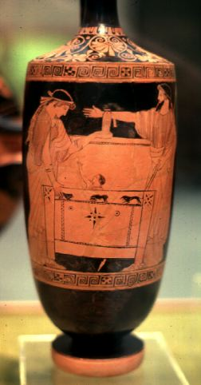
Danae and Perseus being shut in the box by Acrisius

Slide 9
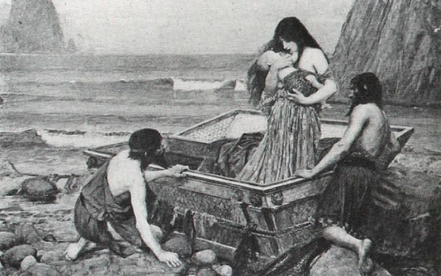
Danae by John William Waterhouse (1892)

Slide 10
The heroic archetype:
Hero’s mother is royal virgin and father a king
Reputed to be son of a god
Circumstances of birth unusual
Attempt by father or grandfather to kill him at birth
He is spirited away
Reared by foster parents elsewhere
On maturity, travels to his future kingdom
Journeys to Underworld
Triumphs over king/giant/dragon/beast
Marries a princess
Becomes king
Loses favour with gods or subjects
Dies mysteriously
His children do not succeed him
His body is not buried
He is honoured with one or more shrines

Slide 11
Perseus and Medusa the Gorgon
Gorgon from γοργός
“terrible, fierce, frightful”

Slide 12
Ovid Metamorphoses Bk 4
Next one of the many princes asked why Medusa, alone among her sisters, had snakes twining in her hair. The guest replied ‘Since what you ask is worth the telling, hear the answer to your question. She was once most beautiful, and the jealous aspiration of many suitors. Of all her beauties none was more admired than her hair: I came across a man who recalled having seen her. They say that Neptune, lord of the seas, violated her in the temple of Minerva. Jupiter’s daughter turned away, and hid her chaste eyes behind her aegis. So that it might not go unpunished, she changed the Gorgon’s hair to foul snakes. And now, to terrify her enemies, numbing them with fear, the goddess wears the snakes that she created as a breastplate.

Slide 13
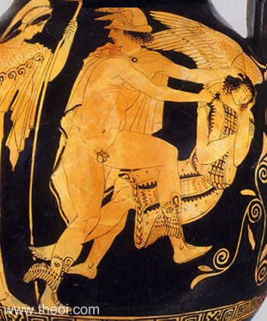
Perseus’ equipment
winged sandals
helmet of invisibility
mirrored shield
sickle of adamant
special knapsack
help from Athena!
Attic red figure pelike, ~450 BCE

Slide 14
Ovid Metamorphoses Bk 4
Far from there, by hidden tracks, and through rocks bristling with shaggy trees, Perseus reached the place where the Gorgons lived. In the fields and along the paths, here and there, he saw the shapes of men and animals changed from their natures to hard stone by Medusa’s gaze. Nevertheless he had himself looked at the dread form of Medusa reflected in a circular shield of polished bronze that he carried on his left arm. And while a deep sleep held the snakes and herself, he struck her head from her neck. And the swift winged horse Pegasus was born from her blood.

Slide 15
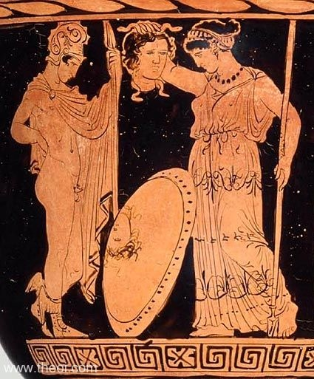
Apulian red figure krater ~400 BCE

Slide 16
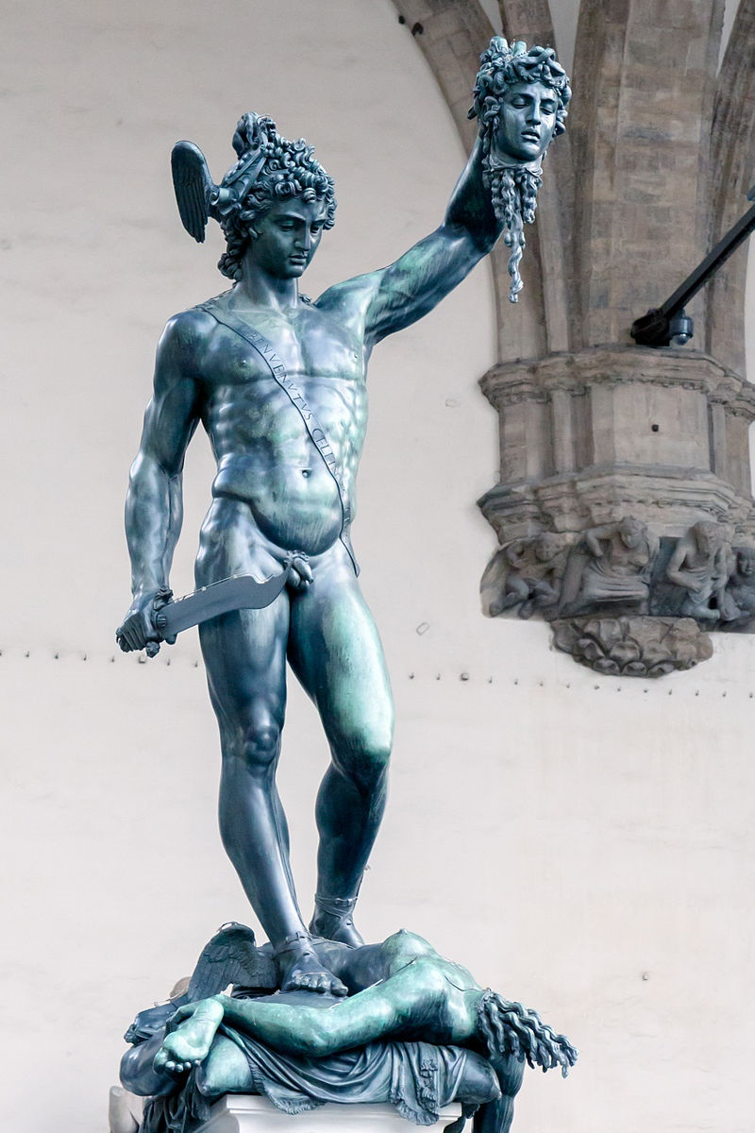
Perseus with the head of Medusa
Benvenuto Cellini, 1545

Slide 17
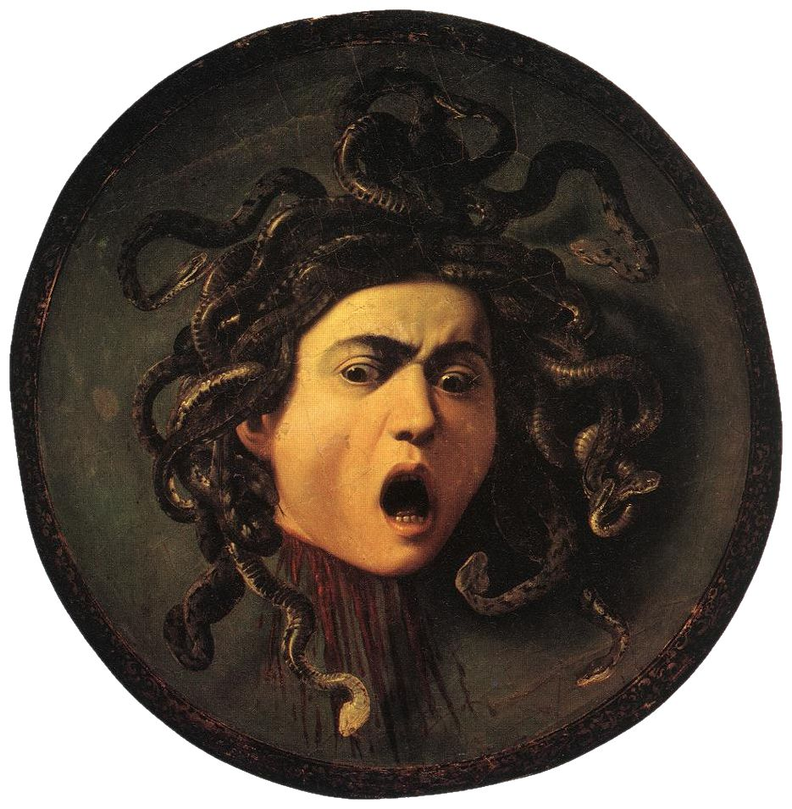
Caravaggio, 1597

Slide 18
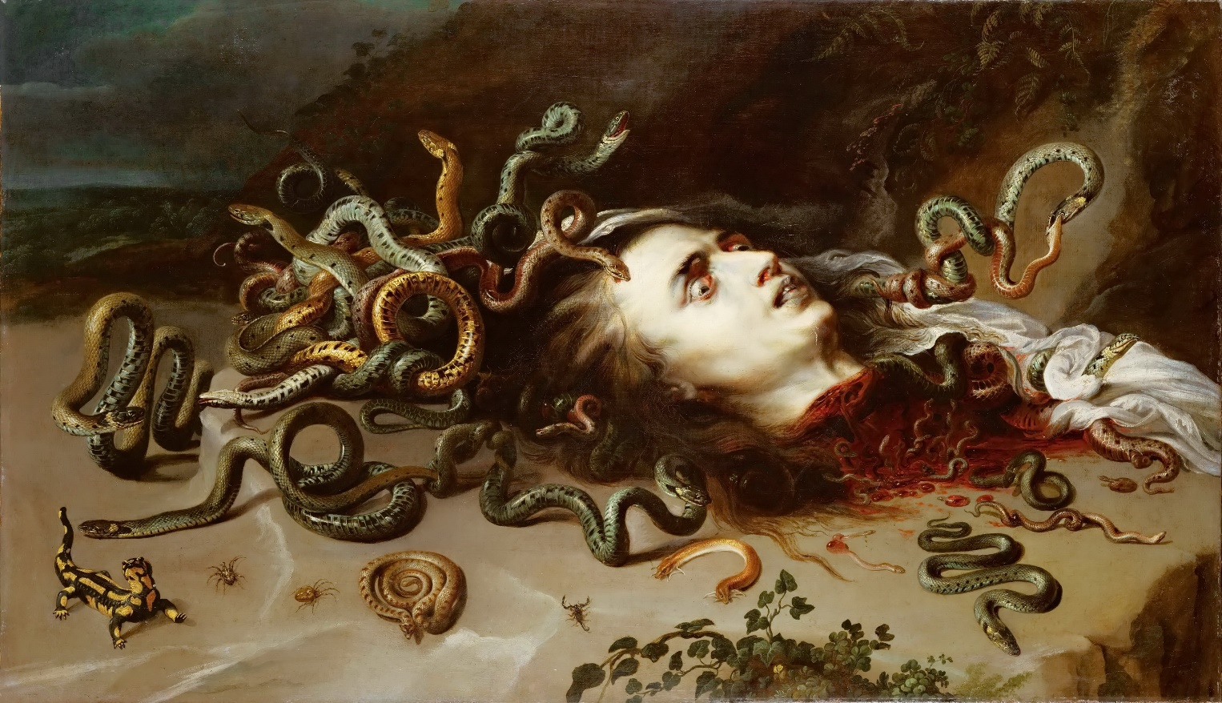
Rubens, 1617-18

Slide 19
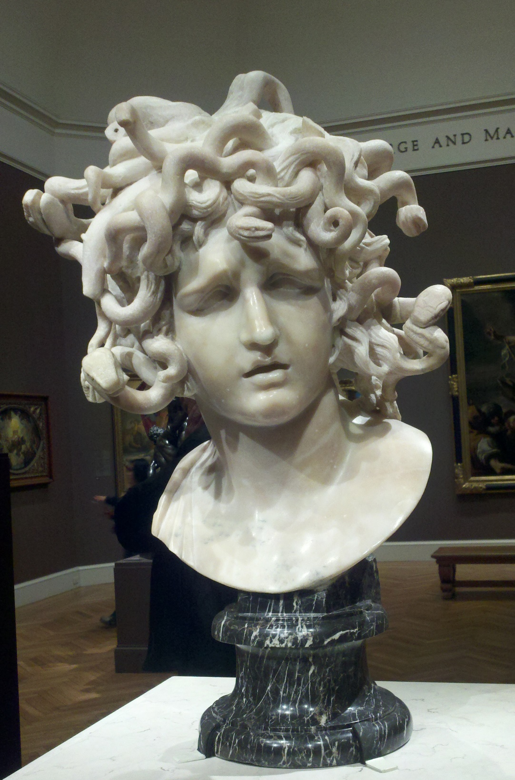
Bernini, ~1630 CE

Slide 20
The heroic archetype:
Hero’s mother is royal virgin and father a king
Reputed to be son of a god
Circumstances of birth unusual
Attempt by father or grandfather to kill him at birth
He is spirited away
Reared by foster parents elsewhere
On maturity, travels to his future kingdom
Journeys to Underworld
Triumphs over king/giant/dragon/beast
Marries a princess
Becomes king
Loses favour with gods or subjects
Dies mysteriously
His children do not succeed him
His body is not buried
He is honoured with one or more shrines

Slide 21
CEPHEUS AND CASSIOPEIA
parents of
ANDROMEDA
PERSEUS
their son PERSES
hybris/hubris
Nereids (sea-nymphs)

Slide 22
Pseudo-Apollodorus, Bibliotheca 2. 43 - 44 (Greek mythographer C2 CE) :
Arriving in Aithiopia, which Kepheus ruled, Perseus came upon his daughter Andromeda laid out as a meal for a sea monster. It seems that the king’s wife Kassiopeia had challenged the Nereides in beauty, boasting that she outdid them all. As a result the Nereides were in a rage, and Poseidon in sympathetic anger sent a flood-tide upon the land and a sea monster as well. The oracle of Ammon prophesied an end to the trouble if Kassiopeia’s daughter Andromeda were served up to the monster as a meal, so Kepheus, pushed to it by the Aithiopians, tied his daughter out on a rock. When Perseus saw her it was love at first sight, and he promised to kill the sea monster and rescue the girl in return for her hand. Oaths were sworn, after which Perseus faced and slew the monster, and set Andromeda free.
Kepheus’ brother Phineus, who was previously engaged to Andromeda, conspired against Perseus, but Perseus learned of the plot, and by displaying the Gorgo to Phineus and his colleagues in the conspiracy, turned them instantly to stone.

Slide 23
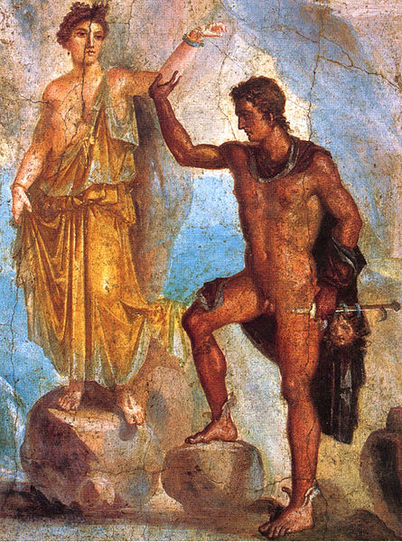
Perseus and Andromeda, Roman wall painting Pompeii

Slide 24
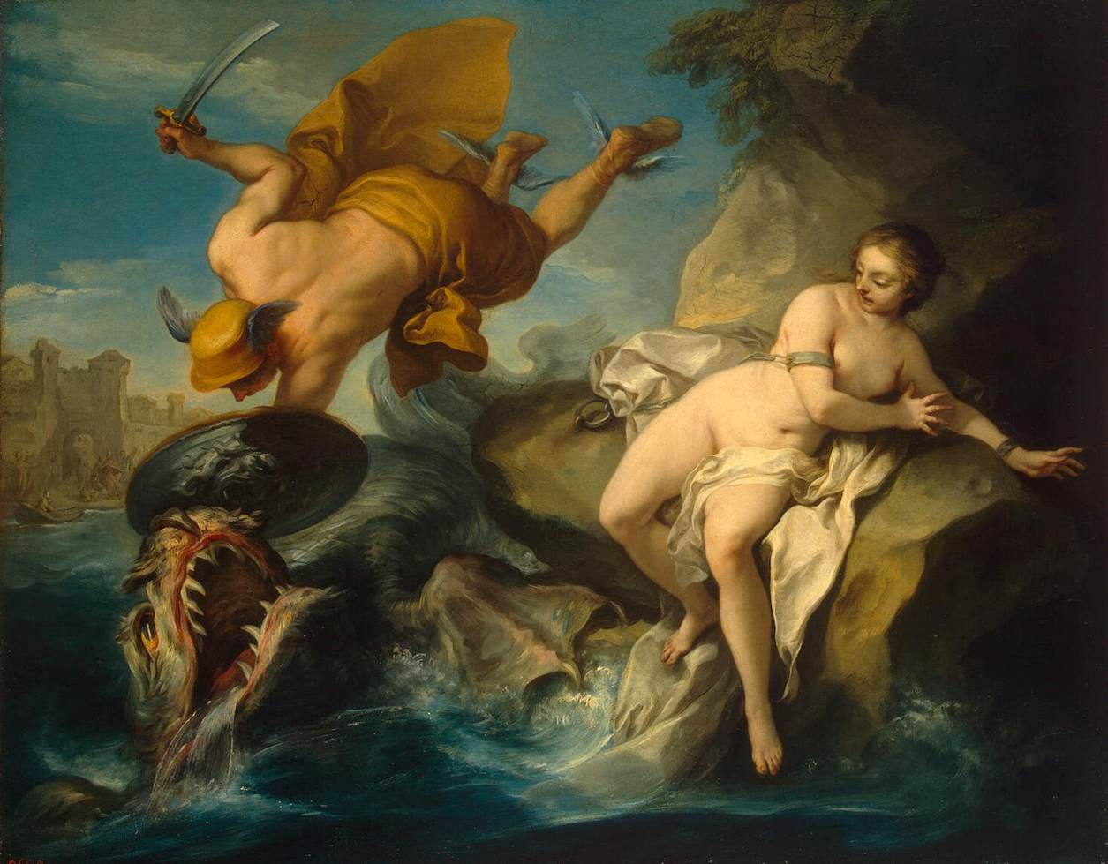
Perseus and Andromeda by Carl Vanloo (1735-40)

Slide 25
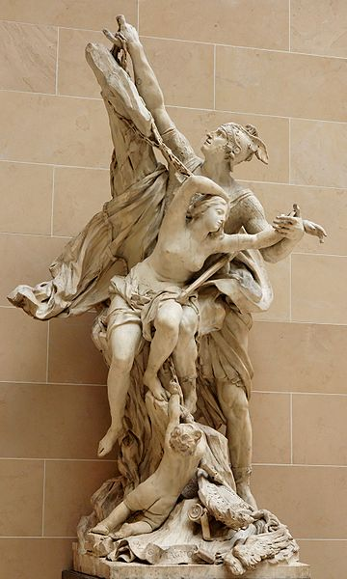
Perseus and Andromeda by Pierre Puget (1715)

Slide 26
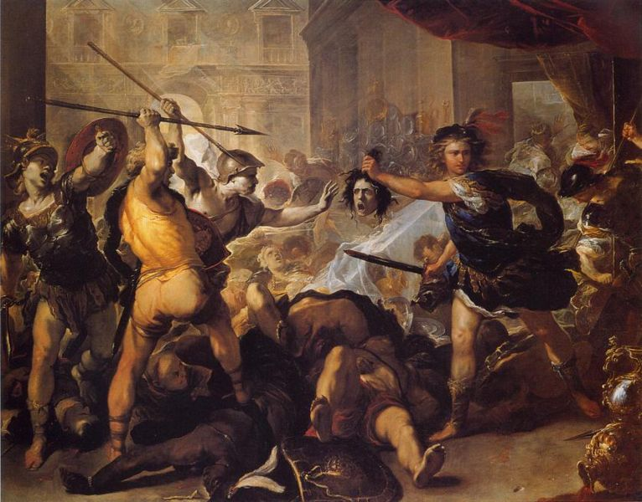
Perseus Turns Phineus and his Followers to Stone by Luca Giordano (1680s)

Slide 27
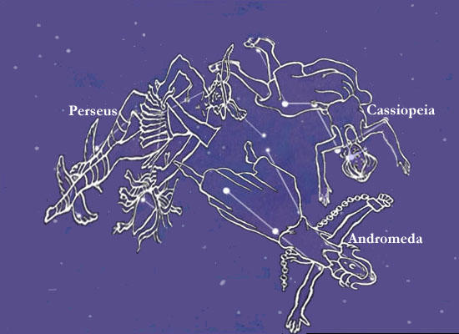

Slide 28
HERACLES / HERCULES

Slide 29
The heroic archetype:
Hero’s mother is royal virgin and father a king
Reputed to be son of a god
Circumstances of birth unusual
Attempt by father or grandfather to kill him at birth
He is spirited away
Reared by foster parents elsewhere
On maturity, travels to his future kingdom
Journeys to Underworld
Triumphs over king/giant/dragon/beast
Marries a princess
Becomes king
Loses favour with gods or subjects
Dies mysteriously
His children do not succeed him
His body is not buried
He is honoured with one or more shrines

Slide 30
Alcmena and Zeus, Alcmena and Amphityron
Twin boys: Heracles and Iphicles
Hera’s hostility: twin snakes
Marries Megara, has three children; Hera’s hostility causes Heracles’ madness: he kills Megara and children
Serves King Eurystheus for 12 years, performs the twelve labours (athloi), as instructed by the Pythia, to win immortality
Heracles puts on poisoned robe and is carried to Mt Oeta to die; mortal part is burned away by the fire; he goes to Olympus, is reconciled with Hera, marries Hebe

Slide 31
The heroic archetype:
Hero’s [mother is royal virgin and] father a king
Reputed to be son of a god
Circumstances of birth unusual
Attempt by father or grandfather to kill him at birth
He is spirited away
Reared by foster parents elsewhere
On maturity, travels to his future kingdom
Journeys to Underworld
Triumphs over king/giant/dragon/beast
Marries a princess
Becomes king
Loses favour with gods or subjects
Dies mysteriously
His children do not succeed him
His body is not buried
He is honoured with one or more shrines

Slide 32
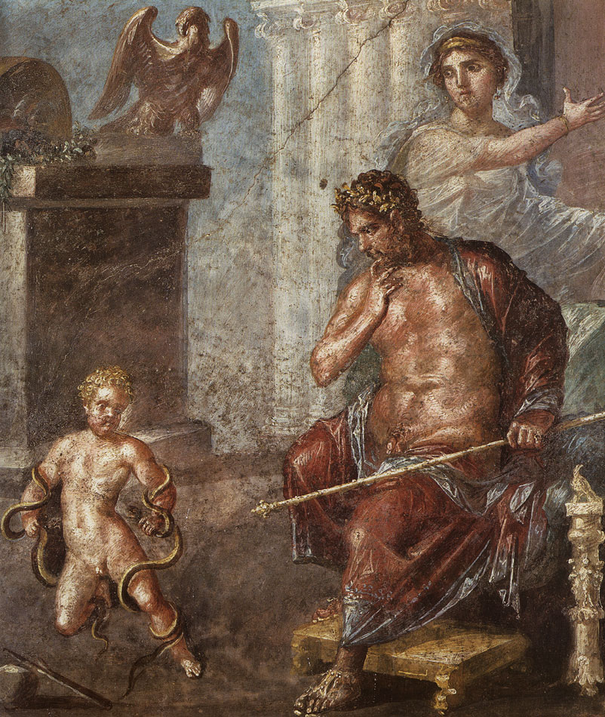
Fresco from House of the Vettii, Pompeii (1st c CE)

Slide 33
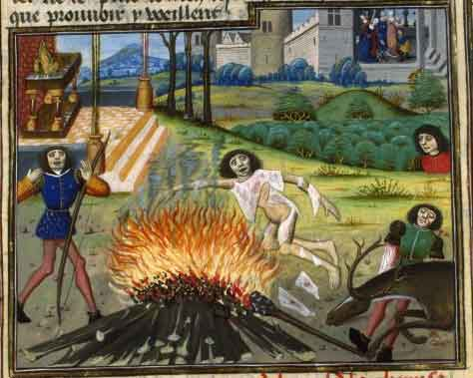
Death of Hercules by Raoul Lefèvre, Histoires de Troyes, (15th c)

Slide 34
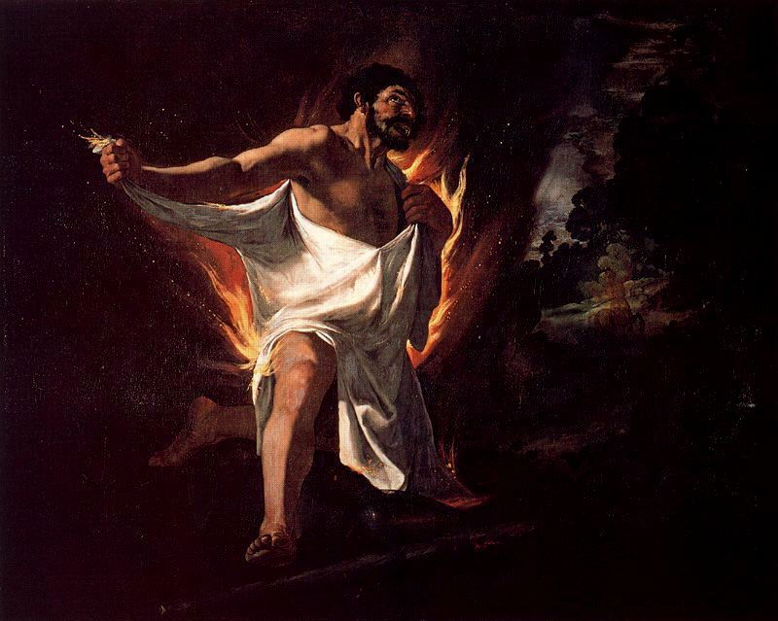
Death of Hercules by Francisco de Zurbarán (1634)

Slide 35
PARADIGM OF
STOIC ENDURANCE
THE CHOICE OF HERCULES
ALLEGORY OF THE CHOICE BETWEEN
PLEASURE AND VIRTUE

Slide 36
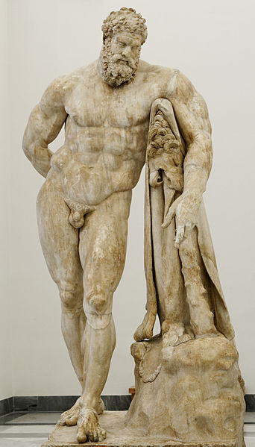
Farnese Hercules, Roman copy after of Hellenistic original, found in Baths of Caracalla

Slide 37
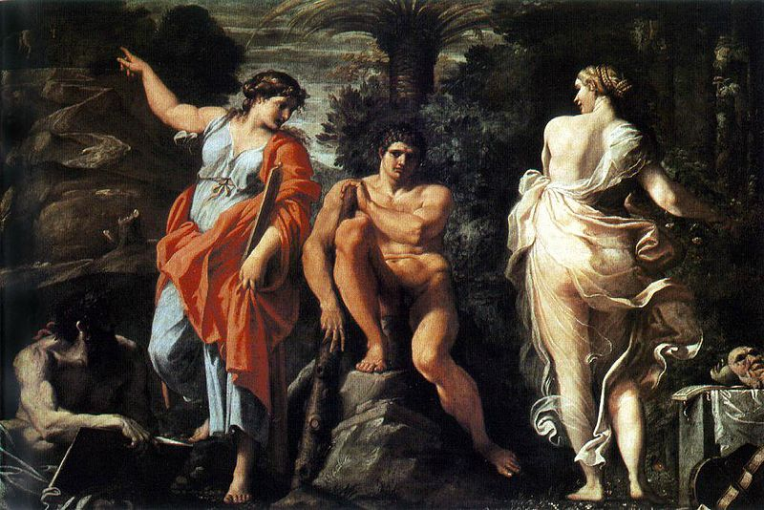
Ercole al bivio (The Choice of Hercules) by Annibale Carracci (1596)

Slide 38
The heroic archetype:
Hero’s mother is royal virgin and father a king
Reputed to be son of a god
Circumstances of birth unusual
Attempt by father or grandfather to kill him at birth
He is spirited away
Reared by foster parents elsewhere
On maturity, travels to his future kingdom
Journeys to Underworld
Triumphs over king/giant/dragon/beast
Marries a princess
Becomes king
Loses favour with gods or subjects
Dies mysteriously
His children do not succeed him
His body is not buried
He is honoured with one or more shrines

Slide 39
The Labours of Heracles

Slide 40
Labours of Heracles assigned by King Eurystheus:
1. Kills lion of Nemea (NE Peloponnese). Hence lionskin.
2. Kills Hydra [snake] of Lerna, nr Argos. Hence poison for arrows.
3. Captures golden hind [deer]. Arcadia or far north.
4. Captures boar from Mt Erymanthus, Arcadia.
5. Cleans stables of King Augeas (in Elis) by diverting river.
Drives away birds of Stymphalus, Arcadia.
Captures bull [parent of Minotaur] on Crete.
8. Captures flesh-eating horses of King of Thrace.
9. Fetches the girdle of the Amazon Hippolyte.
Fetches the cattle of the giant Geryon from far west.
Fetches golden apples from garden of Hesperides (far west).
12. Fetches Cerberus from the Underworld.
Notes:
Not a Homeric hero, warrior fighting warriors, but mainly concerned with animals, taming and bringing back animals eaten by humans

Slide 41
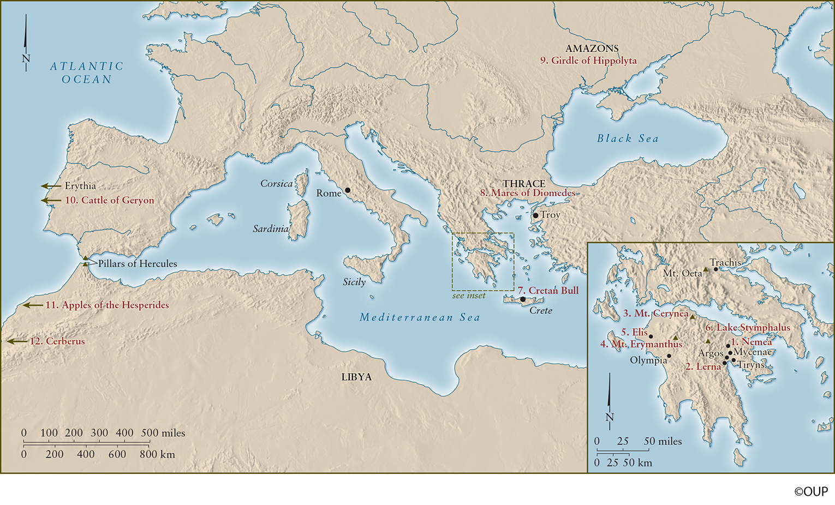

Slide 42
THESEUS
An Athenian hero

Slide 43
The heroic archetype:
Hero’s mother is royal virgin and father a king
Reputed to be son of a god
Circumstances of birth unusual
Attempt by father or grandfather to kill him at birth
He is spirited away
Reared by foster parents elsewhere
On maturity, travels to his future kingdom
Journeys to Underworld
Triumphs over king/giant/dragon/beast
Marries a princess
Becomes king
Loses favour with gods or subjects
Dies mysteriously
His children do not succeed him
His body is not buried
He is honoured with one or more shrines

Slide 44
THESEUS’ PARENTS:
AETHRA (princess of Troezen) AND AEGEUS (king of Athens)
– OR POSEIDON?

Slide 45
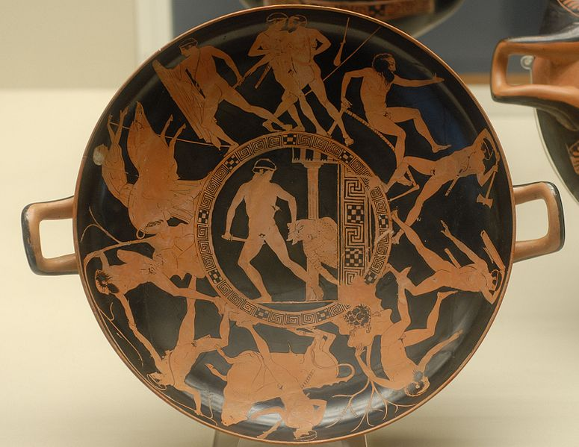
The labours of Theseus, Attic red figure kylix (440-430 BCE)

Slide 46
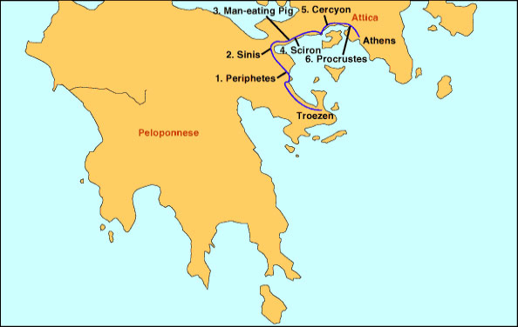
Six labours of Theseus

Slide 47
“Procrustean”
marked by arbitrary often ruthless disregard of individual differences or special circumstances
Merriam-Webster dictionary

Slide 48
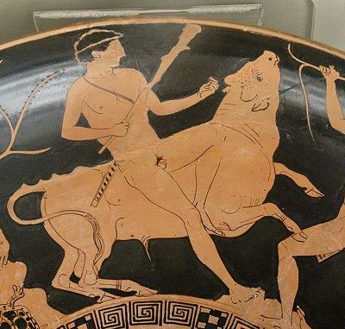
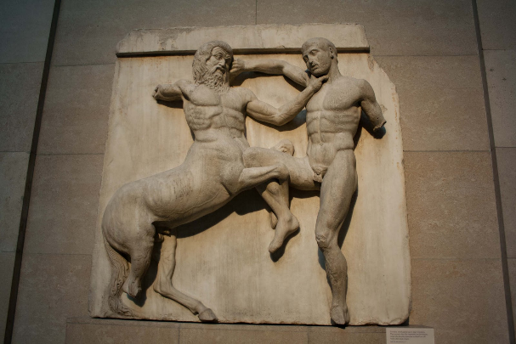
OTHER ADVENTURES OF THESEUS
Captures Bull of Marathon
Slays the Minotaur
Unites Attika as king of Athens
Attempts to get a wife:
  Antiope the Amazon, mother of Hippolytus
  Phaedra, falls in love with Hippolytus
Theseus and Pirithous:
  Lapiths vs. Centaurs
  Expedition to Underworld

Slide 49
Hostilities between Athens and Crete
King Aegeus and King Minos
Tribute sent every 7 or 9 years to Crete
Seven noble boys and seven noble girls
Sent into labyrinth and devoured by Minotaur
Cretan myth: beautiful bull sent by Poseidon at Minos’ request, Minos substitutes another bull in sacrifice thus offending Poseidon, punishment is that his wife Pasiphae falls in love with bull, Daedalus makes contraption to she can have sex with bull, result is Minotaur, fierce creature, must be enclosed in labyrinth made by Daedalus
Mary Renault The King Must Die (1958)

Slide 50
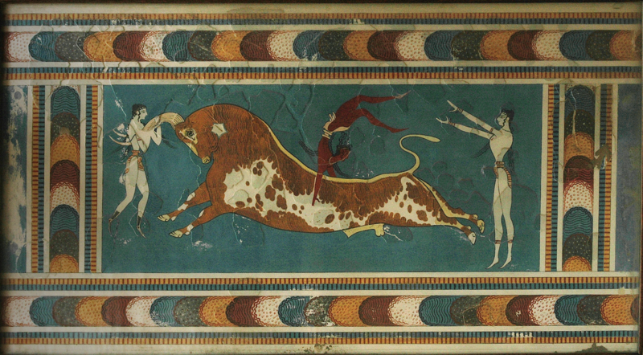
Fresco of bull jumping from Knossos

Slide 51
Ariadne, daughter of King Minos and Pasiphae
Gives Theseus thread and sword
He kills Minotaur (her half-brother!) and emerges
Departs with Theseus
Abandoned on island of Naxos (aka Dia)
Rescued by Dionysus/Bacchus
Becomes his wife
Joins gods or her crown becomes constellation Corona
The Helpful Princess motif

Slide 52
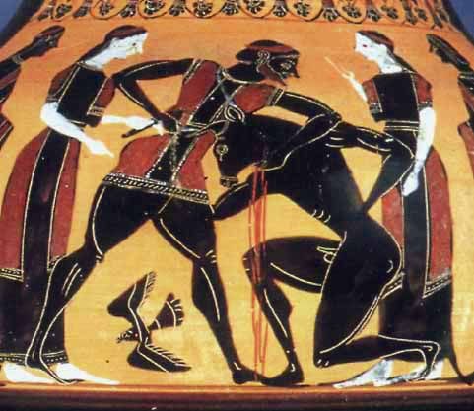
Theseus kills the Minotaur. Black Figure Amphora
6th Century BCE

Slide 53
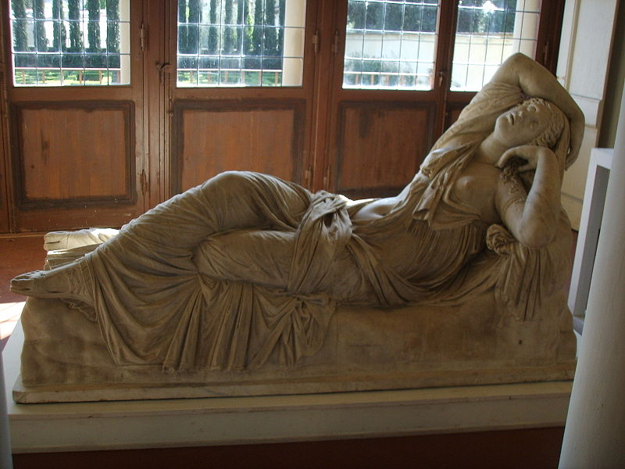
Ariadne, Roman copy of Hellenistic original

Slide 54
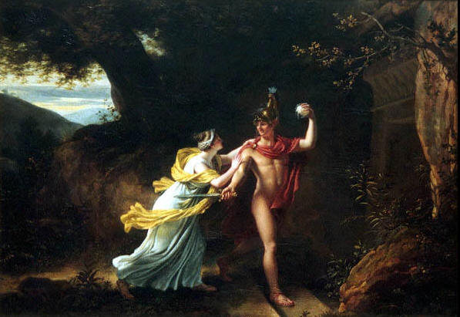
Ariadne and Theseus. Jean Baptiste Regnault. 1754-1829

Slide 55
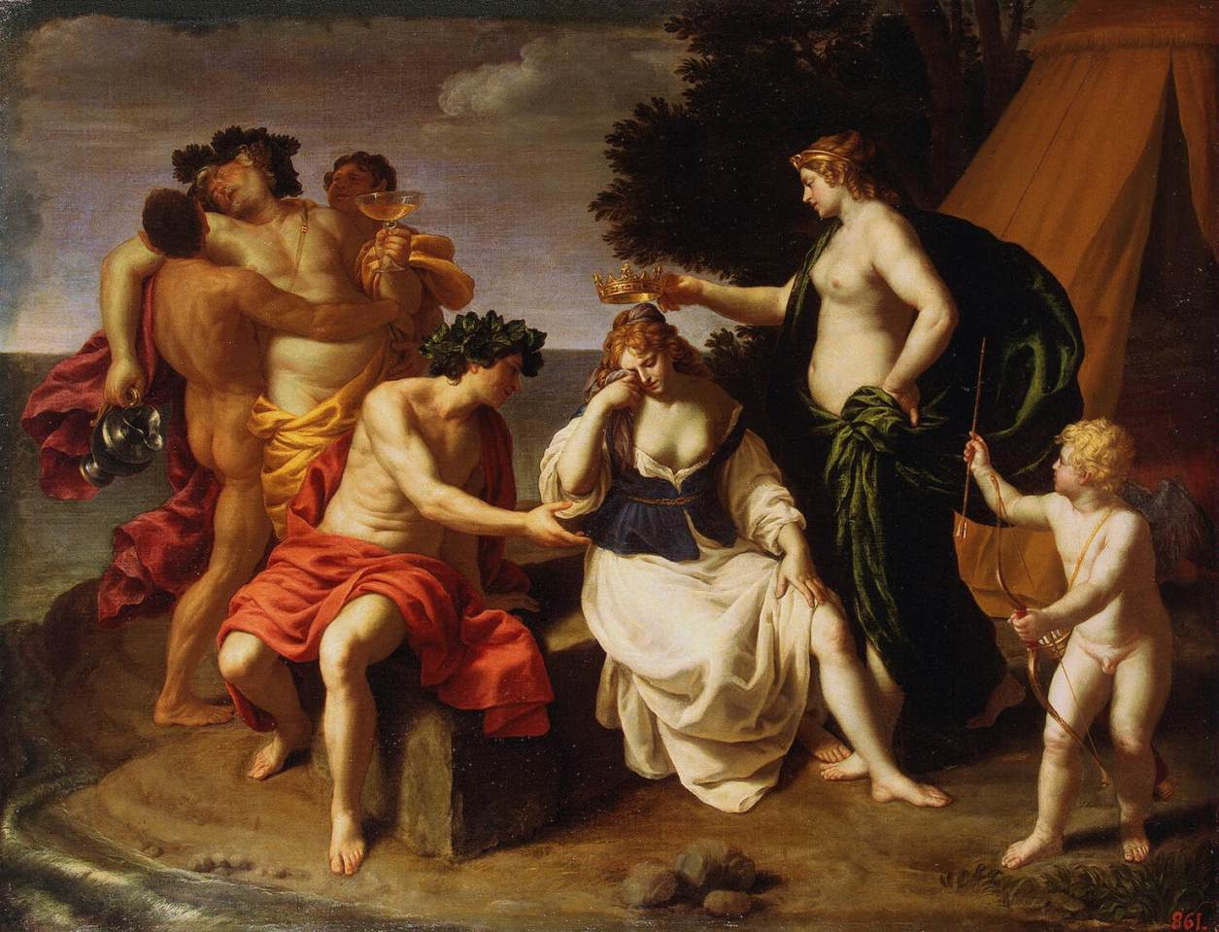
Bacchus (Dionysus) and Ariadne. Alessandro Turchi. 1578-1629

Slide 56
Mythology and opera
Classical mythology furnished stories deployed in opera, dramatic musical art form invented in Italy early C17
Claudio Monteverdi
L’Orfeo (1607)
L’Arianna (1608)
Richard Strauss Ariadne auf Naxos (1912)

Slide 57
JASON

Slide 58
The heroic archetype:
Hero’s mother is royal virgin and father a king
Reputed to be son of a god
Circumstances of birth unusual
Attempt by father or grandfather to kill him at birth
He is spirited away
Reared by foster parents elsewhere
On maturity, travels to his future kingdom
Journeys to Underworld
Triumphs over king/giant/dragon/beast
Marries a princess
Becomes king
Loses favour with gods or subjects
Dies mysteriously
His children do not succeed him
His body is not buried
He is honoured with one or more shrines

Slide 59
AEOLUS
AESON, KING OF IOLCOS
JASON
PELIAS SEIZES POWER
JASON SENT AWAY TO CENTAUR CHIRON FOR SAFETY
BY HIS MOTHER
RETURNS TO CLAIM KINGDOM

Slide 60
IMPOSSIBLE TASK: BRING GOLDEN FLEECE
RAM CARRIED HELLE AND PHRIXUS
FROM GREECE
HELLESPONT
BLACK SEA – COLCHIS (modern GEORGIA)
KING AEETES (SON OF HELIUS)
GUARDED BY UNSLEEPING DRAGON
ARGO, ARGONAUTS
ORPHEUS, HERACLES

Slide 61
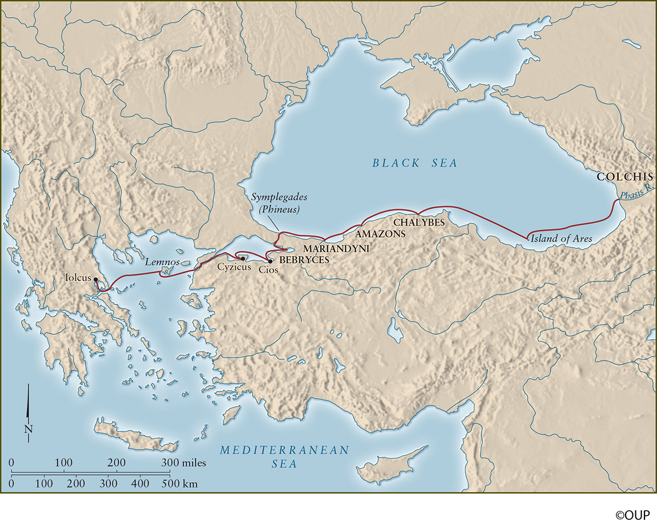

Slide 62
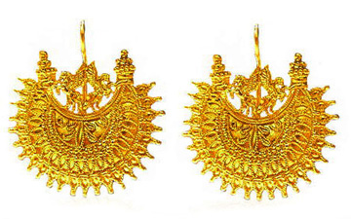
Colchis = modern Georgia? gold filigree work

Slide 63
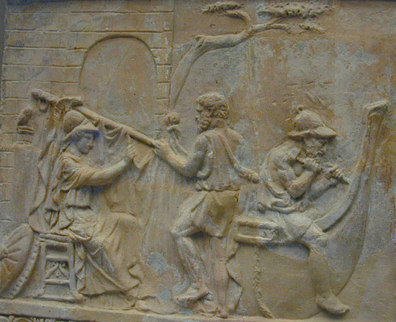
Athena supervising the building of the Argo, Terracotta relief, (c. 1st century CE)

Slide 64
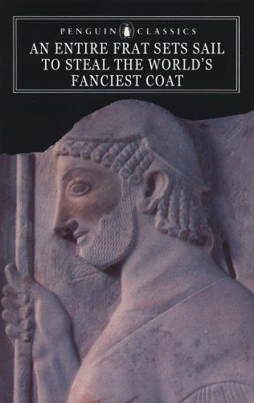

Slide 65
JASON AND MEDEA
Aeëtes assigns impossible tasks:
to yoke fire-breathing bulls, plough field, sow dragon’s teeth (from Theban serpent), kill men that sprout up
Medea: Aeëtes’ daughter, Helius’ grand-daughter, Circe’s niece, magic skills: ointment to protect Jason from bulls, drug for dragon

Slide 66
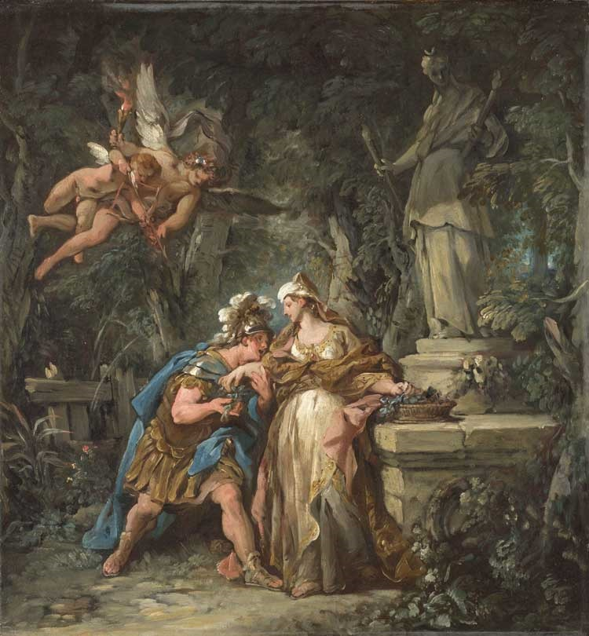
Jason Swearing his Eternal Love to Medea by Jean-Francois Detroy (1742/3)

Slide 67
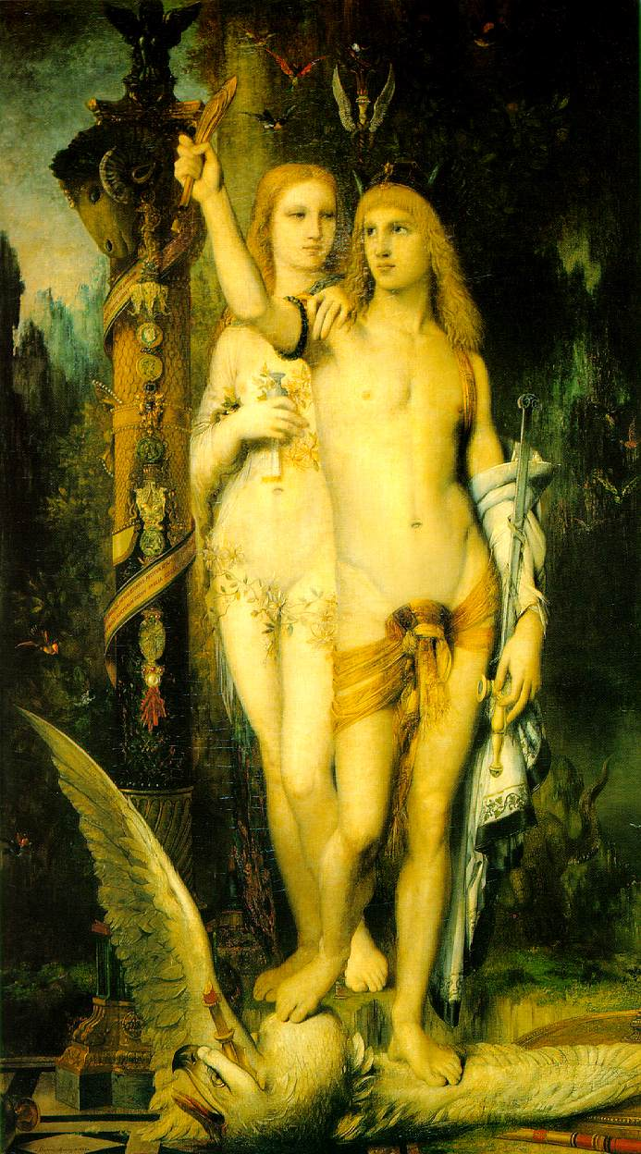
Jason and Medea by Gustav Moreau (1865)

Slide 68
Ovid Metamorphoses 7:
The brazen-footed bulls puffed forth fire from their adamantine nostrils and the grass burned at the touch of their breath … The Argonauts were petrified with fear. On came Jason and felt not their fiery breath, so great was the power of Medea’s drugs. He stroked their deep dewlaps with fearless hand and compelled them, driven beneath the yoke, to draw the plough’s heavy weight and tear open the soil as yet unploughed.

Slide 69
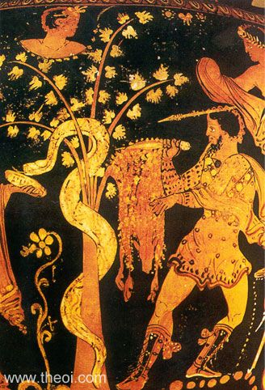
Jason takes the fleece, Apulian Red Figure (4th c BCE)

Slide 70
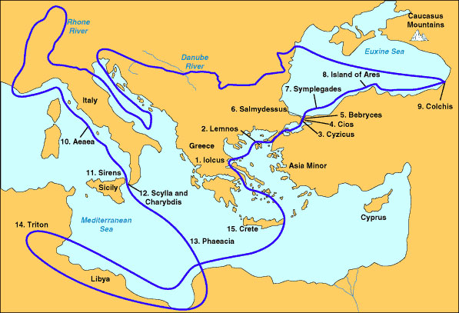

Slide 71
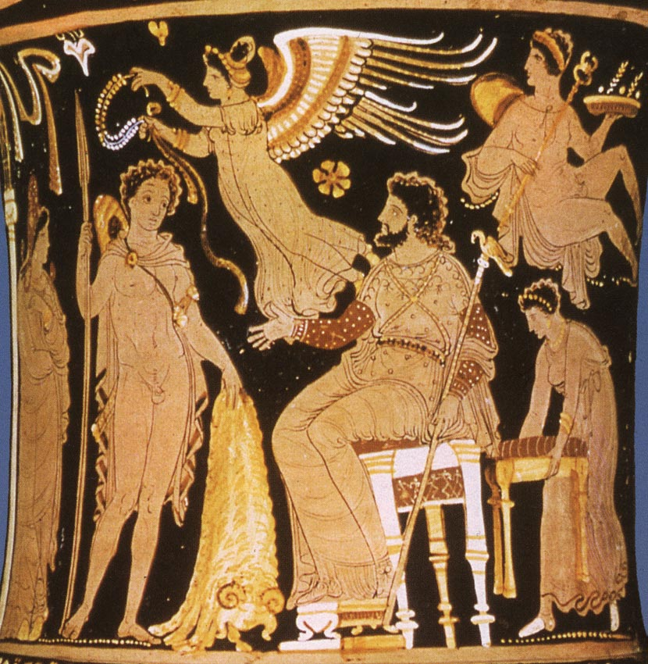
Jason returns to Iolcos with the fleece

Slide 72
Return from Colchis
– Medea chops up brother Apsyrtus and drops pieces in water to slow Aeëtes’ pursuit
– Visit to Circe for purification
– To Iolcus, gives fleece to Pelias
– Pelias reneges on deal
– Medea causes death of Pelias
– Jason and Medea driven out and go to Corinth as exiles
– Jason abandons Medea, she kills their sons, flees to Athens on chariot of the Sun, given asylum by Aegeus

Slide 73
Jason’s ignominious death
Notes:
SLEEPING UNDER STERN OF ROTTING ARGO

Slide 74
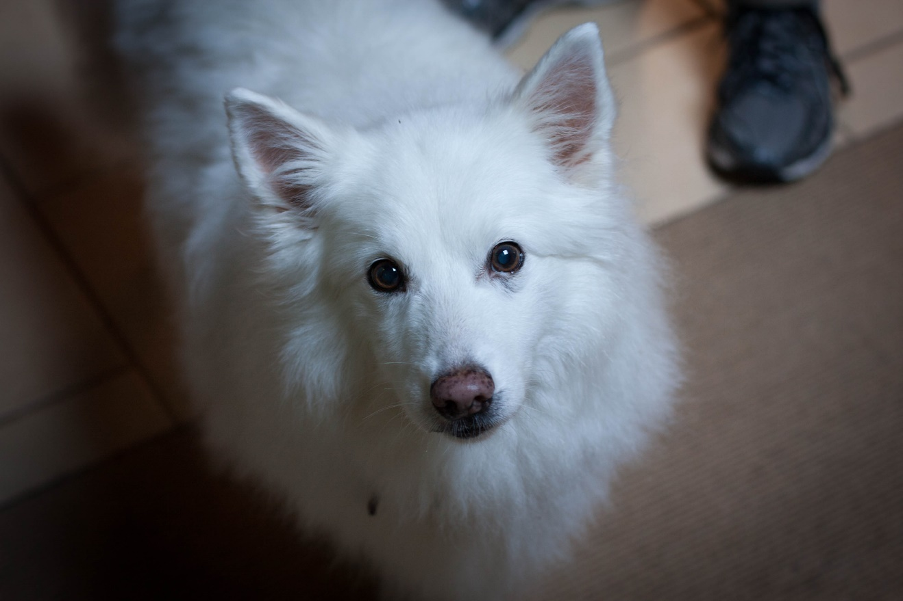
Toby

Slide 75
Achilles and Odysseus
Homeric heroes
Homeric epic - Iliad and Odyssey
“The Homeric question”
Milman Parry and Albert Lord (Harvard)
oral composition cf. Yugoslavian oral poetry
formulae/formulas/formulaic composition
aoidoi = singers/poets, rhapsodes = “song-stitchers”

Slide 76
CYPRIA | judgement of Paris
ILIAD | Achilles vs Hector
AETHIOPIS | Amazons at Troy; death of Achilles
LITTLE ILIAD | Trojan Horse
ILIOU PERSIS | sack of Troy
NOSTOI | return journeys
ODYSSEY | return of Odysseus
TELEGONY | death of Odysseus

Slide 77
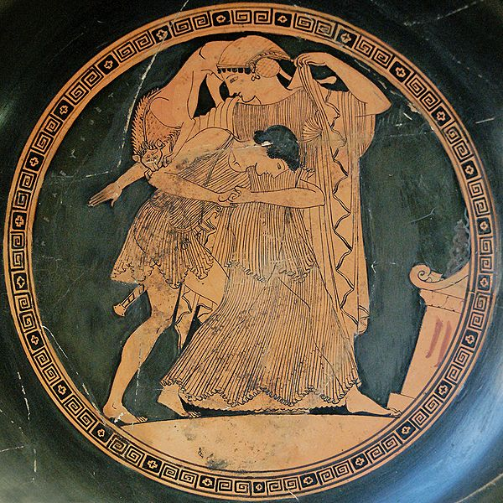
Peleus and Thetis, Attic red figure kylix (490 BCE)

Slide 78
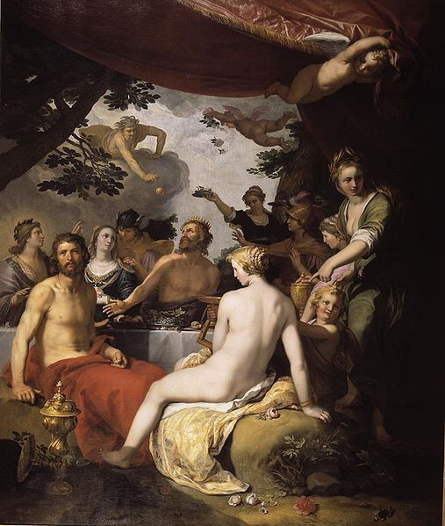
The wedding of Peleus and Thetis by Abraham Bloemaert (1564)

Slide 79
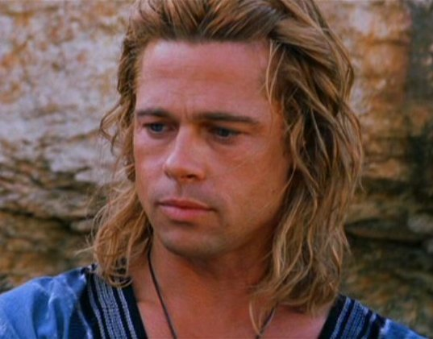
Brad Pitt as Achilles from Troy (2004)

Slide 80
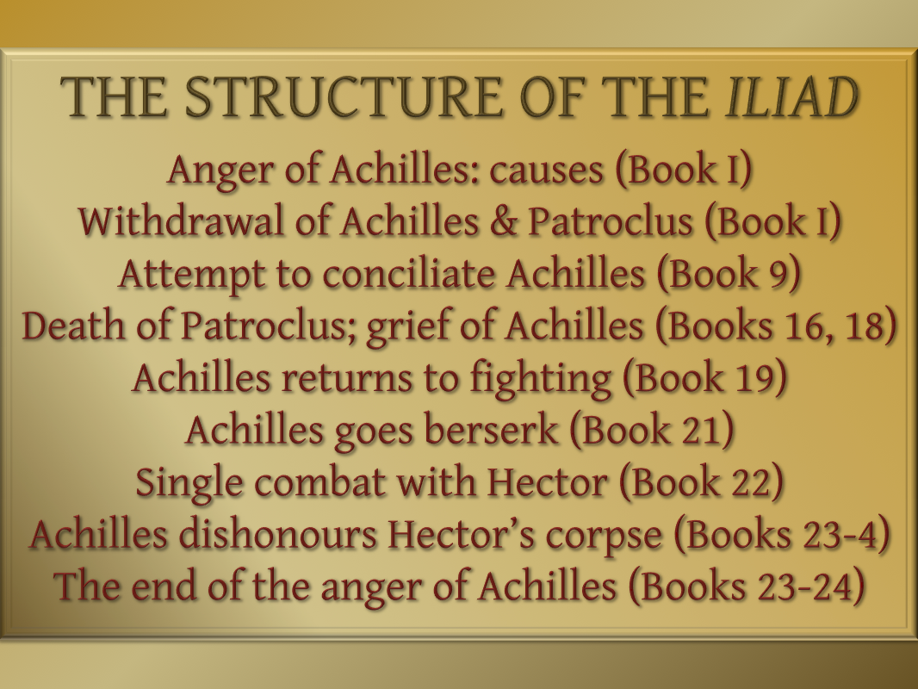

Slide 81
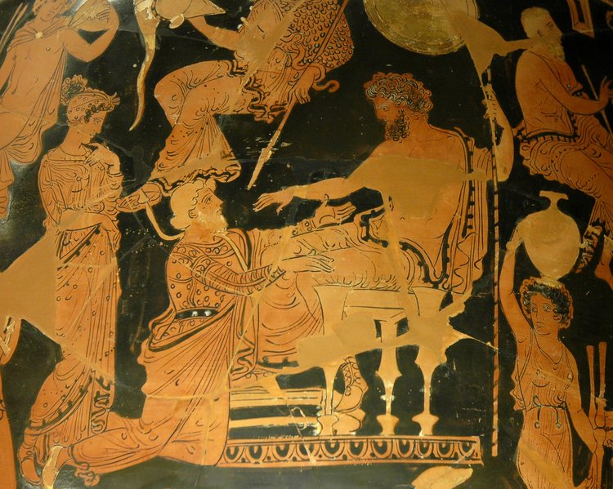
Chryses asks for his daughter from Agamemnon, Apulian red figure krater (360-50 BCE)

Slide 82
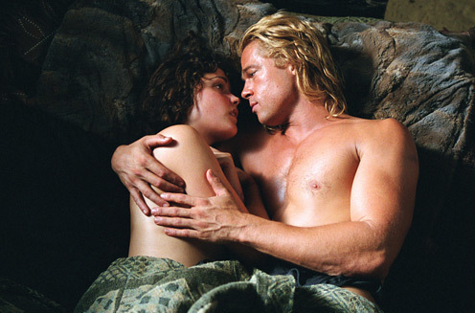
Brad Pitt as Achilles and Rose Byrne as Briseis from Troy (2004)

Slide 83
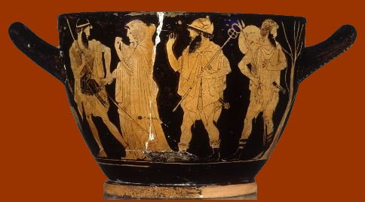
Briseis taken from Achilles, Attic red figure krater (5th century CE)

Slide 84
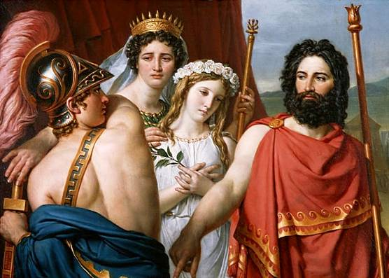
The Anger of Achilles by Jacques-Louis David (1819)

Slide 85
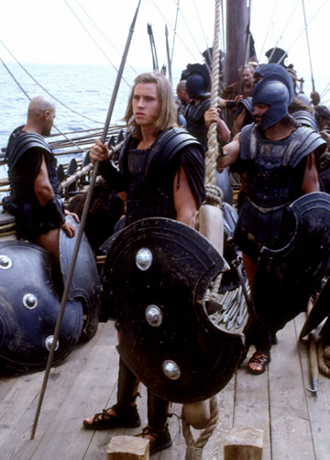
Garrett Hedlund as Patroclus from Troy (2004)

Slide 86
Madeline Miller
The Song of Achilles 2013
retells story of Achilles and Patroclus from Patroclus’s point of view

Slide 87
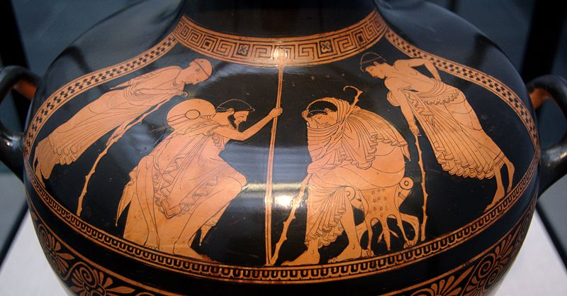
Embassy to Achilles, Odysseus and Phoenix in front of Achilles, Attic red-figure hydria (ca. 480 BCE)

Slide 88

Achilles bandaging Patroclus’ arm, Attic red figure kylix by the Sosius painter (c. 500 BCE)

Slide 89

Hector (Eric Bana) kills Patroclus (Garrett Hedlund) from Troy (2004)

Slide 90

The battle over Patroclus’ body, Attic black figure kylix (530 BCE)

Slide 91

Greeks and Trojans Fighting for the Corpse of Patroklos by Antoine Wiertz (1836)

Slide 92

Achilles and the body of Patroclus by Nikolaj Nikolajewitsch Ge (1855)

Slide 93

Brad Pitt as Achilles from Troy (2004)

Slide 94

Achilles (Brad Pitt) returns to fighting, from Troy (2004)

Slide 95

Achilles (Brad Pitt) goes berserk, from Troy (2004)

Slide 96

Achilles battles the river Xanthos, by Auguste Couder (1819)

Slide 97

Achilles fights Hector, Athenian red-figure krater (500-480 BCE)

Slide 98

Achilles (Brad Pitt) single combat with Hector (Eric Bana), from Troy (2004)

Slide 99

Achilles (Brad Pitt) kills Hector (Eric Bana), from Troy (2004)

Slide 100

Achilles drags Hector's body, Attic black-figure hydria by Antiopa painter, (c. 520 BCE)

Slide 101

Achilles dragging the body of Hector, Attic white figure lekythos by the Diosphos painter (490 BCE)

Slide 102

Priam ransoming Hector’s body, Attic black figure vase attributed to the Rycroft painter (520-510 BCE)

Slide 103


Slide 104

ACHILLES HEEL
Notes:
Thetis dips him in Styx holding heel – Paris’ arrow kills him

Slide 105

Achilles thneskon (Achilles dying) by Ernst Herter (1884)

Slide 106

Achilles thneskon (Achilles dying, rear view) by Ernst Herter (1884)

Slide 107
Odysseus
NOSTALGIA
NOSTOS = RETURN HOME
ALGOS = PAIN
POLYTROPOS = VERSATILE
Hermes > Autolycus [master thief] >
Anticleia m. Laertes > Odysseus

Slide 108

Ithaca

Slide 109
Odyssey: nostos as quest
Divine enemy: Poseidon
Divine ally: Athena
Conflicts with divine/human/monstrous opponents
[Must overcome Death]
Rewarded with [return to his own] marriage/power/wealth

Slide 110
ODYSSEUS’ ODYSSEY:
9: Thrace – Cicones
9: Lotus-eaters
9: Sicily – Cyclops
10: Laestrygonians
10: Aeaea – Circe
11: Underworld
12: Sirens
12: Scylla & Charybdis (Strait of Messina)
12: Island of Helius
5: Ogygia – Calypso
6-8: Scheria – Phaeacians: Nausicaa, Alcinoüs, Arete
13-24: Ithaca – the suitors

Slide 111

interactive map at
http://www.classics.upenn.edu/myth/php/homer/index.php?page=odymap

Slide 112

Odysseus at the Palace of Circe by Wilhelm Schubert van Ehrenberg (1667)

Slide 113

Odysseus and Circe
Settecamini Painter
Ca. 350 BCE

Slide 114

Odysseus and his men at Circe’s, Attic black figure kylix (c. 540 BCE)

Slide 115

Odysseus’ men turned into pigs, Attic red figure lekythos, (5th century BCE)

Slide 116

Circe and Odysseus’ Men
Athenian Red-Figure
Ca. 5th BCE

Slide 117

Circe Transforming the Companions of Ulysses Into Pigs
Jan van der Straet
1570
Notes:
Creator: Straet, Jan van der, 1523-1605
Title: Circe transforming the companions of Ulysses into pigs. Studiolo du Palazzo Vecchio
Date: 1570
Location: Greek
Material: fresco
Repository: Palazzo vecchio (Florence, Italy)
Subject: Animals
Subject: Circe
Subject: Mannerism
Subject: Mythology--Greek
Subject: Painting--Flanders (Belgium)--16th C. A.D
Collection: ARTstor Slide Gallery
Source: Data from: University of California, San Diego

Slide 118

Odysseus and Circe
Bartholomaus Spranger
Ca. 1580
Notes:
Creator: Spranger, Bartholomaus, 1546-1611
Title: Odysseus and Circe
Date: 1580's
Material: oil on canvas
Measurements: 108 X 81 cm
Repository: Kunsthistorisches Museum Wien
Subject: Circe (Greek mythology)
Subject: Gods
Subject: Odysseus (Greek mythology)
Subject: Painting--Flanders (Belgium)--16th C. A.D
Collection: ARTstor Slide Gallery
Source: Data from: University of California, San Diego

Slide 119

Wine of Circe by Edward Burne-Jones (1863)

Slide 120


Slide 121

Bronze Siren (8th century BCE)

Slide 122

Funerary statue of Siren, Athens (c. 370 BCE)

Slide 123

Odysseus and the Sirens, detail from an Attic red-figured stamnos, (ca. 480-470 BC)

Slide 124

Odysseus and the Sirens by John William Waterhouse (1891)

Slide 125


Slide 126

Ulysses (Odysseus) recognized by his dog by Pierre-Amédée Durand (1810)

