Slide 1
Greek & Roman Mythology:
Ancient yet Timeless
Susanna Braund
Lecture 5, October 24 2018

Slide 2
What are the roles of women in the myths of the heroes?
Perseus:
Danaë
Medusa
Andromeda
Athena
Theseus:
Ariadne
Jason:
Medea

Slide 3
What are the roles of women in the myths of the heroes?
Perseus:
Danaë – mother impregnated by god
Medusa – monster
Andromeda – helpless princess
Athena – goddess helper
Theseus:
Ariadne – princess helper
Jason:
Medea – princess helper

Slide 4
Vladimir Propp
Morphology of the Folktale (1928)
Identified linear sequence in Russian folktale depicting “The Quest”
7 characters or roles
31 units or functions
(cf. Joseph Campbell’s the monomyth)

Slide 5
ANDROMEDA
HELPLESS PRINCESS
PRIZE

Slide 6
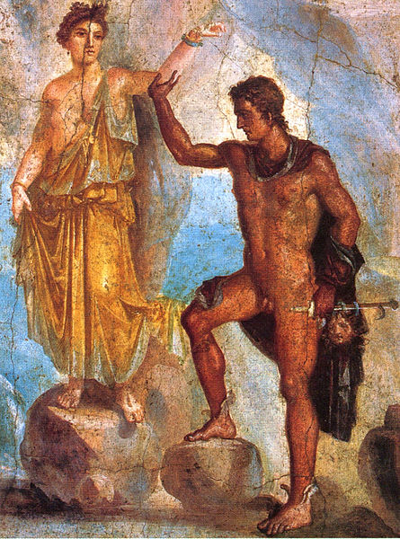
Perseus and Andromeda, Roman wall painting Pompeii

Slide 7
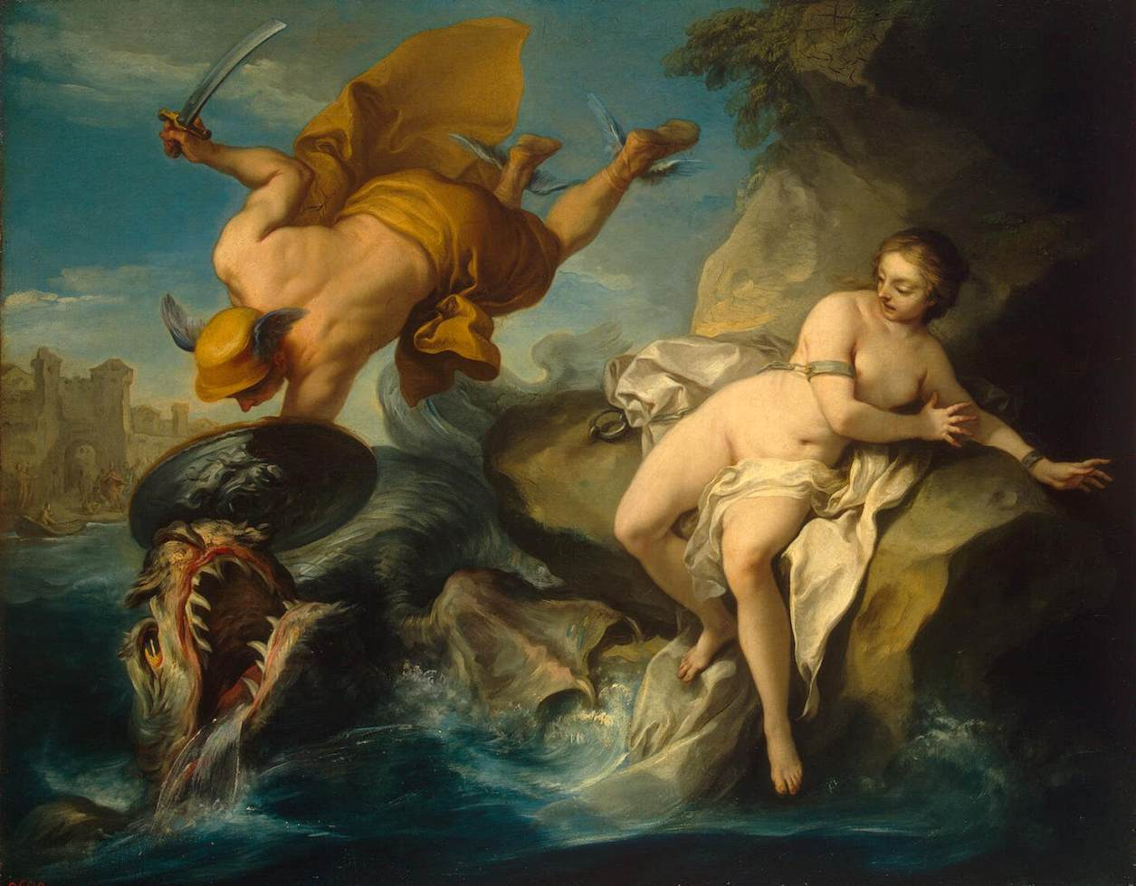
Perseus and Andromeda by Carl Vanloo (1735-40)

Slide 8
The helpful princess
Virgin, daughter of king
Abandons father for the love of a hero
Aids hero in completing his task, betraying her homeland
Hero completes task and marries the virgin
The bride is subsequently betrayed / abandoned

Slide 9
Helpful princesses
Nausicaä & Odysseus
Medea & Jason
Ariadne & Theseus

Slide 10
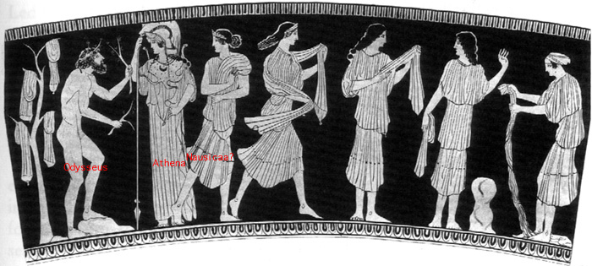

Slide 11
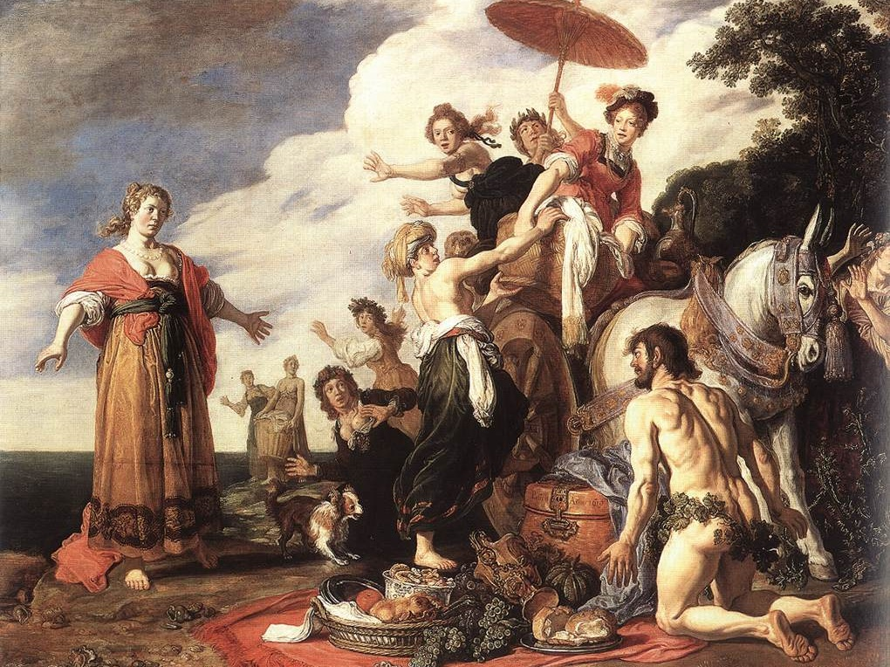
Odysseus and Nausicaa by Pieter Lastman (1619)

Slide 12
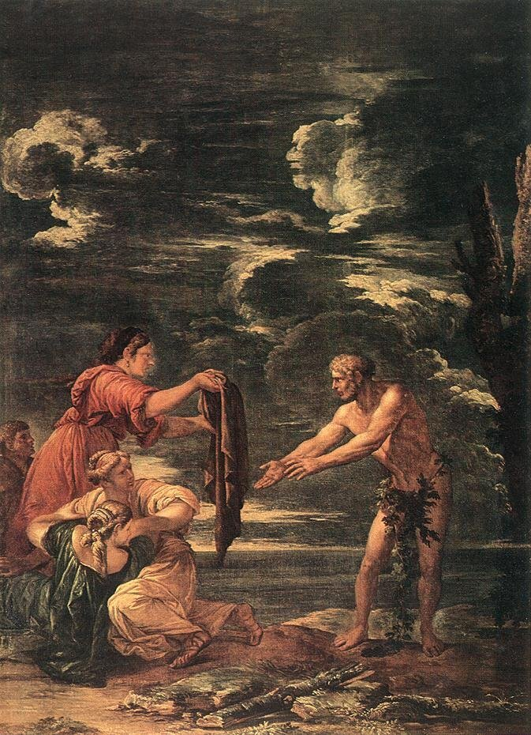
Odysseus and Nausicaa by Salvator Rosa (17th century)

Slide 13
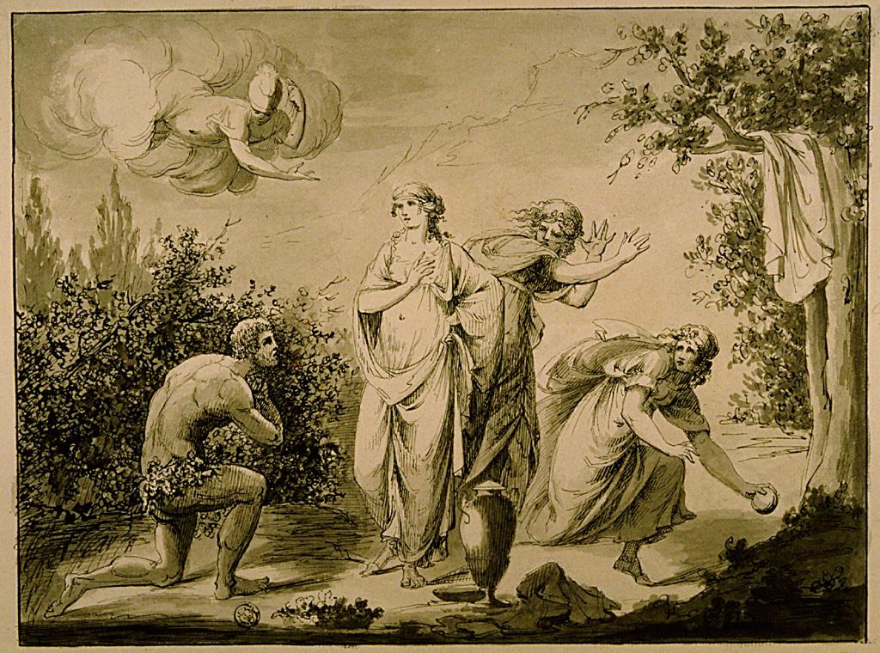
Ulysses and Nausicaa by Giovanni Battista Cipriani (1727-1785)

Slide 14
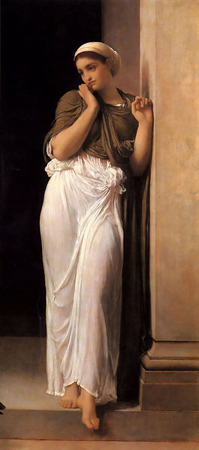
Nausicaa by Lord Leighton (1878)

Slide 15
JASON AND MEDEA
King Aeëtes of Colchis assigns impossible tasks:
to yoke fire-breathing bulls, plough field, sow dragon’s teeth (from Theban serpent), kill men that sprout up
Medea: Aeëtes’ daughter, Helius’ grand-daughter, Circe’s niece, magic skills: ointment to protect Jason from bulls, drug for dragon

Slide 16
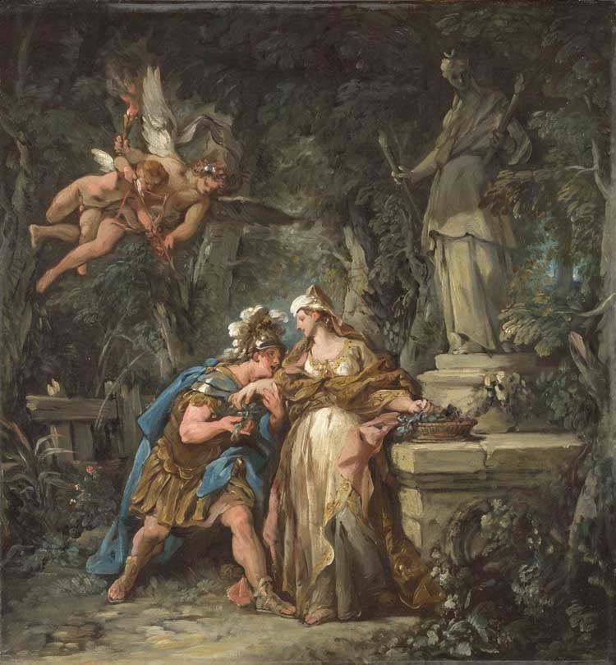
Jason Swearing his Eternal Love to Medea by Jean-Francois Detroy (1742/3)

Slide 17
Return from Colchis
– Medea chops up brother Apsyrtus and drops pieces in water to slow Aeëtes’ pursuit
– Visit to Circe for purification
– To Iolcus, gives fleece to his uncle Pelias
– Pelias reneges on deal
– Medea causes death of Pelias
– Jason and Medea driven out and go to Corinth as exiles
– Jason abandons Medea, she kills their sons, flees to Athens on chariot of the Sun, given asylum by Aegeus

Slide 18
Medea rejuvenates a ram for Pelias

Slide 19
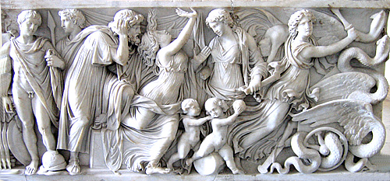
Creon watches as his daughter Glauce writhes in agony
Roman Sarcophagus, 2nd century CE

Slide 20
Medea killing her children

Slide 21
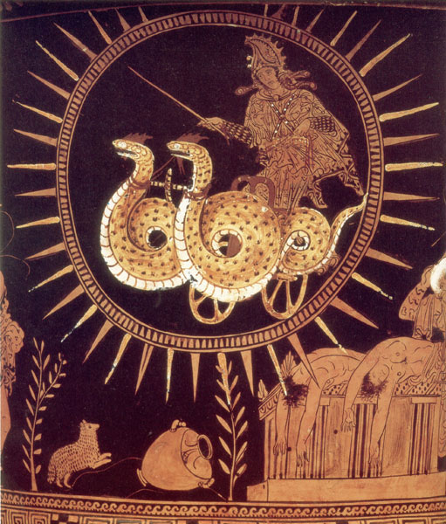
Medea in her golden chariot

Slide 22
Medea: heroine – or hero?
Medea
Frederick Sandys, 19th century

Slide 23
Pier Paolo Pasolini
Medea 1969
Maria Callas

Slide 24
Ariadne, daughter of King Minos and Pasiphae
Gives Theseus thread and sword
who kills Minotaur (her half-brother!) and emerges
Departs with Theseus
Abandoned on island of Naxos (aka Dia)
Rescued by Dionysus/Bacchus
Becomes his wife
Joins gods or her crown becomes constellation Corona

Slide 25
Ariadne and Theseus. Jean Baptiste Regnault. 1754-1829

Slide 26
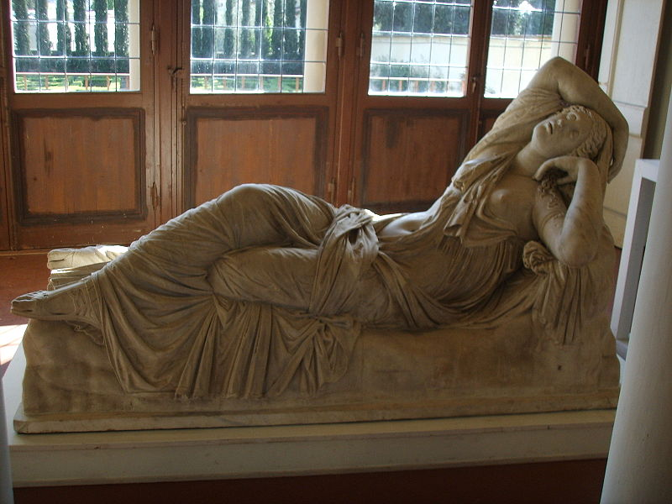
Ariadne, Roman copy of Hellenistic original

Slide 27
Bacchus (Dionysus) and Ariadne. Alessandro Turchi. 1578-1629

Slide 28
Ariadne in Latin literature
Catullus Poem 64:
miniature epic poem on the marriage of Peleus and Thetis describes bedspread on which story of Theseus and Ariadne is depicted
Ovid Letters of Heroines 10:
letter of Ariadne to Theseus

Slide 29
Mythology and opera
Classical mythology furnished stories deployed in opera, dramatic musical art form invented in Italy early C17
Claudio Monteverdi
L’Orfeo (1607)
L’Arianna (1608)
Richard Strauss Ariadne auf Naxos (1912)

Slide 30
Plot of Monteverdi’s opera L’Arianna (1608), libretto by Rinuccini:
The action is preceded by a brief prologue, delivered by Apollo. Venus and Cupid are then discovered, in conversation, on a desolate seashore. Venus informs Cupid that Duke Theseus of Athens, together with Ariadne, will soon be arriving on the island of Naxos on their way to Athens. They are fleeing from Crete, where the pair have been complicit in the slaying of Ariadne's monster half-brother, the Minotaur, in the labyrinth below the palace of her father, King Minos. Venus is aware that Theseus intends to abandon Ariadne on Naxos, and to proceed to Athens alone. Cupid offers to rekindle Theseus's passion for Ariadne, but Venus has decided to unite her with the god Bacchus, and asks Cupid to arrange this.
Cupid conceals himself, as Theseus and Ariadne arrive on the island a short distance away. Ariadne muses over her disloyalty to her father, but declares her love for Theseus. She departs to find shelter for the night, after which a fishermen's chorus compares her eyes with the stars of heaven. Theseus, alone with his counsellor, discusses his abandonment of Ariadne, and is advised that this decision is justified, as she will not be acceptable to the people of Athens as their ruler's consort.

Slide 31
A chorus greets the dawn as Ariadne, after a troubled night's sleep, returns to the shore with her companion, Dorilla, to find that Theseus has departed. Dorilla offers her comfort. In despair at the thought that Theseus will not return, Ariadne nevertheless decides to go to the landing area to wait for him. In a pastoral interlude a chorus sings of the joys of rural life, and expresses the hope that Theseus will not forget Ariadne. Primed by an envoy with the news that Ariadne is alone and sorrowing, the chorus again sings in sympathy with her. On the beach, Ariadne sings her lament for her lost love and prepares to kill herself. At this point fanfares are heard heralding an arrival, causing Ariadne to hope that it is Theseus returning. In another interlude the chorus expresses hope on her behalf, but a second envoy announces that it is Bacchus who has arrived, having taken pity on Ariadne. A sung ballo celebrates the anticipated betrothal of Bacchus and Ariadne. In the final scene Cupid reappears, and Venus rises from the sea before Jupiter speaks his blessing from the heavens. The union is sealed as Bacchus promises Ariadne immortality in heaven, and a crown of stars.

Slide 32
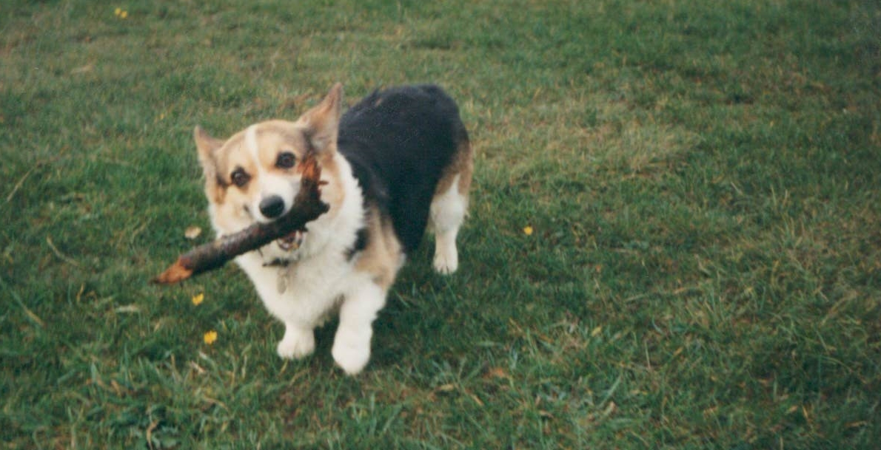
Florence the corgi

Slide 33
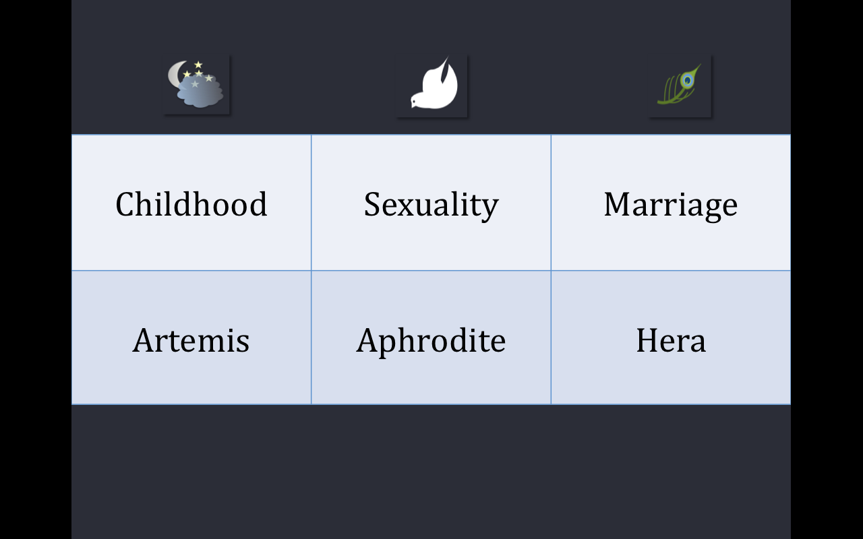
Childhood | Sexuality | Marriage
Artemis | Aphrodite | Hera

Slide 34
AVOIDANCE STRATEGY #1: CELIBACY EXAMPLE:
CALLISTO - ARTEMIS

Slide 35
AVOIDANCE STRATEGY #2: CREATE SEPARATE SOCIETY EXAMPLE:
AMAZONS

Slide 36
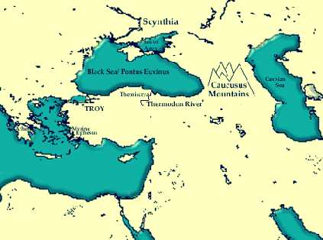
River Thermodon, original home of the Amazons

Slide 37
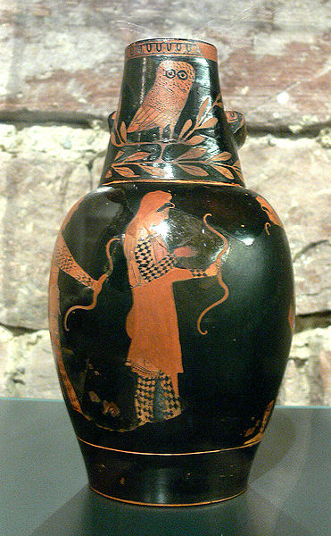
Amazons with bows; Attic red figure oinochoe by the Mannheim Painter (460-50 BCE)

Slide 38
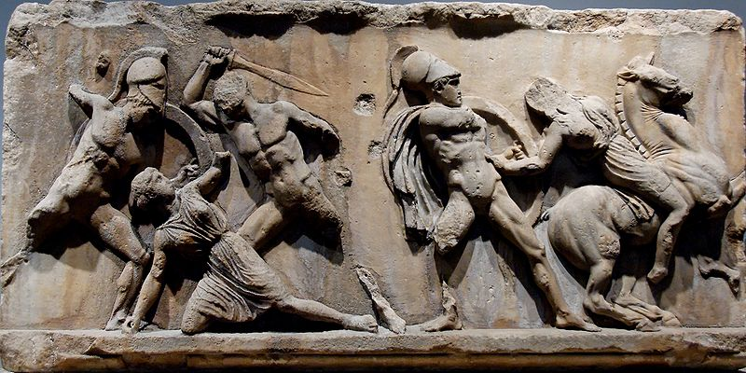
Amazonomachy, Mausoleum of Halicarnassus (350s BCE)

Slide 39
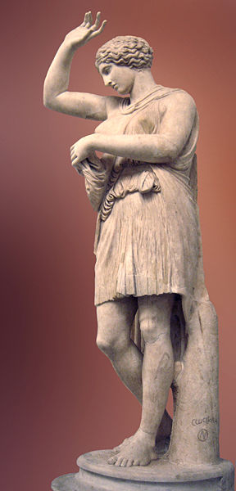
Wounded Amazon; Capitol-Sosicles type

Slide 40
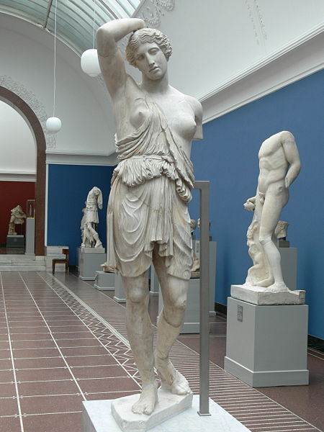
Wounded Amazon; Roman c. 150 CE

Slide 41
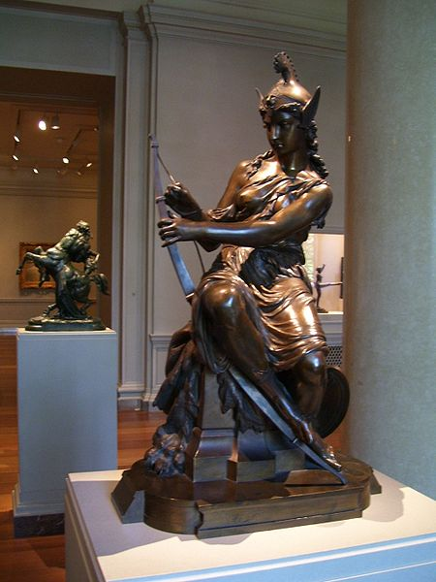
Amazon (Antiope) preparing for battle, Pierre Emile Washington, 1860

Slide 42
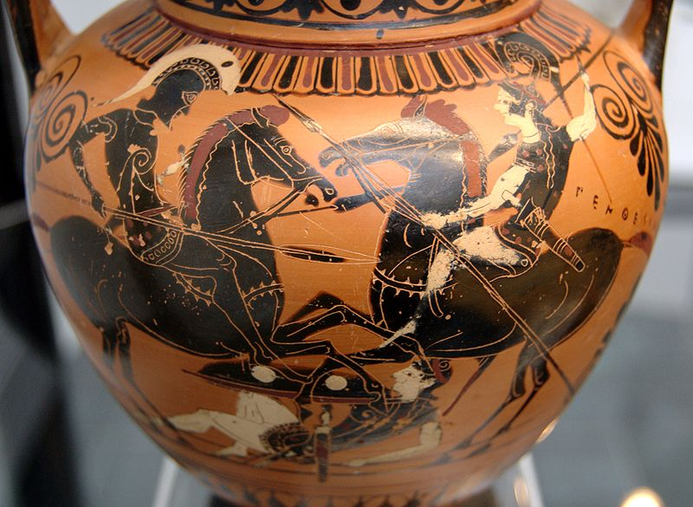
Achilles and Penthesilea; black figure neck Attic amphora, c. 520 BCE

Slide 43
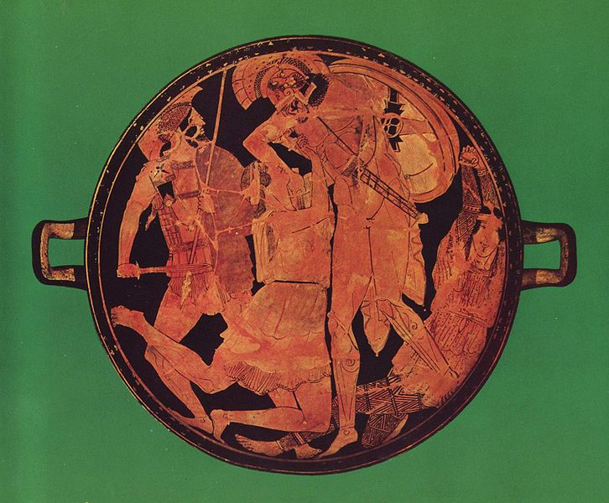
Achilles killing Penthesilea; Attic red figure kylix, 470-60 BCE

Slide 44
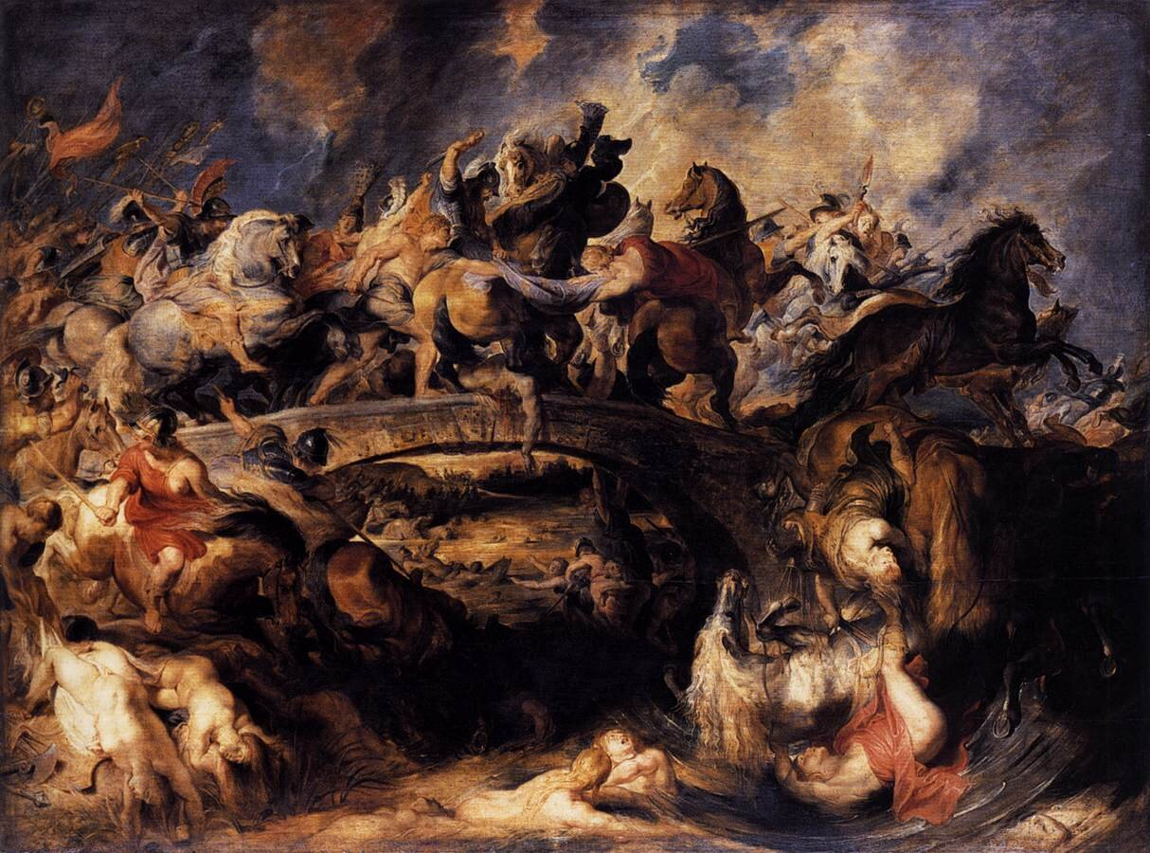
Battle of the Amazons, Rubens 1600

Slide 45
AVOIDANCE STRATEGY #3: BE A BUDDY EXAMPLE:
ATALANTA

Slide 46
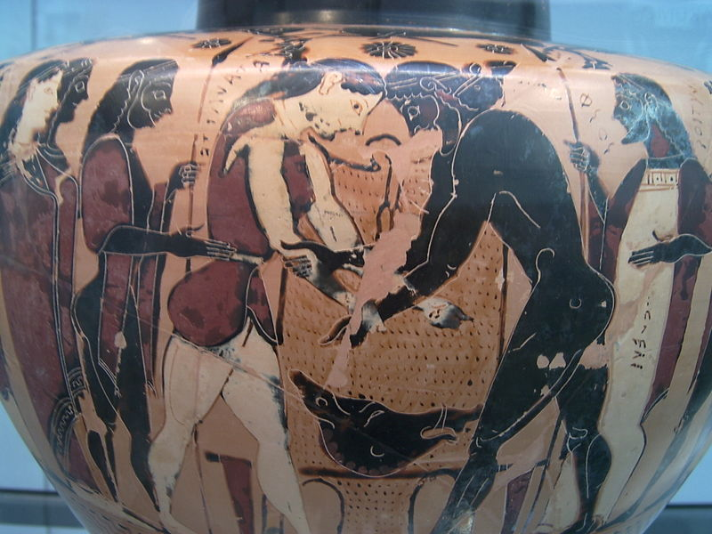
Atalanta wrestles Peleus (Hyrdia, c. 550 BCE)

Slide 47
AVOIDANCE STRATEGY #4: SACRIFICE YOURSELF EXAMPLES:
ANTIGONE
ELECTRA
IPHIGENEIA

Slide 48
RAPE > MARRIAGE PARADIGM
EXAMPLE:
PERSEPHONE AND HADES

Slide 49
RAPE > SLAVERY PARADIGM
EXAMPLE:
CASSANDRA

Slide 50
SEXUALITY
APHRODITE
EXAMPLES:
ARIADNE/THESEUS
MEDEA/JASON
SCYLLA, DAUGHTER OF NISUS/MINOS
MYRRHA/CINYRAS

Slide 51
MARRIAGE, CHILDBEARING,
FAMILY
HERA
EXAMPLES:
ALCESTIS
PENELOPE

Slide 52
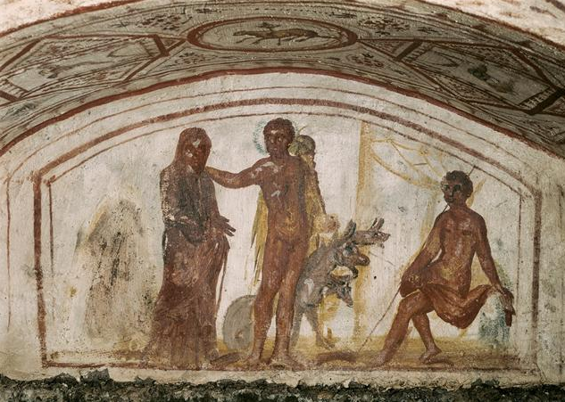
k
Alcestis being led back by Hercules, Catacomb on Via Latina (mid 4th c CE)

Slide 53
INFIDELITY
APHRODITE
EXAMPLES:
PHAEDRA (THESEUS) /
HIPPOLYTUS
CLYTEMNESTRA (AGAMEMNON) /
AEGISTHUS

Slide 54
MADNESS/DESTRUCTION OF
FAMILY
ANY INSULTED GOD
EXAMPLE:
AGAVE, MOTHER AND
MURDERER OF PENTHEUS

Slide 55
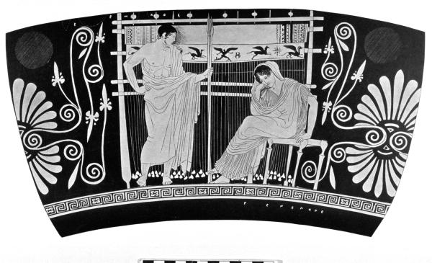
Penelope and Telemachus, Attic red figure vase, (c. 430 BCE)

Slide 56
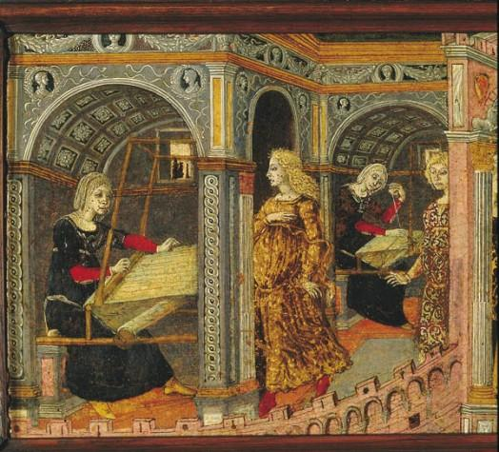
Pénélope devant son métier à tisser (Penelope at her Loom)

Slide 57
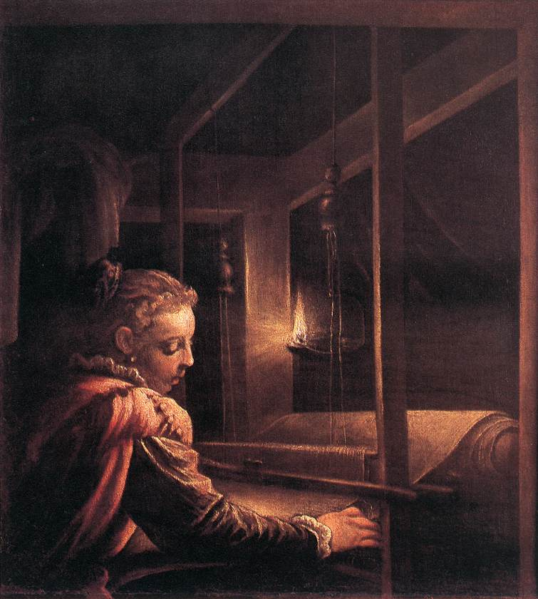
Penelope by Leandro Bassano (1575-85)

Slide 58
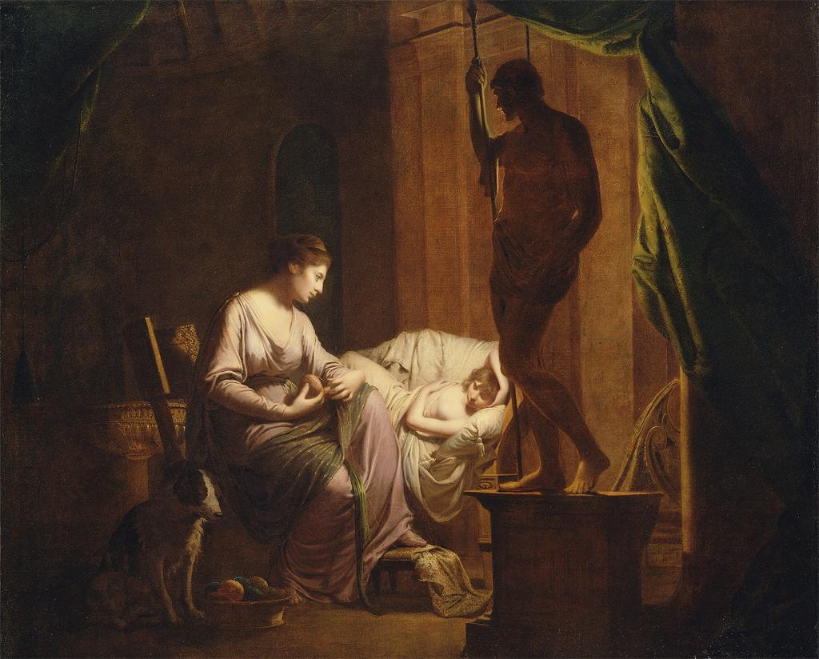
Penelope Unravelling the Web by Joseph Wright of Derby (1783-4)

Slide 59
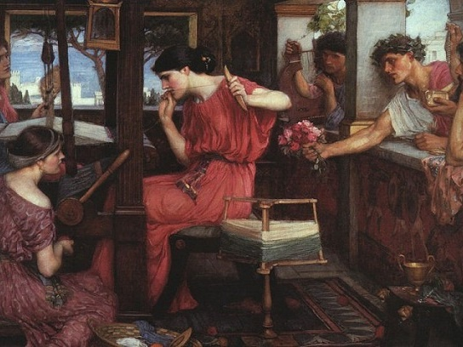
Penelope and the Suitors by John William Waterhouse (1912)

Slide 60
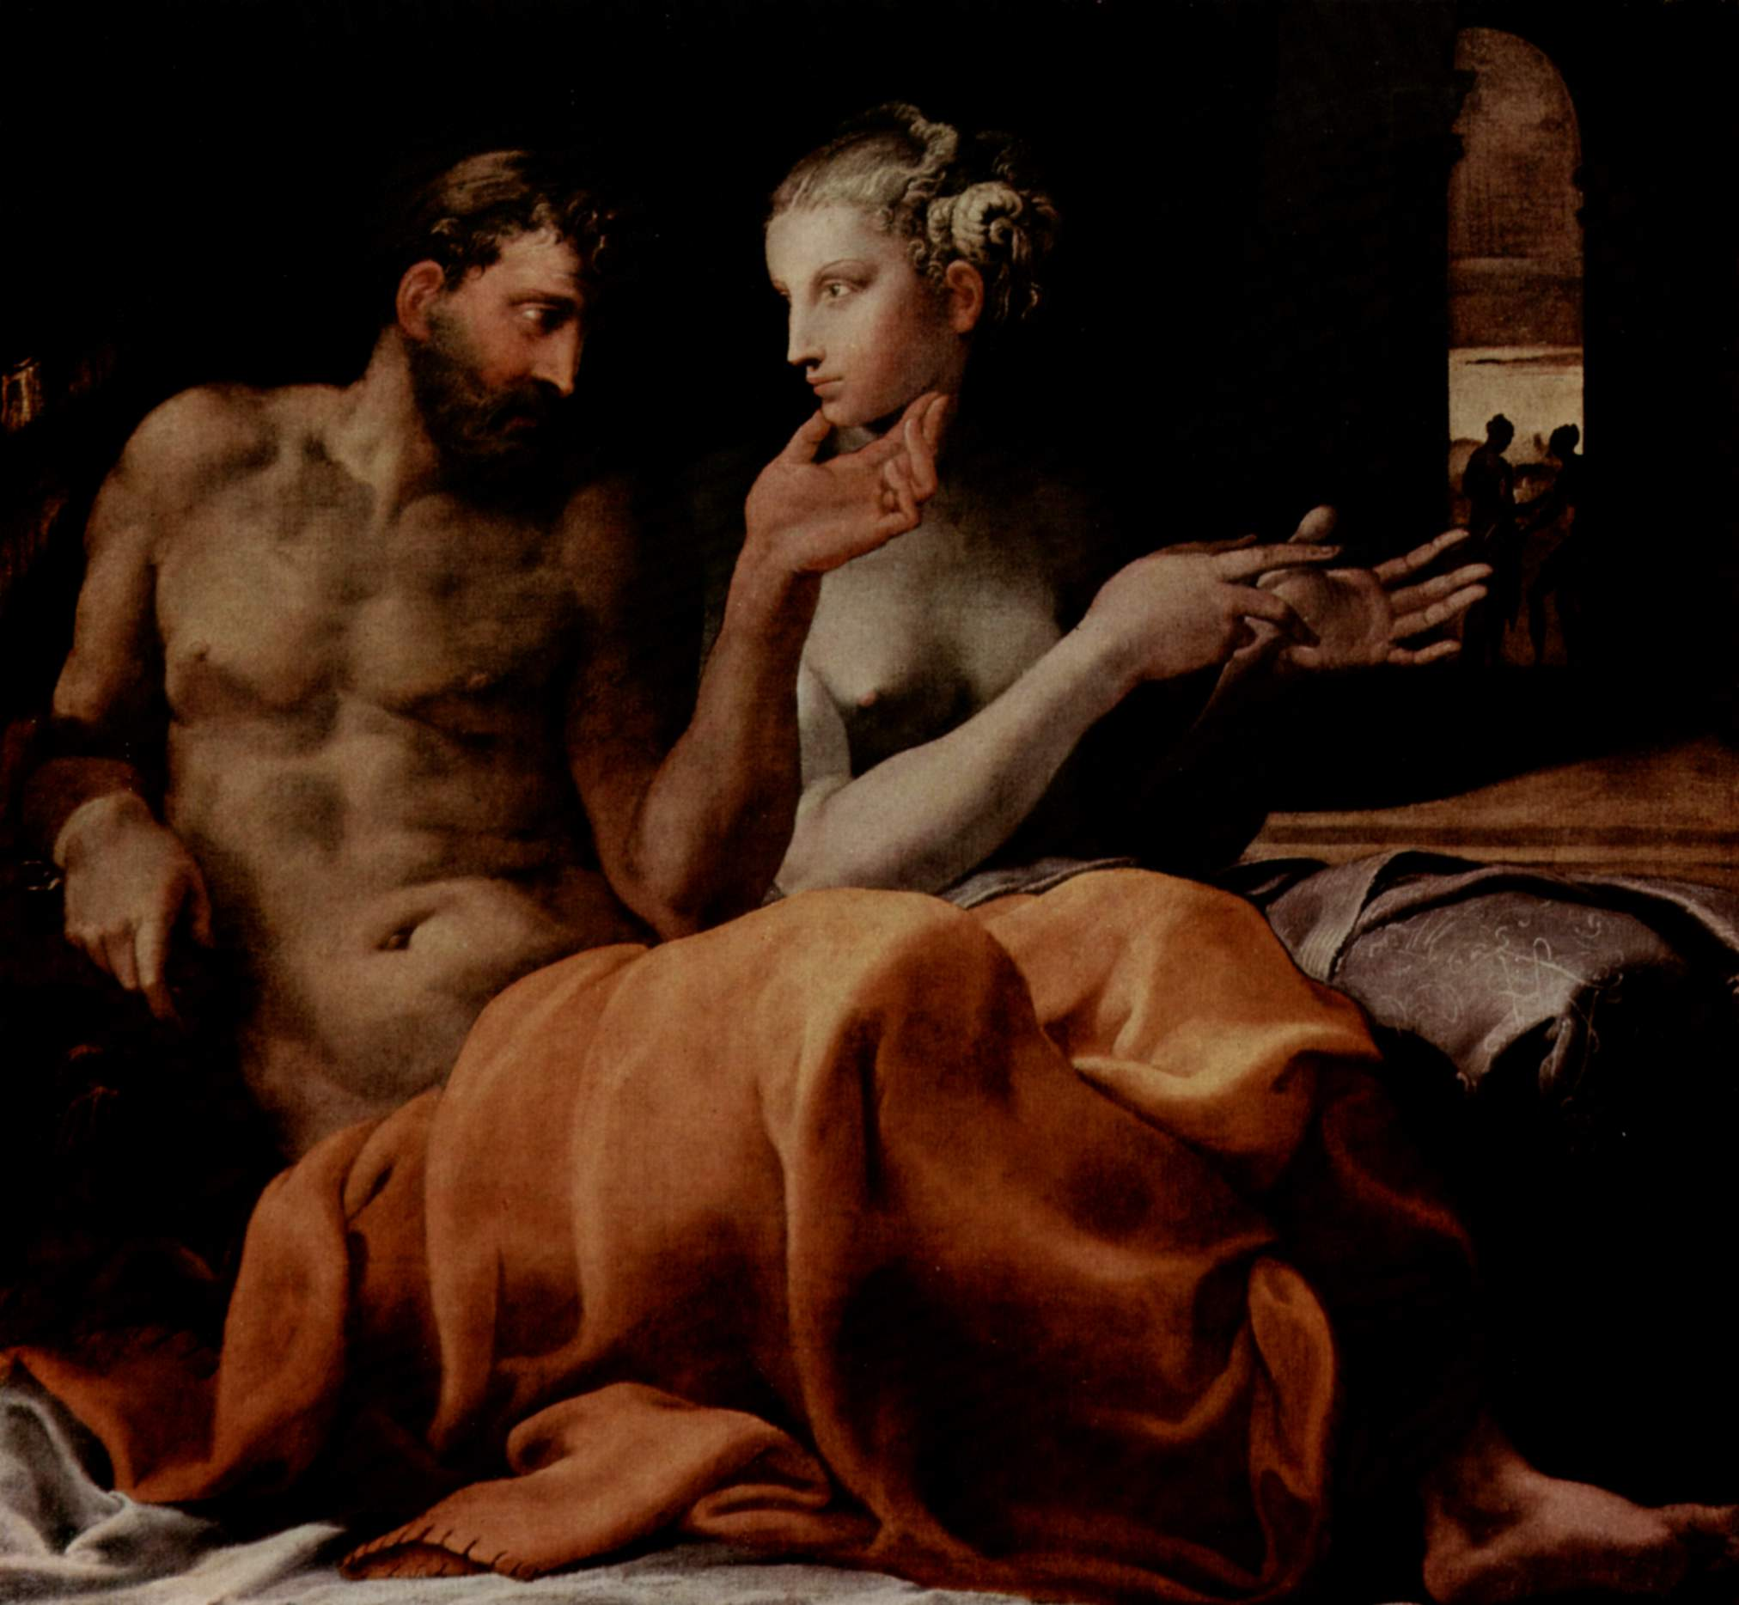
Odysseus and Penelope by Francesco Primaticcio (1505-1570)

