Slide 1
Greek and Roman Mythology: Ancient yet Timeless
Susanna Braund
Lecture 6, October 31, 2018

Slide 2
Timeline
Later Bronze Age, 1600-1100 BCE:
Thebes (Greek mainland)
Mycenae (Greek Peloponnese)
The Trojan War (Asia Minor)
The aftermath of the Trojan War

Slide 3
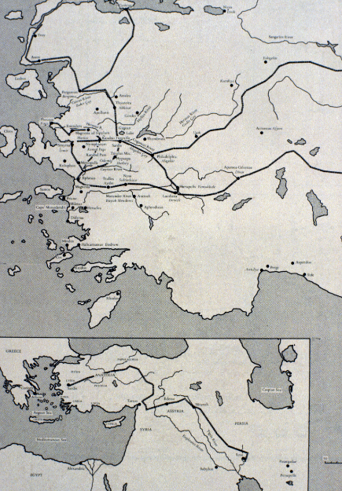
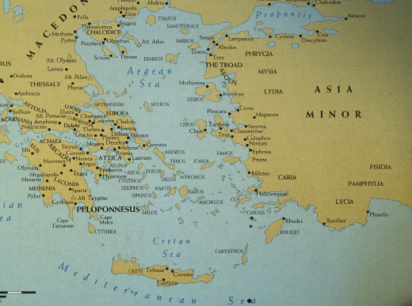
Hisarlik, Turkey – Dardanelles

Slide 4
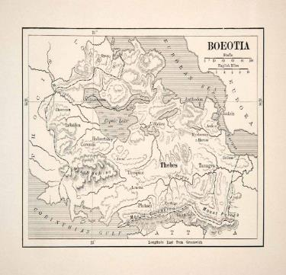
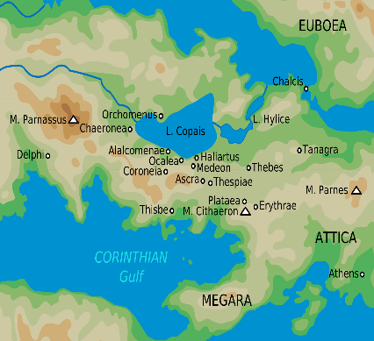
Location of Thebes
Important mountains near Thebes:
Helicon (home of the Muses, where Hesiod met the Muses)
Parnassus (above Delphi)
Cithaeron (where baby Oedipus was supposed to have been left to die)
Notes:
NB mountains!

Slide 5
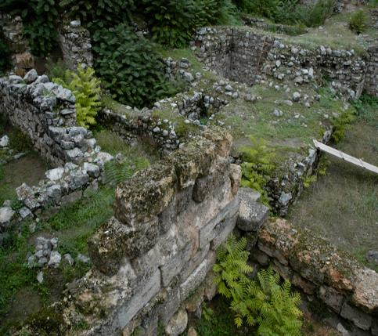
Ruins of Cadmeia Fortress, Thebes

Slide 6
Herodotus (Greek historian, C5 BCE)
Histories Book 1 Chapter 1 Section 1: his aim is to explain the disputes between Greeks and barbarians:
Phoenician traders abduct Io, daughter of Inachus king of Argos
Greeks (?Cretans) abduct Europa, daughter of Agenor king of Tyre
Greeks abduct Medea, daughter of king of Colchis
Paris son of Priam king of Troy abducts Helen, wife of Menelaus king of Sparta

Slide 7
Founding of Thebes
King Agenor of Tyre
Europa taken by Zeus to Crete
Her brother Cadmus searches for her, in vain
Wanders all over
Delphic oracle: follow the heifer till she lies down
To Boeotia: at Dirce – a sacred spring he kills the snake of Ares, on Athena’sorders he sows the teeth
Spartoi (lit. “sown men”) > noble Theban families
Founded Cadmeia, later called Thebes

Slide 8
The Theban or Labdacid saga
Laius son of Labdacus (grandson of Cadmus) abducts Chrysippus son of Pelops king of Elis
Delphic oracle: he is cursed to be killed by his own son
Marries Jocasta, their son Oedipus is mutilated (“Swollen-Foot”) and left to die on Mt Cithaeron
Oedipus is saved and taken to Corinth where he is adopted by the king and queen, Polybus and Merope
Delphic oracle tells him he is fated to kill his father and marry his mother, so he decides never to return to Corinth
At meeting of three ways, road rage incident: kills arrogant old man
Proceeds towards Thebes, solves riddle of Sphinx

Slide 9
Oedipus is welcomed in Thebes which is suffering from plague
He is made king for saving Thebes from Sphinx and he marries the widowed queen
Happy marriage, has four children with her: Eteocles and Polynices, Antigone and Ismene
Because of plague, Delphic oracle consulted: pollution caused by presence of murderer of King Laius must be cleansed
Discovers he has fulfilled the oracle unwittingly
Blinds himself, Jocasta commits suicide [in some versions]
Oedipus goes into exile accompanied by daughter Antigone, leaving Creon (Jocasta’s brother) ruling Thebes
Later dies on Mt Cithaeron OR at Colonus in Attica
Sophocles’ tragedies:
Oedipus the King = Oedipus Tyrannus = Oedipus Rex
Oedipus at Colonus

Slide 10
Oedipus curses his sons Eteocles and Polynices so that they compete to rule Thebes
Excluded by Eteocles, Polynices goes to Argos, raises an army to seize Thebes: the “Seven Against Thebes” (Aeschylus tragedy) fight at the seven gates of Thebes
The brothers kill one another - split flames on their funeral pyre
Antigone buries Polynices’ corpse despite this being forbidden by Creon (Sophocles’ tragedy Antigone)
She is sentenced to death by Creon despite being engaged to his son Haemon
Later the Epigoni (“The Descendants”) of the Seven Against Thebes return to destroy the by-now abandoned city of Thebes

Slide 12
OEDIPUS MYTH:
GREEK EPIC CYCLE: Oedipodeia
Thebaid
ATHENIAN TRAGEDY: AESCHYLUS
SOPHOCLES
EURIPIDES
ROMAN TRAGEDY: ACCIUS (2nd C BCE) [fragments]
SENECA (1st C CE): Oedipus, Phoenician Women
ROMAN EPIC: STATIUS (1st C CE): Thebaid

Slide 13
MEDIEVAL ROMANCE: Roman de Thébes
RENAISSANCE EPIC: Boccaccio (14th C CE)
RENAISSANCE DRAMA: Dolce Giocasta (1560)
Corneille Oedipe (1678)
Racine La Thébaïde (1664)
Dryden & Lee Oedipus (1678)
Voltaire Oedipe (1718)
19th CENTURY ANALYSIS: Hölderlin (1804)
Hegel (1831)
Wagner (1868)
19th CENTURY ART: Ingres (1808) and much more

Slide 14
20TH CENTURY: Freud The Ego and the Id (1923)
Freud “The Dissolution of the Oedipus Complex” (1924)
Stravinsky Oedipus Rex (1927)
Gide Oedipe (1932)
Cocteau The Infernal Machine (1934)
Martha Graham Night Journey (1947)
Anouilh Oedipus or the Lame King (1978)
21st CENTURY: Oedipus starring vegetables: YouTube
http://vimeo.com/19152100 or http://www.wishnow.com

Slide 15
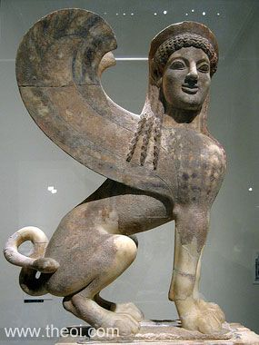
Sphinx, Archaic Greek statue (ca. 540 BCE)
Notes:
Human face – lion’s body – wings; “strangler”; riddle

Slide 16
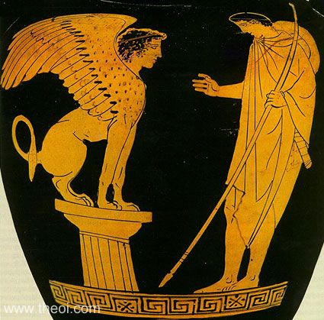
Oedipus and the Sphinx, Attic red-figure kylix (ca 450-440 BCE)

Slide 17
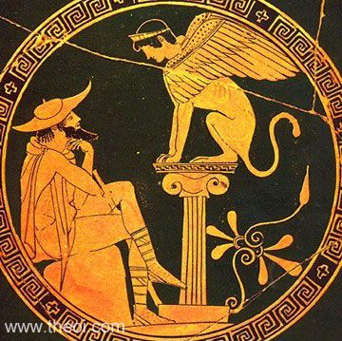
Oedipus and the Sphinx, Attic red-figure kylix

Slide 18
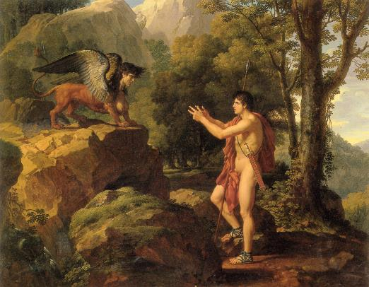
Oedipus and the Sphinx, Francoise Xavier Fabre, 1806-10

Slide 19
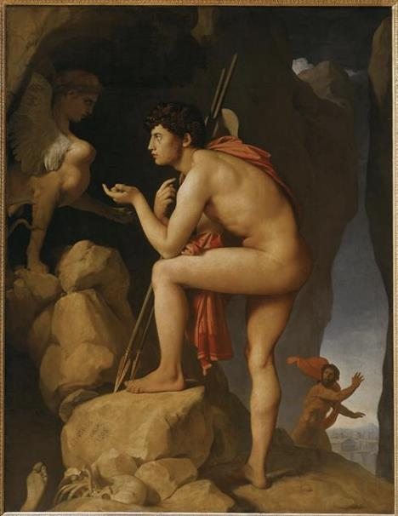
Oedipus and the Sphinx by Jean-Auguste-Dominique Ingres (1808)

Slide 20
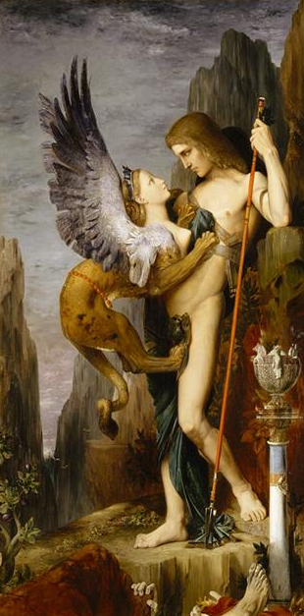
Oedipus and the Sphinx by Gustave Moreau (1864)

Slide 21
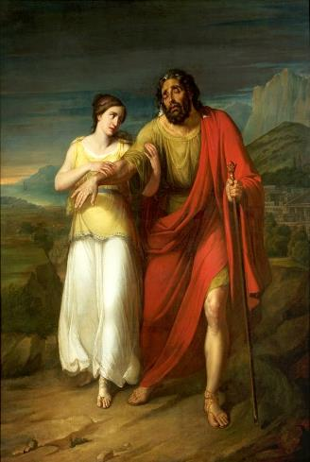
Oedipus and Jocasta
Oedipus and Antigone,
Antoni Brodowski, 1828

Slide 22
Oedipe et Antigone s'exilant de Thèbes Louis Duveau, 1843

Slide 23
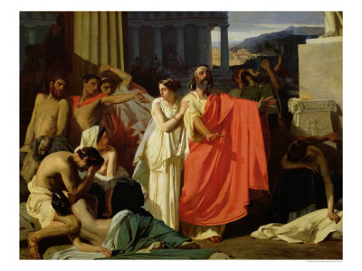
Oedipus and Antigone Being Exiled,
Ernest Hillemacher, 1843

Slide 24
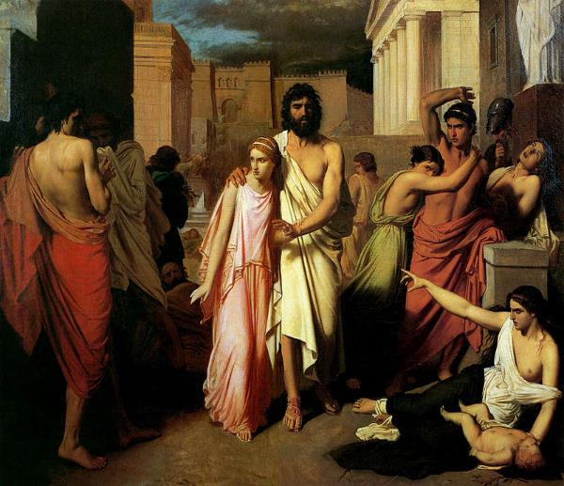
The Plague of Thebes
by Charles Jalabert
(1819-1901)

Slide 25
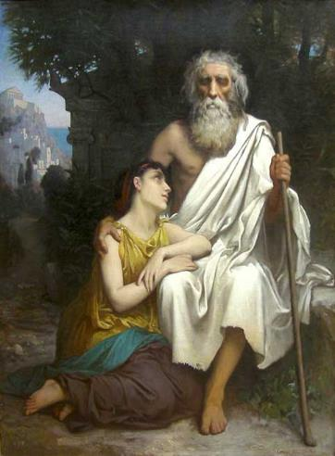
Oedipus and Antigone (Camille Felix Bellanger)

Slide 26
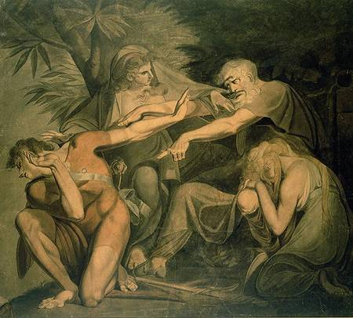
Oedipus Cursing His Son Polynices
Johann Heinrich Füssli, 1777

Slide 27
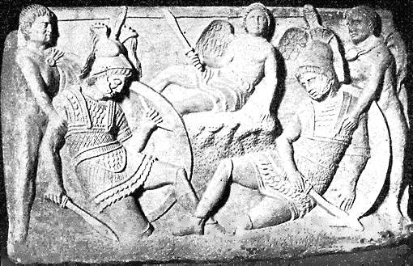
The Seven Against Thebes, Sarcophagus

Slide 28
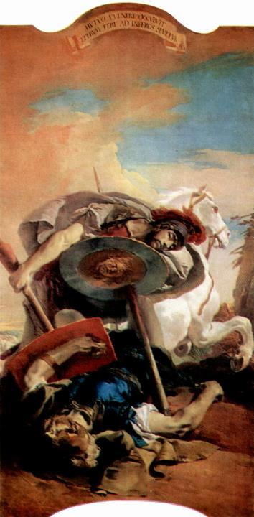
Eteocles and Polynices,
by Giovanni Battista Tiepolo
1696-1770

Slide 29
Antigone. Marie Spartali Stillman, 1844-1927

Slide 30
Antigone in front of the dead Polyneices. Nikiforos Lytras, 1865

Slide 31
Antigone et Polynice. Benjamin Constant , 1845-1902

Slide 32
Greek Stamp for International Women’s Year, 1975 The conflict between Antigone and Creon

Slide 33
Some modern adaptations:
-Antigone, play by Jean Cocteau (1889–1963)
-Antigone, full-length album by Heaven Shall Burn (2004)
-Antigone, opera by Carl Orff (1895–1982)
-Antigone, play by Jean Anouilh (1910–1987)
-"Antigone-Legend", for soprano and piano (text by Bertolt Brecht), by Frederic Rzewski (b. 1938)
-Tegonni, An African Antigone by Femi Osofisan (b. 1946)
-Antigone, adaptation of Sophocles' play by Peruvian poet José Watanabe (b. 1946)
-Antigone, comic book by David Hopkins (b. 1977)
-The Burial at Thebes by Seamus Heaney
-The Burial At Thebes (2008) opera by Dominique Le Gendre to a libretto by Seamus Heaney and Derek Walcott
-Antígona Vélez (1950) adaptation of Sophocles' play by Argentinean writer Leopoldo Marechal (1900–1970)
-Antigonai (2009) an opera based on fragments by Sophocles and Hölderlin for three choirs and a women trio by Argentine composer Carlos Stella
-Antigone by Bertolt Brecht, based on the translation by Friedrich Hölderlin and published under the title Antigonemodell 1948.

Slide 34
Timeline
Later Bronze Age, 1600-1100 BCE:
Thebes (Greek mainland)
Mycenae (Greek Peloponnese)
The Trojan War (Asia Minor)
The aftermath of the Trojan War

Slide 35
Hisarlik, Turkey – Dardanelles

Slide 36
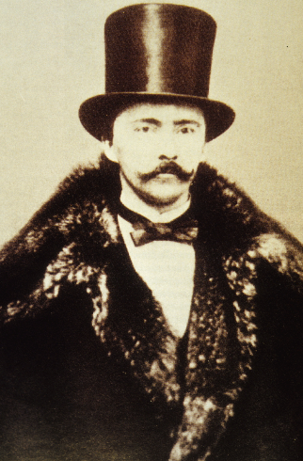
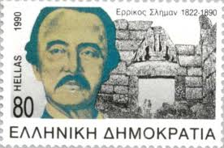
Heinrich Schliemann
Notes:
Excavation 1870-73, 1879-90

Slide 37
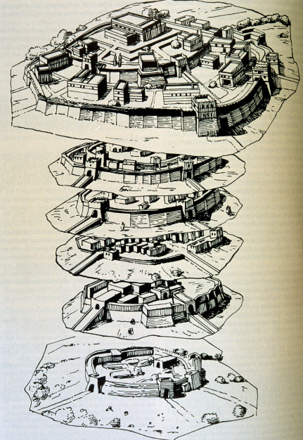
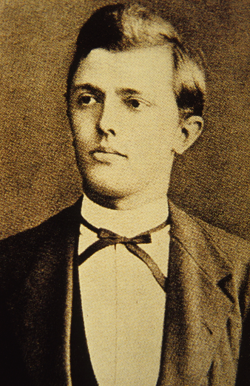
Wilhelm Dörpfeld and stratigraphy;
traditional date of fall of Troy: 1184 BCE
Notes:
Architect, worked with Schliemann and continued after his death: nine settlements on site: Troy I Early Bronze Age 2920-2450 BCE > restored by Romans = Troy IX C1 CE; Troy VI identified as the Troy of the Trojan War 1700-1250 BCE but destroyed actually by earthquake; Troy VII has signs of siege and fire around 1150 BCE; trad date of sack of Troy 1184 BCE

Slide 38
Massive trench bulldozed across Troy in 1872

Slide 39
Dörpfeld on the walls of Troy

Slide 40
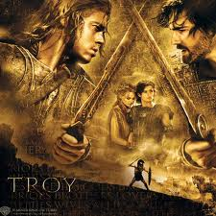
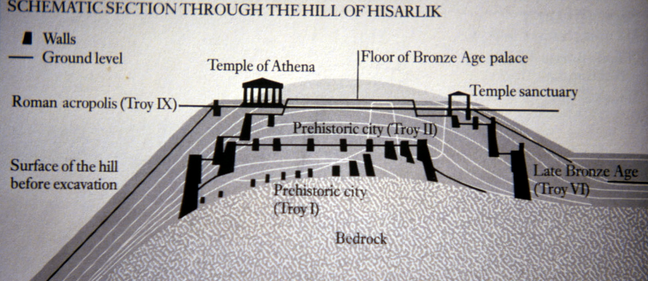
Troy

Slide 41
Complete stratigraphy of Troy

Slide 42
Timeline
Later Bronze Age, 1600-1100 BCE:
Thebes (Greek mainland)
Mycenae (Greek Peloponnese)
The Trojan War (Asia Minor)
The aftermath of the Trojan War

Slide 43
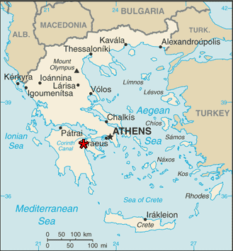
Mycenae

Slide 44
PELOPONNESE = “ISLAND OF PELOPS”

Slide 45
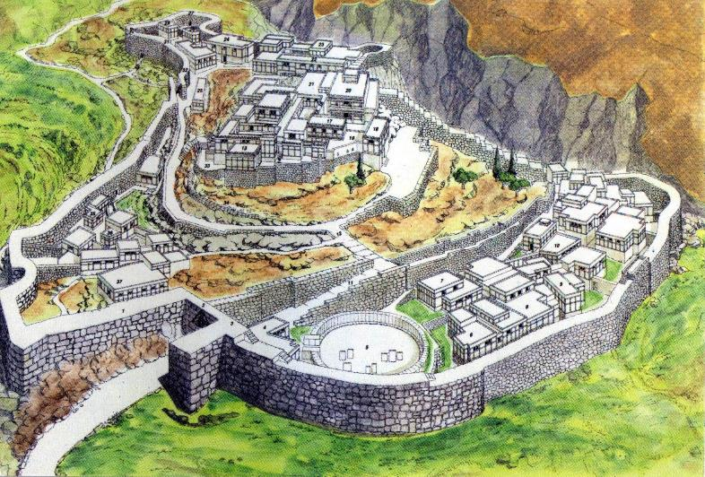

Slide 46
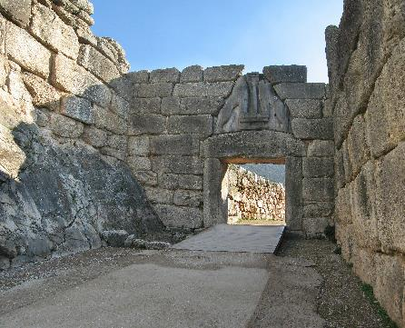
Lions Gate
Mycenae

Slide 47
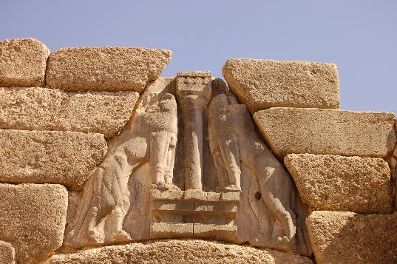
Lions Gate – Mycenae “Cyclopean masonry” cf. Tiryns

Slide 48
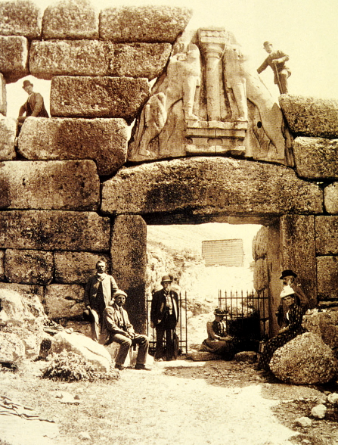
Schliemann
Dörpfeld
Cyclopean
masonry
Lion’s Gate
Notes:
Limestone boulders, no mortar, at Mycenae and Tiryns; excavated 1876 by Schliemann; circle of shaft graves > masks of beaten gold, weapons; tholos tombs like beehives; clay tablets with Linear B from palace at Pylos deciphered in 1950s, later excavations on Crete and at Thebes

Slide 49
Surviving tragedies on Mycenaean saga:
AESCHYLUS 525-456 BCE
Oresteia trilogy 458 BCE
Agamemnon, Libation Bearers, Eumenides
SOPHOCLES 496-405 BCE
Electra
EURIPIDES 485-406 BCE
Electra, Iphigenia in Aulis, Iphigenia in Tauris
SENECA 4 BCE – 65 CE
Agamemnon
Thyestes

Slide 50
Five generations:
1. Tantalus
2. Pelops and Hippodamia
3. Thyestes and Atreus
4. Aegisthus, Agamemnon and Menelaus
Clytemnestra and Helen
5. Iphigeneia, Electra, Orestes

Slide 51
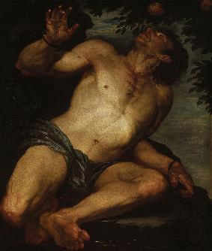
Tantalus Oil painting by Gioacchino Assereto, circa 1640s, Auckland Art Gallery

Slide 52
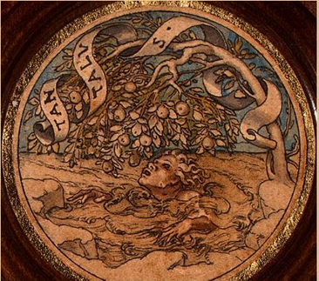
Tantulus
Joseph Heintz, the Elder, 1535

Slide 53
Five generations:
1. Tantalus
2. Pelops and Hippodamia
3. Thyestes and Atreus
4. Aegisthus, Agamemnon and Menelaus
Clytemnestra and Helen
5. Iphigeneia, Electra, Orestes

Slide 54
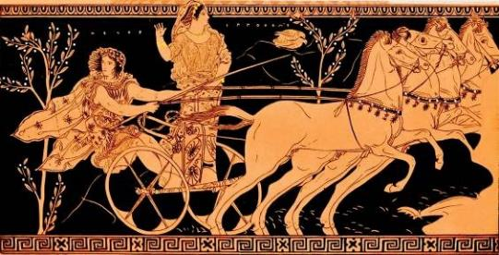
Pelops drives away with Hippodamia, daughter of Oenomaüs.
From an 500 B.C.E. Attic amphora

Slide 55
Five generations:
1. Tantalus
2. Pelops and Hippodamia
3. Thyestes and Atreus
4. Aegisthus, Agamemnon and Menelaus
Clytemnestra and Helen
5. Iphigeneia, Electra, Orestes

Slide 56
ZEUS LEDA TYNDAREUS
POLLUX and CASTOR
HELEN and CLYTEMNESTRA
[THE DIOSCURI]

Slide 57
Clytemnestra & Aegisthus killing Agamemnon, Attic wine-mixing bowl (ca 470 BCE)
MFA Boston

Slide 58
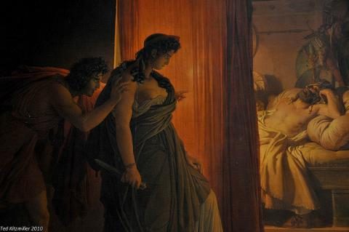
Murder of Agamemnon, Pierre-Narcisse Guérin, 1810, The Louvre

Slide 59
Five generations:
1. Tantalus
2. Pelops and Hippodamia
3. Thyestes and Atreus
4. Aegisthus, Agamemnon and Menelaus
Clytemnestra and Helen
5. Iphigeneia, Electra, Orestes

Slide 60
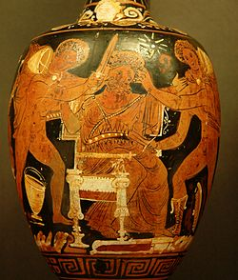
Aegisthus being murdered by Orestes – Wine Jug, 430-400 B.C.E., Greece, The Louvre

Slide 61
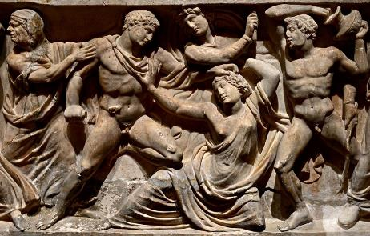
Orestes slaying Aegisthus and Clytemnestra,
Frontal relief of a sarcophagus,
Rome. Marble. Ca. 150 C.E.
Saint-Petersburg, The State Hermitage Museum

Slide 62
JUSTICE
REVENGE
VENDETTA
Aeschylus Agamemnon 990-1:
“The ancient curse is bringing down the house in self-destruction”
What is justice?
Killing your husband in revenge
for his killing your daughter?
Killing your mother in revenge
for her killing your father?
Is the child the child of the mother or the father?

Slide 63
Amos and Kip

Slide 64
GO TO HELL

Slide 65
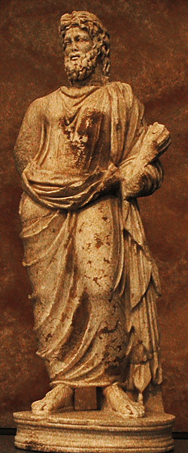
Hades as Pluto (1st century CE Roman copy of a Greek original)

Slide 66
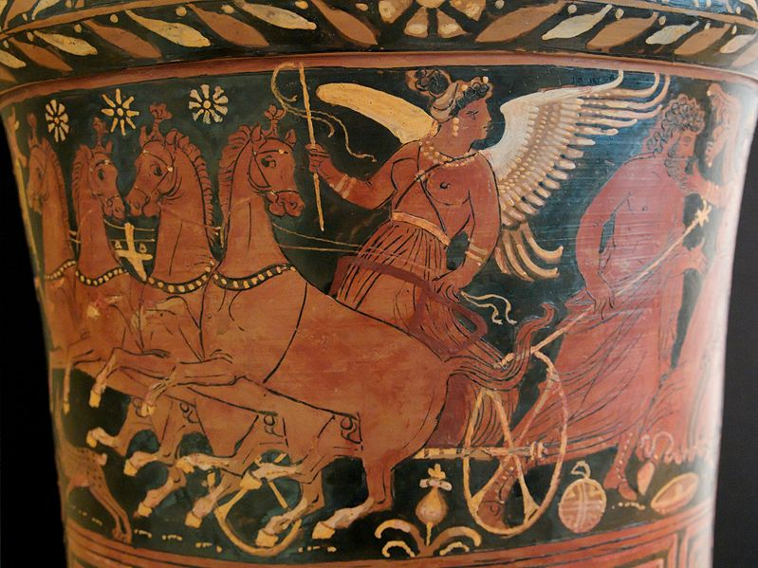
The horses of Hades (winged Fury as charioteer; Apulian red figure c. 330 BCE)

Slide 67
Notes:
Vertical cosmos

Slide 68
THE REALM OF HADES
aka TARTARUS or EREBUS
RIVERS: STYX
ACHERON
COCYTUS
PHLEGETHON
LETHE
TARTARUS – place of punishment
ELYSIUM - ELYSIAN FIELDS

Slide 69
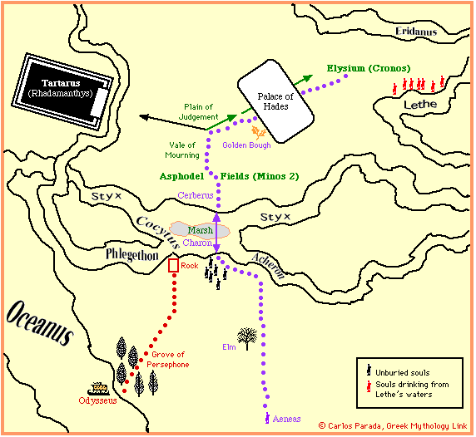
Notes:
Aka “Isles of the Blest”
The Underworld is a moral place

Slide 70
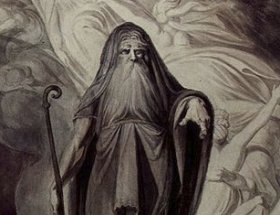
The Underworld According to Homer’s Odyssey

Slide 71
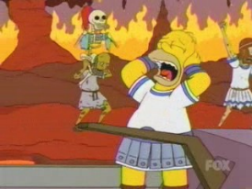
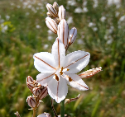
Physical Features
At the extremities of existence:
Along banks of Okeanos
Beyond the sun; region of perpetual darkness and fog
Landscape:
Shores of the Underworld:
Grove of Persephone
Rock at confluence of Cocytos, Phlegethon, Acheron
Asphodel meadows
Halls of Hades
Places of punishment
Notes:
Far north

Slide 72
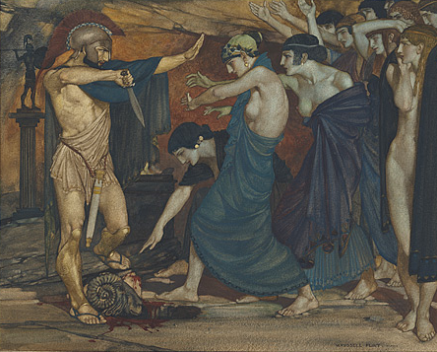
William Russell Flint (Scottish illustrator)
Odysseus in Hades
1914
National Gallery of Australia, Canberra

Slide 73
Stradanus (Johan van der Straet, Flemish painter)
Odysseus at the Entrance of Hades
c. 1600-1605

Slide 74
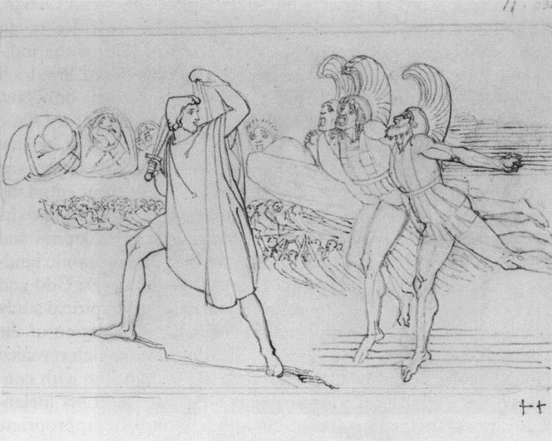
John Flaxman (British sculptor and illustrator)
Odysseus in the Underworld
1792

Slide 75
HADES – PLUTO – DIS
PERSEPHONE/PROSERPINA
chthonic deities

Slide 76
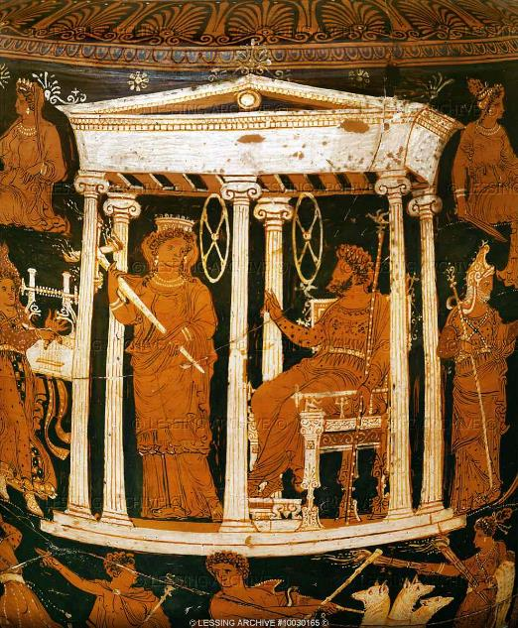
Red figure krater (330 BCE) (detail)

Slide 77
HERMES
PSYCHOPOMPOS
Notes:
Only god who goes there

Slide 78
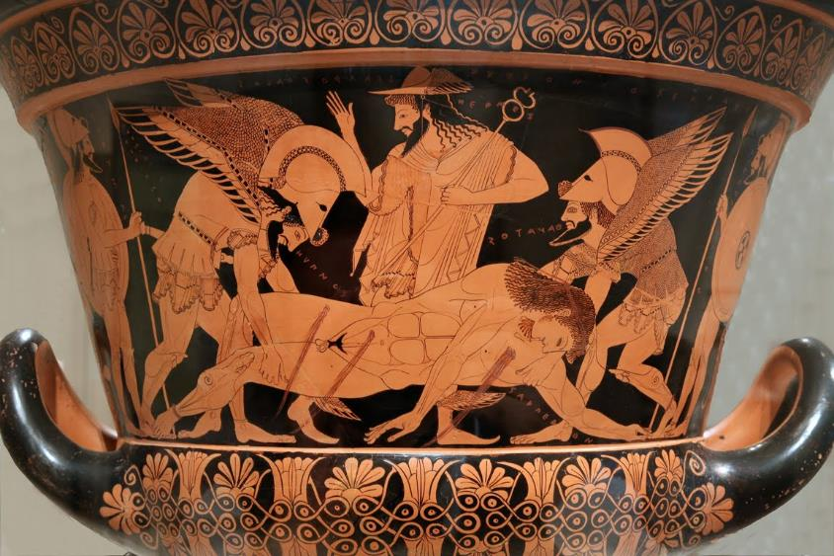
Sarpedon being carried off by Thanatos, Hypnos, and Hermes, krater (510 BCE)

Slide 79
CHARON

Slide 80
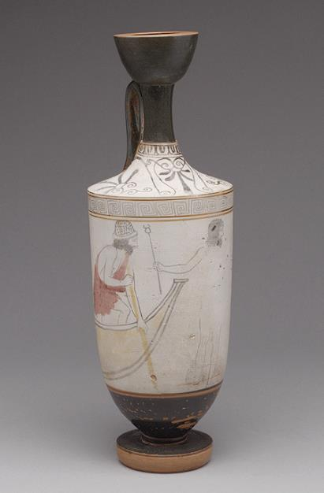
Charon on Attic white-ground lekythos, Classical

Slide 81
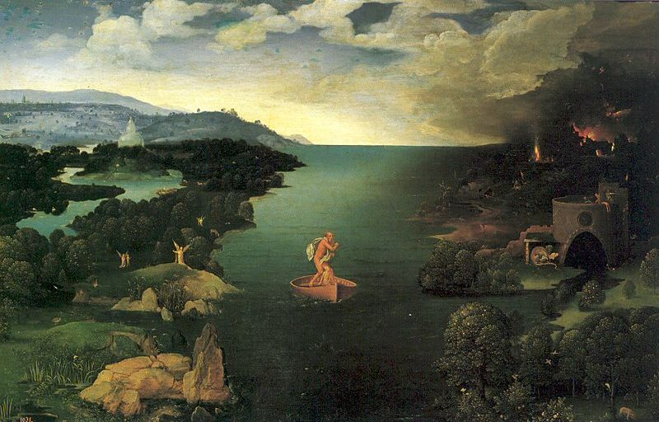
Charon Crossing the Styx by Joachim Patinir

Slide 82
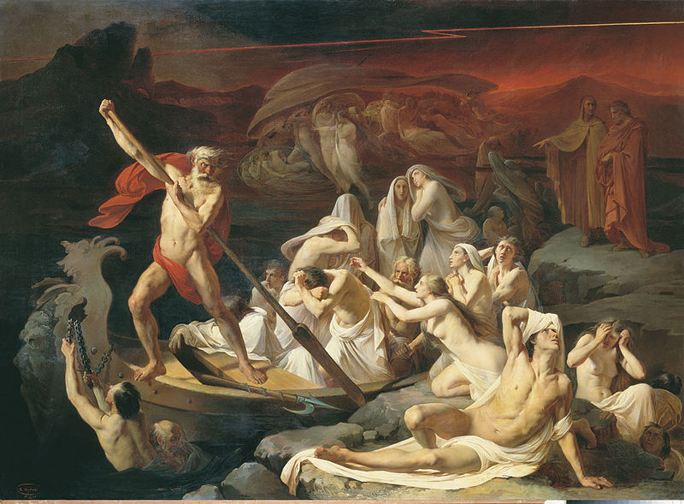
Crossing the River Styx by Alexander Dmitrievich Litovchenko (1861)

Slide 83
CERBERUS

Slide 84
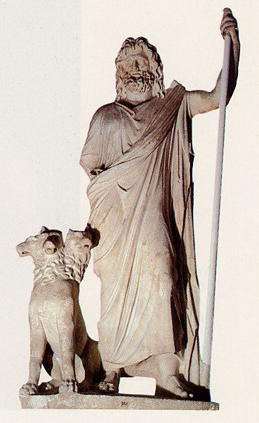
Hades and Cerberus

Slide 85
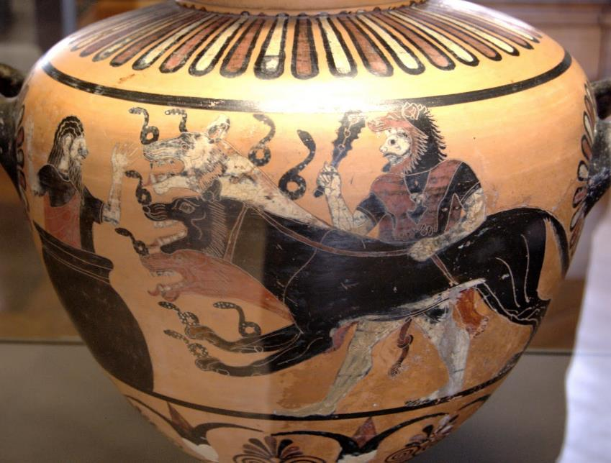
Black-figure hydria by Eagle Painter (525 BCE)

Slide 86
Cerberum domat Hercules by Antonion Tempesta (1600)

Slide 87
William Blake, Cerberus (1825-7)

Slide 88
Bess & Eddie, miniature dachshunds

Slide 89
MINOS

Slide 90
Rhadamanthys, and Minos (on throne), and Aeacus in the underworld on Apulian Red-figure krater (ca 330-310 BCE)

Slide 91
Hubristic Sinners
Tityus
Crime: Attempted rape of Leto
Punishment: Liver devoured
Tantalus
Crime: Kin slaying, cannibalism
Punishment: Eternal hunger, thirst
Sisyphus
Crime: Hubristic craftiness
Punishment: Futile labor
Notes:
Tityus son of Gaia; Tantalus son of Zeus, serves up son Pelops at banquet of gods; Sisyphus killed guests

Slide 92
Tantalus by Gioacchino Assereto

Slide 93
Sisyphus, supervised by Persephone on Attic black-figure amphora (ca. 530 BC)

Slide 94
IXION – killed father-in-law; Zeus took him to Olympus where he lusted after Hera; Zeus made a cloud looking like Hera which Ixion had sex with, then threw him out of Olympus and had him bound to a fiery wheel for eternity; offspring of copulation with cloud were Centaurs
DANAIDS – daughters of Danaus; killed husbands on wedding-night, punished by carrying water in sieve/leaking pots for ever

Slide 95
The Danaïds, John William Waterhouse, 1903

Slide 96
Plato Republic Book 10 (Myth of Er)
‘Everyone had to suffer an appropriate penalty for each and every sin ten times over, in retribution for the number of times and the number of persons he had wronged … if they had done good deeds and were just and holy, in the same proportion they were given a worthy reward.’

Slide 97
The souls then meet the Fates (Moirai), daughters of Necessity: Lachesis, Clotho and Atropos.
The lots are cast and the soul with the first lot gets to choose his next life from the entire range: men, women, animals, long lives, short lives, famous, infamous and so on.
Examples: former soul of Orpheus did not want to be born a woman; former soul of Ajax chose lion because did not want to be born a man; former soul of Atalanta chose life of male athlete; former soul of Odysseus chose life of an ordinary man
After their choices have been ratified by the Fates, the souls drink from river Lethe and then are reborn

Slide 98
KATABASIS (descent)
Heracles – Cerberus – 12th Labour
Theseus & Pirithoüs – Persephone
Orpheus – Eurydice
Aeneas - Anchises

Slide 99
Hercules Taming Cerberus by Peter Paul Rubens (1577-1640)

Slide 100
Orpheus and Cerberus by Thomas Crawford (1843)

Slide 101
Orpheus with lyre surrounded by animals, stone relief (2nd BCE)

Slide 102
Orpheus by Christine de Pisan (C14th-15th)

Slide 103
Orpheus in Hades by Jules Machard (1865)

Slide 104
Orpheus and Eurydice, Roman relief (1st century BCE)

Slide 105
Orpheus and Eurydice by Peter Paul Rubens (1636-8)

Slide 106
Orpheus and Eurydice, Michel Drolling, 1820

Slide 107
Orpheus, son of Apollo
Eurydice
Sue Hubbard ‘Eurydice’ (2004)

Slide 108
VIRGIL’S UNDERWORLD
Aeneid – epic poem written 29-19 BCE – in Book 6, Trojan hero Aeneas goes down to Underworld as instructed by the Sibyl of Cumae, to meet his dead father Anchises – to be permitted to enter the Underworld he must first pluck the Golden Bough in the forest – this gives name to Sir James Frazer’s exploration of comparative mythology in The Golden Bough (1890 onwards)

Slide 110
Cumae

Slide 111
Cumae

Slide 112
Cumae
Entrance to the Sibyl’s cave

Slide 113
Aeneas with the Sibyl and Charon by Giuseppe Maria Crespi

Slide 114
Virgil Aeneid Book 6 – the Sibyl of Cumae
Here are imprisoned and await punishment those who hated their brothers … or struck a parent and devised guile against a dependent or who hovered over their acquired wealth all alone and did not share it with their relatives … and those who were killed for adultery or took up arms in an impious cause and were not afraid to betray the pledges made to their masters. … All dared enormous crime and were successful in the attainment of their daring. I should not be able to recount all the forms of wickedness or enumerate all the names of the punishments if I had a hundred tongues and a hundred mouths.

Slide 115
Virgil Aeneid Book 6 cont.
Then at last they came to the happy places, the pleasant green glades of the Woods of the Fortunate, the home of the blessed. Here air that is more pure and abundant clothes the plains in soft-colored light and they have their own sun and their own stars. Some exercise their limbs on the grassy wrestling grounds, vie in sport, and grapple on the yellow sand. Others dance in a chorus and sing songs …

Slide 116
Then father Anchises replied: “The souls to which bodies are owed by Fate at the stream of Lethe drink waters that release them from previous cares and bring everlasting forgetfulness. Indeed I have desired for a long time to tell you about these souls, to show them before your very eyes, and to list the number of my descendants; now all the more may you rejoice with me that you have found Italy. … When the last glimmer of life has gone, all the evils and all the diseases of the body do not yet completely depart from these poor souls; … many ills, for a long time encrusted, become deeply ingrained in an amazing way.

Slide 117
Therefore they are plied with punishments, and they pay the penalties of their former wickedness … until a long period of the circle of time has removed the ingrown corruption and has left pure etherial spirit and the first of the original essence. … When the souls have completed the cycle of one thousand years, the god calls all these in a great throng to the river Lethe, where they are made to forget so that they might begin to wish to return to bodies and see again the vault of heaven.”

Slide 118
Ideas that inform Virgil’s picture of the afterlife:
Homer
Plato’s Myth of Er in Republic 10
Pythagorean ideas
Stoic philosophy
Orphic ideas

Slide 119
Pythagoreanism - Pythagoras, C6 BCE Greek philosopher, founded a school and a philosophical system. His teaching was ethical, religious, and mystical. Metempsychosis / transmigration = the soul (human and animal) passes from one body to another body; hence vegetarianism and rituals of purification thought to promote superior reincarnation
Orphism – ancient Greek mystic cult, supposedly drawn from writings of Orpheus, Orphic hymns; soul was a fallen god, which might be restored by a system of “purifications” (katharmoi) and “rituals” (orgia); the physical body (soma) was a prison-chamber for the soul (psyche); Orphic saying: sōma sēma, “the body is tomb”

Slide 120
Virgil’s influence on later European thought
Dante (1265-1321)
The Divine Comedy
Inferno – Virgil is Dante’s guide!
Purgatorio
Paradiso
Christian world appropriates the pagan view of Hell

Slide 121
For more on the gods of the Underworld including Erinyes (Furies) and Moirae (Fates) see
www.theoi.com

