Slide 1
Greek and Roman mythology:
ancient yet timeless
Susanna Braund
Lecture 1: September 26 2018

Slide 2
Week 1: Creation stories and theories of myth
Week 2: Goddesses – Great Goddess and matriarchal society – Demeter – Hestia - Hera – Athena – Artemis – Aphrodite
Week 3: Gods – rise of the Olympian regime: Zeus, Poseidon, Hades; Apollo, Hermes, Dionysus
Week 4: Human archetypes, male: different types of hero: Heracles, Perseus, Theseus, Achilles, Odysseus, Jason
Week 5: Human archetypes, female: helpful and helpless princesses including Andromeda, Ariadne, Persephone, Medea; resourceful Penelope
Week 6: Troy and archaeology, Thebes and Oedipus, Mycenae and Agamemnon; the Underworld – topography and symbolism

Slide 3
Creation myths
Narrative of beginnings of a people/culture - how the world began, how people first came into it, how it is ordered/structured
Oral tradition - most cultures have them - often considered sacred narratives conveying profound truths
Common features:
stories with plot and characters - deities, human-like figures, or animals, who often speak and transform easily
set in a nonspecific past
reveal central worldview of the culture
describe chaos > cosmos

Slide 4
Creation myths: typical patterns
Creation ex nihilo in which the creation is through thought/word/dream/ bodily secretions of divine being
Earth diver creation in which a diver, usually a bird sent by a creator, plunges to the seabed through a primordial ocean to bring up sand or mud which develops into a terrestrial world
Emergence myths in which ancestors pass through a series of worlds and metamorphoses until reaching the present world
Creation by the dismemberment of a primordial being or the splitting of a primordial unity such as the cracking of a cosmic egg or bringing form from chaos

Slide 5
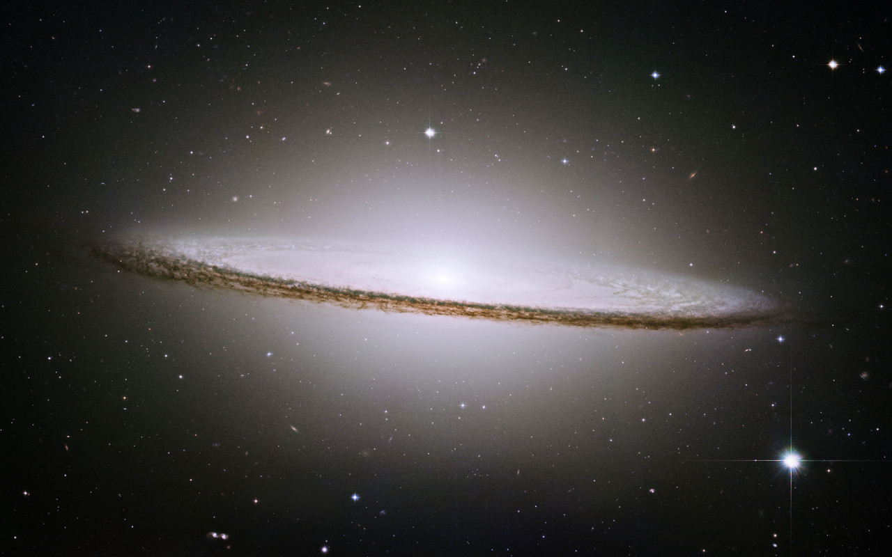

Slide 6
In the beginning God created the heavens and the earth. Now the earth was formless and empty, darkness was over the surface of the deep, and the Spirit of God was hovering over the waters.
And God said, “Let there be light,” and there was light. God saw that the light was good, and he separated the light from the darkness. God called the light “day,” and the darkness he called “night.” And there was evening, and there was morning—the first day.
-Genesis 1:1-3

Slide 7
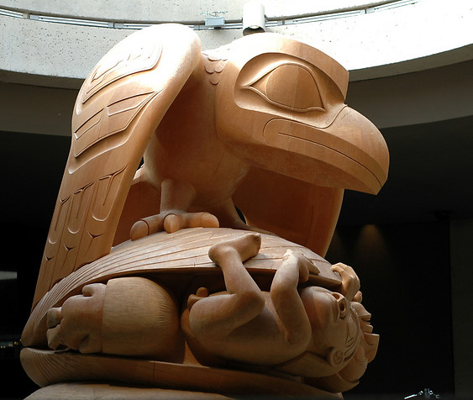
Raven and the First Men by Bill Reid (1978-80), Haida nation

Slide 8
MONOTHEISM
POLYTHEISM
Greek: theos/thea
PANTHEON

Slide 9
BABYLONIAN EPIC ENUMA ELISH:
APSU
TIAMAT
MARDUK

Slide 10
EGYPTIAN CREATION STORY
NU
SHU
GEB
OSIRIS
SETH
ATUM
TEFNUT
NUT
ISIS
NEPHTHYS
HORUS

Slide 11
PTAH
(hence EGYPT = TEMPLE OF PTAH)

Slide 12
Hawaiian Kumulipo
At the time that turned the heat of the earth,
At the time when the heavens turned and changed,
At the time when the light of the sun was subdued
To cause light to break forth,
At the time of the night of Makalii (winter)
Then began the slime which established the earth,
The source of deepest darkness, of the depth of darkness,
The source of Night, of the depth of night
Of the depth of darkness,
Of the darkness of the sun in the depth of night,
Night is come,
Born is Night

Slide 13
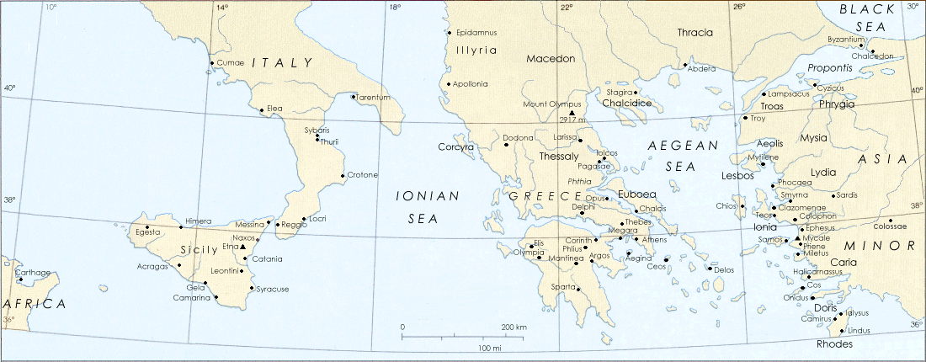
The Ancient Greek World

Slide 14
COSMOGONY =
Gr. cosmos + gonos
COSMOLOGY=
Gk. cosmos + logos

Slide 15
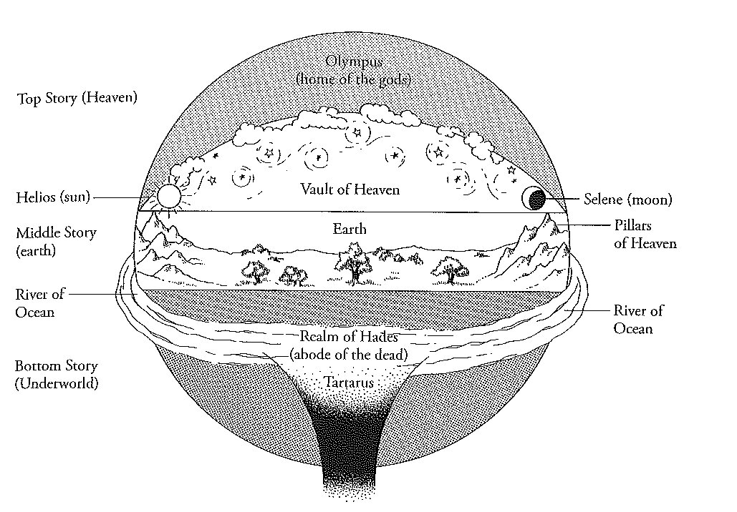

Slide 16
HESIOD
THEOGONY
WORKS & DAYS
Gr. theo + gonos

Slide 17
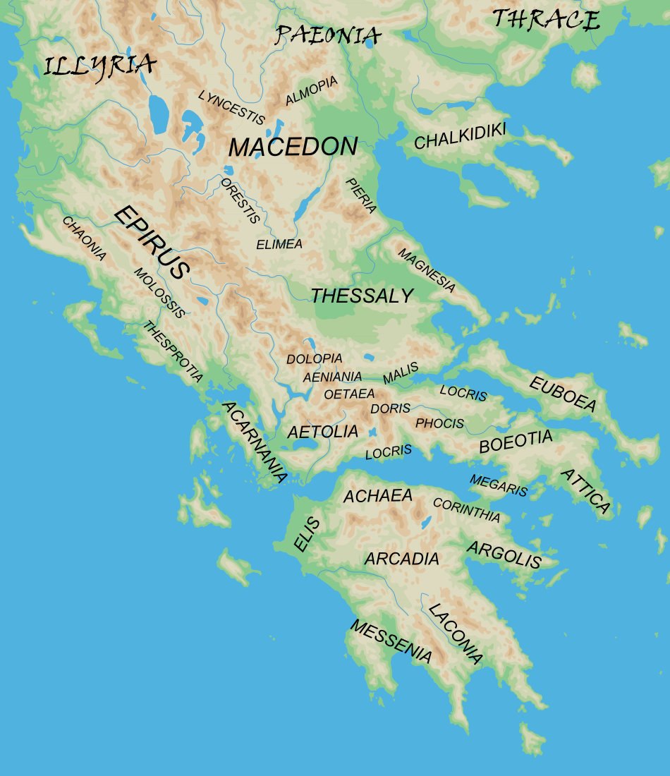

Slide 18
Hesiod Theogony opening
From the Heliconian Muses let us begin to sing, who hold the great and holy mount of Helicon, and dance on soft feet about the deep-blue spring and the altar of the almighty son of Cronos, and, when they have washed their tender bodies in Permessus or in the Horse's Spring or Olmeius, make their fair, lovely dances upon highest Helicon and move with vigorous feet. Thence they arise and go abroad by night, veiled in thick mist, and utter their song with lovely voice…

Slide 19
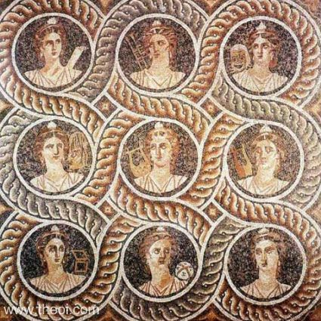
The Nine Muses, ca. 1st C BCE

Slide 20
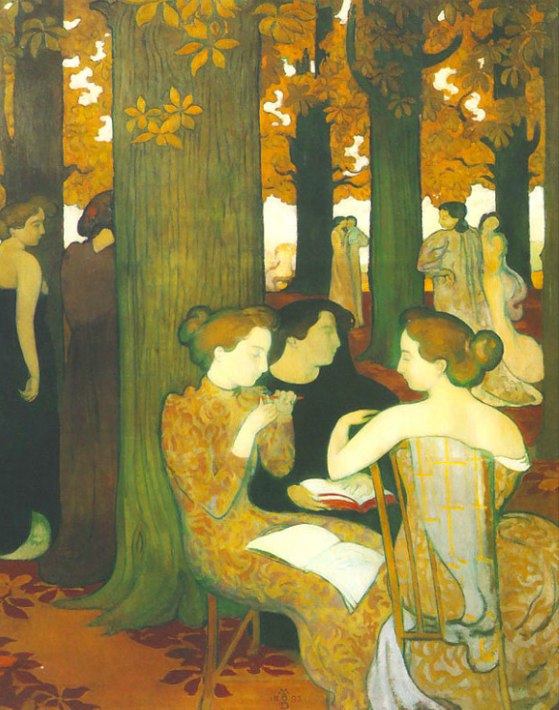
The Muses by Maurice Denis (1893)

Slide 21
Calliopê –
Clio –
Polyhymnia –
Melpomonê –
Thalia –
Erato –
Euterpê –
Terpischorê –
Urania –
Epic poetry
History
Mime
Tragedy
Comedy
Lyric / Love poetry
Flute
Dance
Astronomy

Slide 22
MNEMOSYNE
MEMORY

Slide 23
Hesiod Theogony
And one day they taught Hesiod glorious song while he was shepherding his lambs under holy Helicon, and this word first the goddesses said to me – the Muses of Olympus, daughters of Zeus who holds the aegis: "Shepherds of the wilderness, wretched things of shame, mere bellies, we know how to speak many false things as though they were true; but we know, when we will, to utter true things.”
So said the ready-voiced daughters of great Zeus, and they plucked and gave me a rod, a shoot of sturdy laurel, a marvellous thing, and breathed into me a divine voice to celebrate things that shall be and things there were aforetime; and they bade me sing of the race of the blessed gods that are eternally, but ever to sing of themselves both first and last.

Slide 24
Hesiod Theogony
And so at the first Chaos came to be, but next wide-bosomed Earth, the ever-sure foundations of all the deathless ones who hold the peaks of snowy Olympus, and dim Tartarus in the depth of the wide-pathed Earth (Gaia), and Eros (Love), fairest among the deathless gods, who unnerves the limbs and overcomes the mind and wise counsels of all gods and all men. From Chaos came forth Erebus and black Night; but of Night were born Aether and Day, whom she conceived and bare from union in love with Erebus.

Slide 25
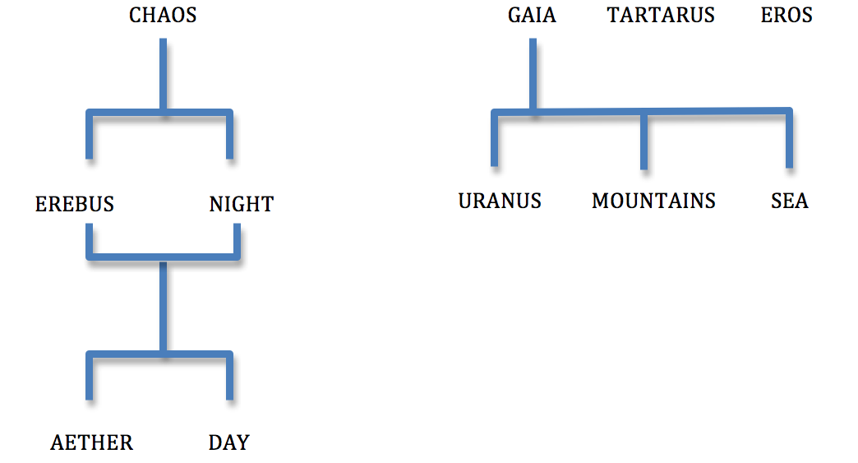

Slide 26
Hesiod Theogony
And so at the first Chaos came to be, but next wide-bosomed Earth, the ever-sure foundations of all the deathless ones who hold the peaks of snowy Olympus, and dim Tartarus in the depth of the wide-pathed Earth, and Eros (Love), fairest among the deathless gods, who unnerves the limbs and overcomes the mind and wise counsels of all gods and all men. From Chaos came forth Erebus and black Night; but of Night were born Aether and Day, whom she conceived and bare from union in love with Erebus.

Slide 27
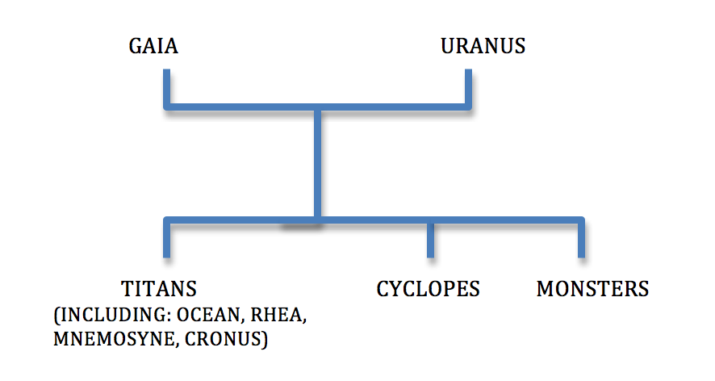

Slide 28
Castration of Uranus
They were hated by their own father from the first and he hid them away in a secret place as soon as each was born and rejoiced in his evil doing. But vast Earth groaned within, and she made the element of flint and shaped a great sickle, and told her plan to her dear sons. And she spoke: “My children, born of a sinful father, if you will obey me, we should punish the vile outrage of your father; for he first thought of doing shameful things.” So she said; but fear seized them all, and none uttered a word. But great Cronos took courage and answered her: “Mother, I will undertake to do this deed, for I reverence not our father, for he first thought of doing shameful things.” So he said: and vast Earth rejoiced greatly, and hid him in an ambush, and put in his hands the jagged sickle, and revealed to him the whole plot. And Heaven (Uranus) came and he lay about Earth (Gaia), spreading himself full upon her. Then the son from his ambush stretched forth his left hand and in his right took the great long sickle with jagged teeth, and swiftly lopped off his own father’s genitals.

Slide 29
Castration of Uranus by his son Cronus
Drops of blood that fall create
the Erinyes (the avenging Furies)
the giants
the nymphs of ash wood
Genitals create Aphrodite

Slide 30
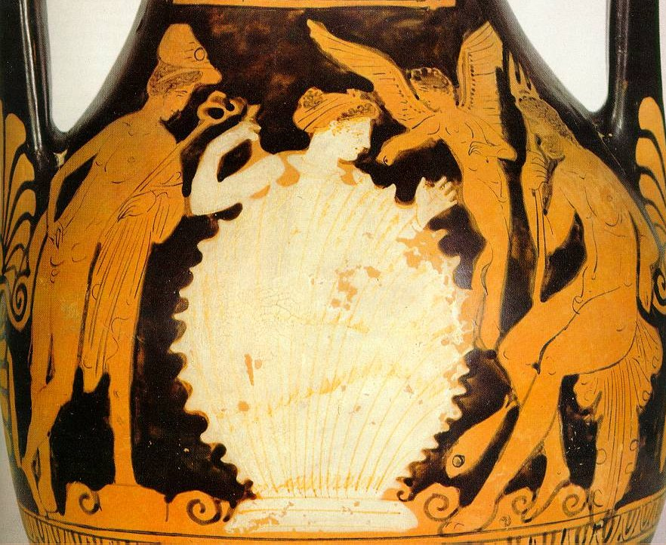
Attic Pelike, ca 370-360 BC

Slide 31
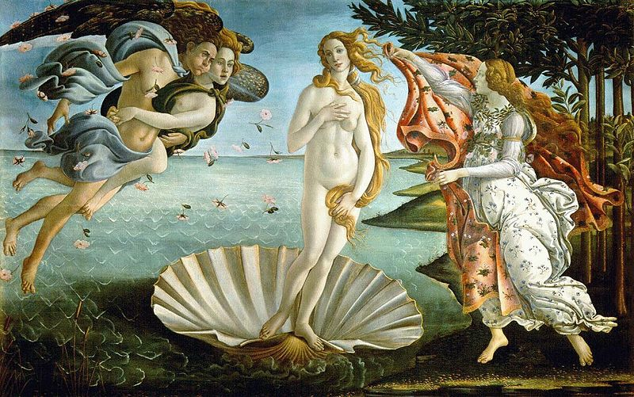
The Birth of Venus by Botticelli, c. 1486

Slide 32
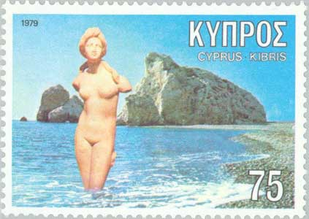

Slide 34
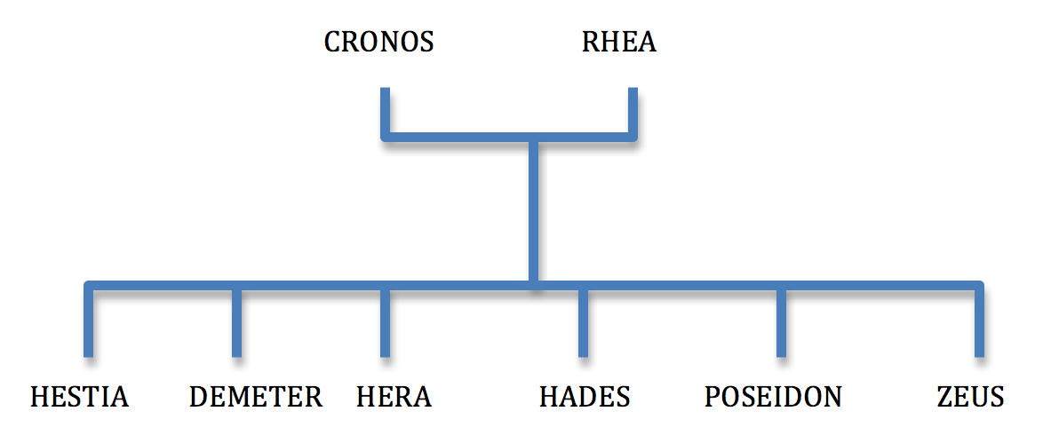

Slide 35
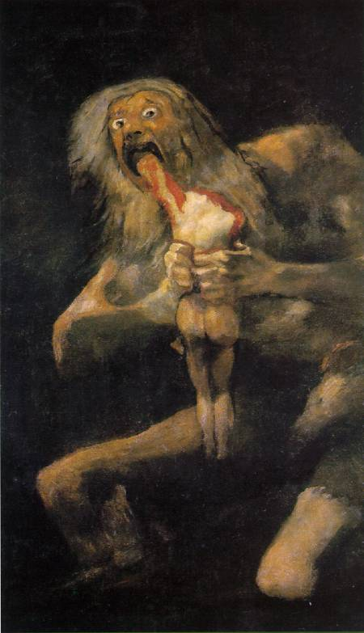
Saturno devorando a un hijo by Goya (1819-23)

Slide 36
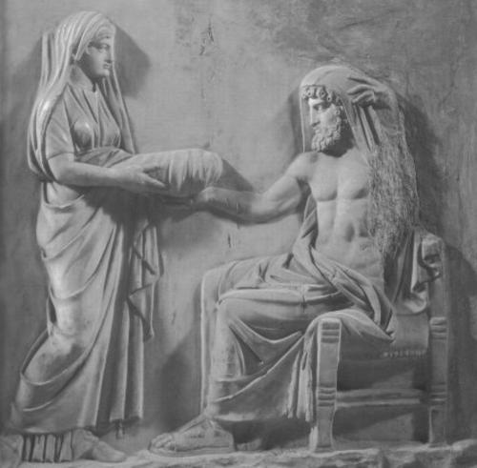
Cronus and Rhea, Greek relief

Slide 37
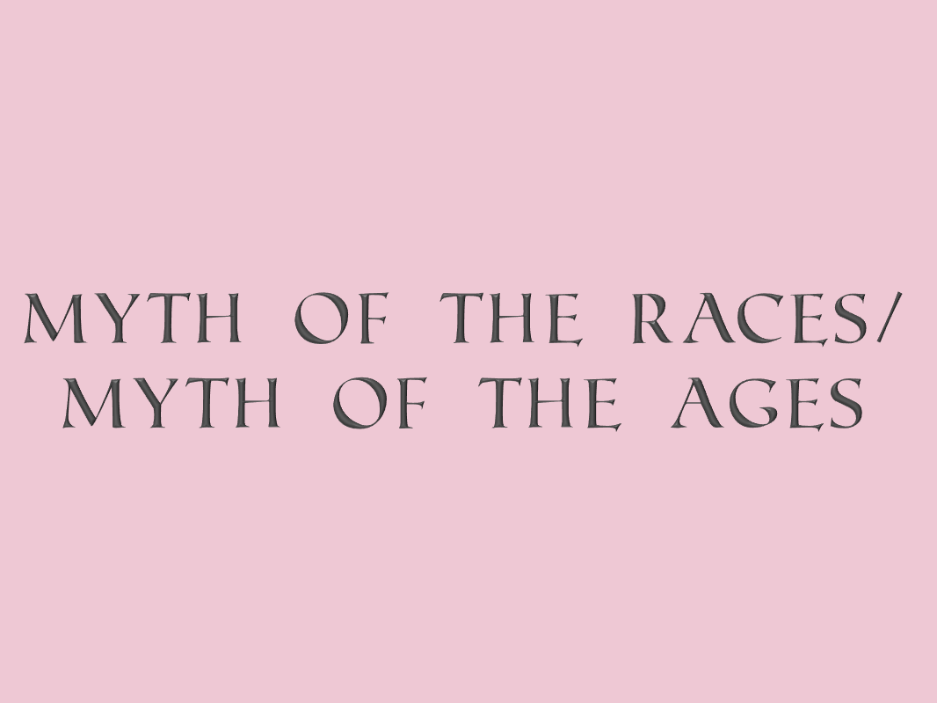

Slide 38
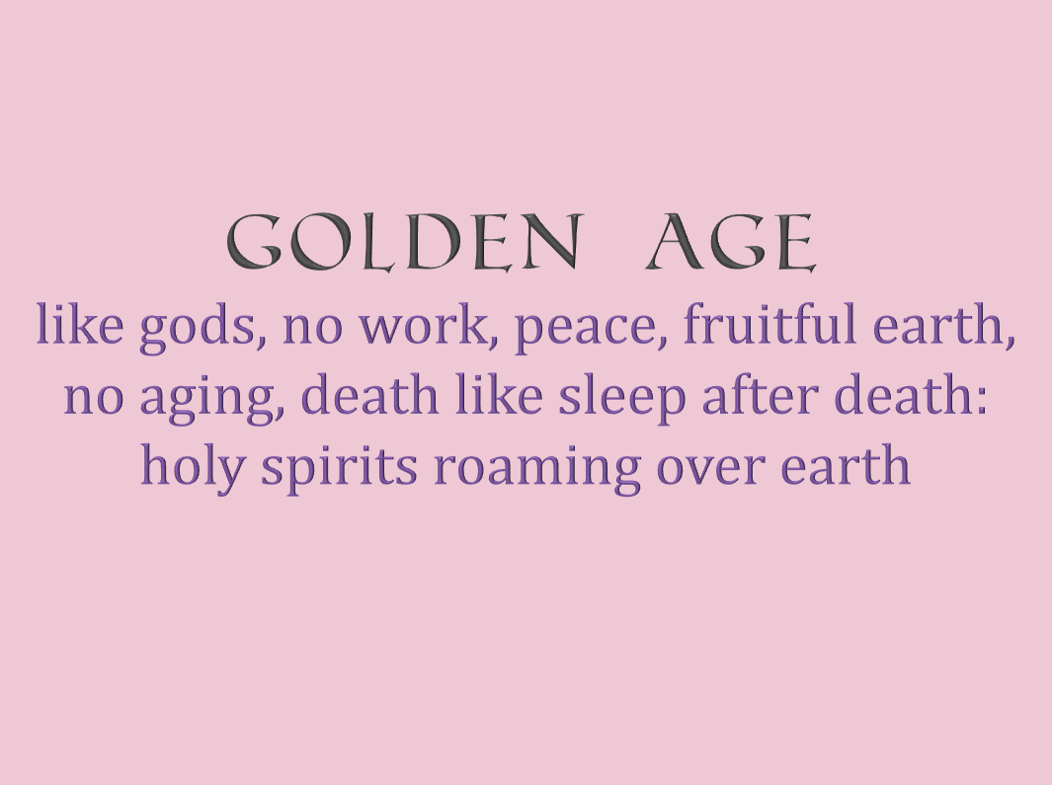
GOLDEN AGE
like gods, no work, peace, fruitful earth, no aging, death like sleep after death: holy spirits roaming over earth

Slide 39
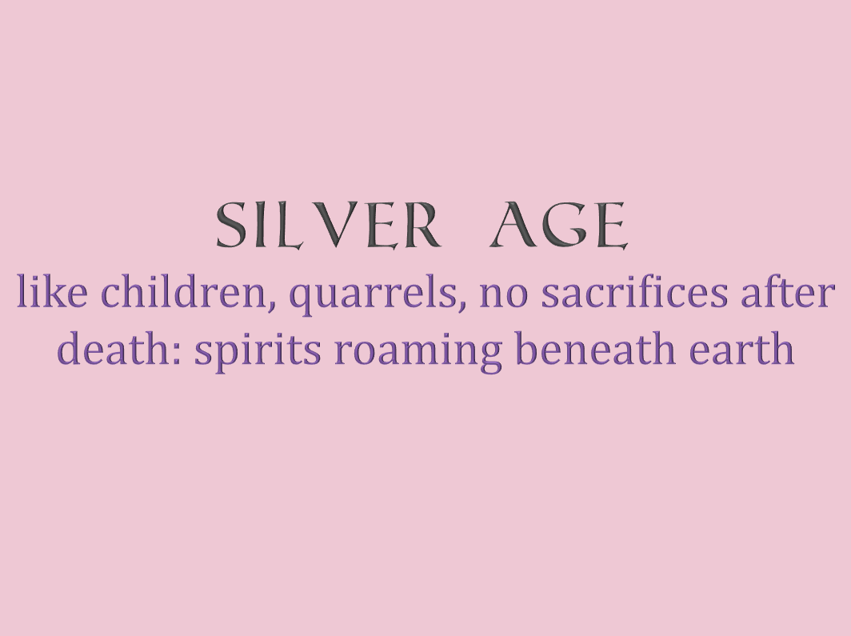
silver AGE
like children, quarrels, no sacrifices after death: spirits roaming beneath earth

Slide 40
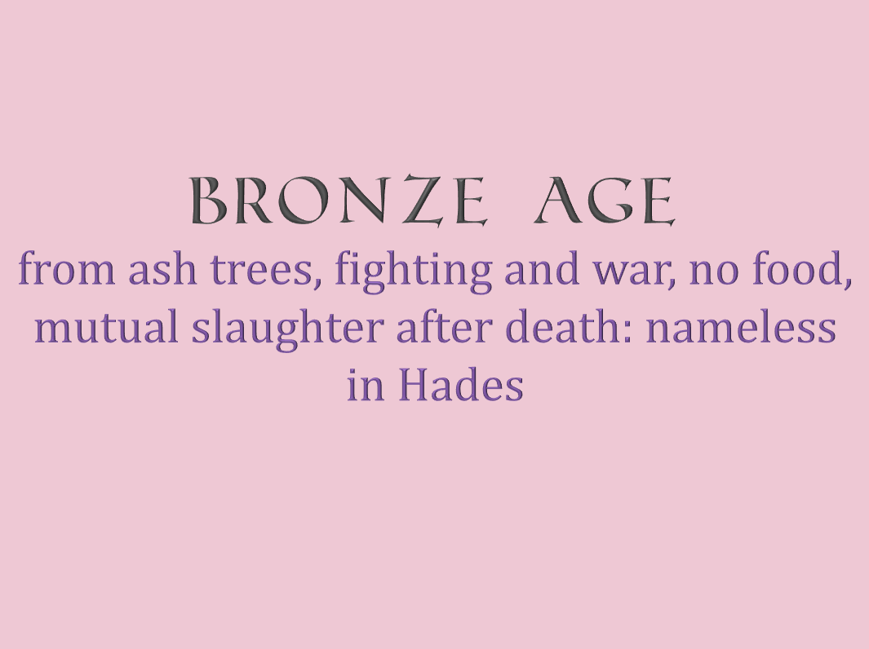
bronze AGE
from ash trees, fighting and war, no food, mutual slaughter after death: nameless in Hades

Slide 41
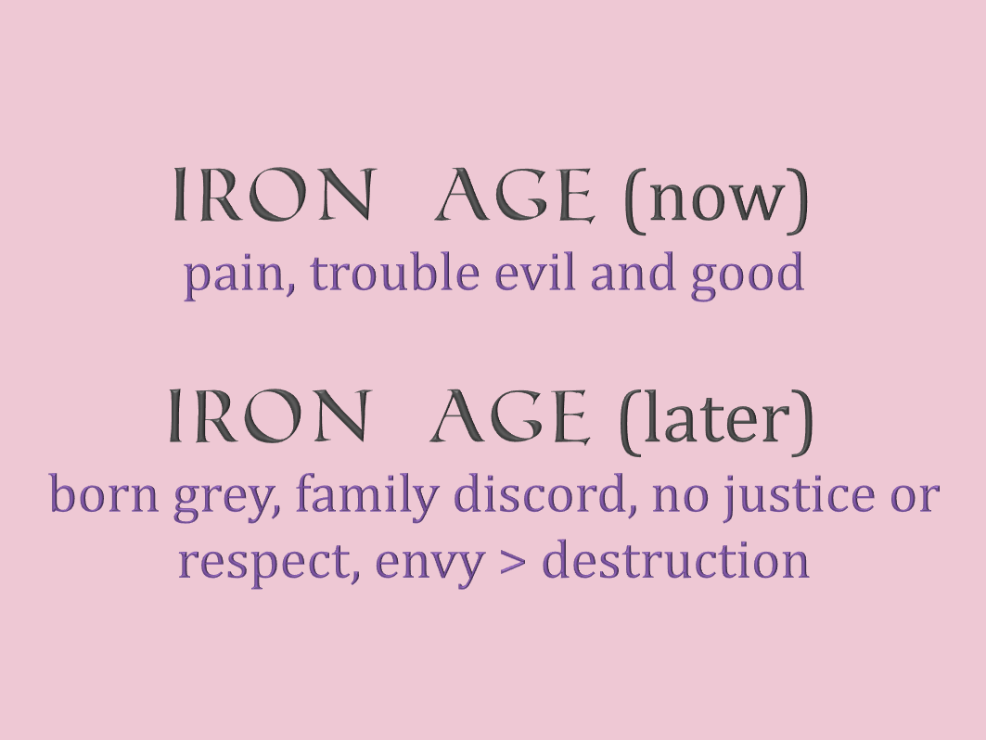
iron AGE (now)
pain, trouble evil and good
iron AGE (later)
born grey, family discord, no justice or respect, envy > destruction

Slide 42
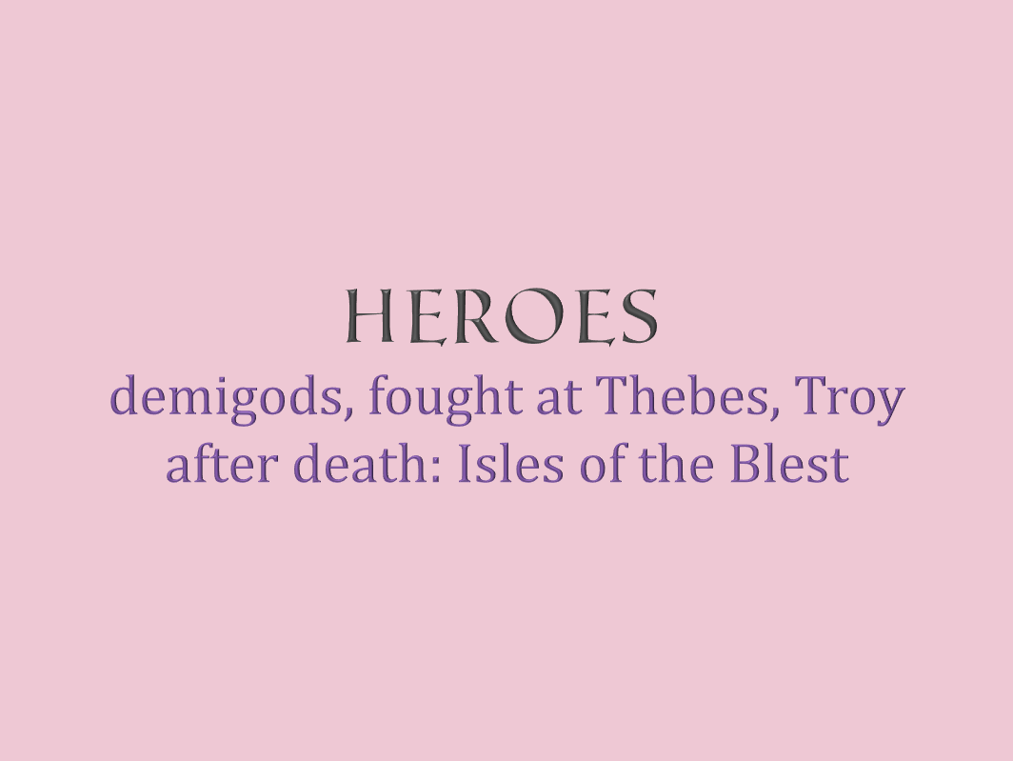
Heroes
demigods, fought at Thebes, Troy
after death: Isles of the Blest

Slide 43
Hesiod Works & Days 106-201:
GOLDEN AGE GOLDEN AGE
SILVER AGE SILVER AGE
BRONZE AGE HEROIC AGE
HEROIC AGE BRONZE AGE
IRON AGE IRON AGE (now)
IRON AGE (later)

Slide 44
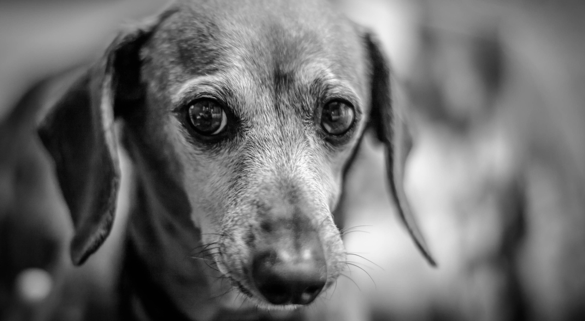
Amos

