Slide 1
Greek mythos/muthos
myth

Slide 2
WALTER BURKERT:
“a traditional tale with secondary, partial reference to something of collective importance”

Slide 3
MYTH
LEGEND
SAGA
FOLKTALE

Slide 4
SACRED TEXT?
JUDAEO-CHRISTIAN BIBLE
ISLAMIC QUR’AN

Slide 5
Parthenon, Athens

Slide 6
Drawing of Phidias’ Athene Parthenos

Slide 7
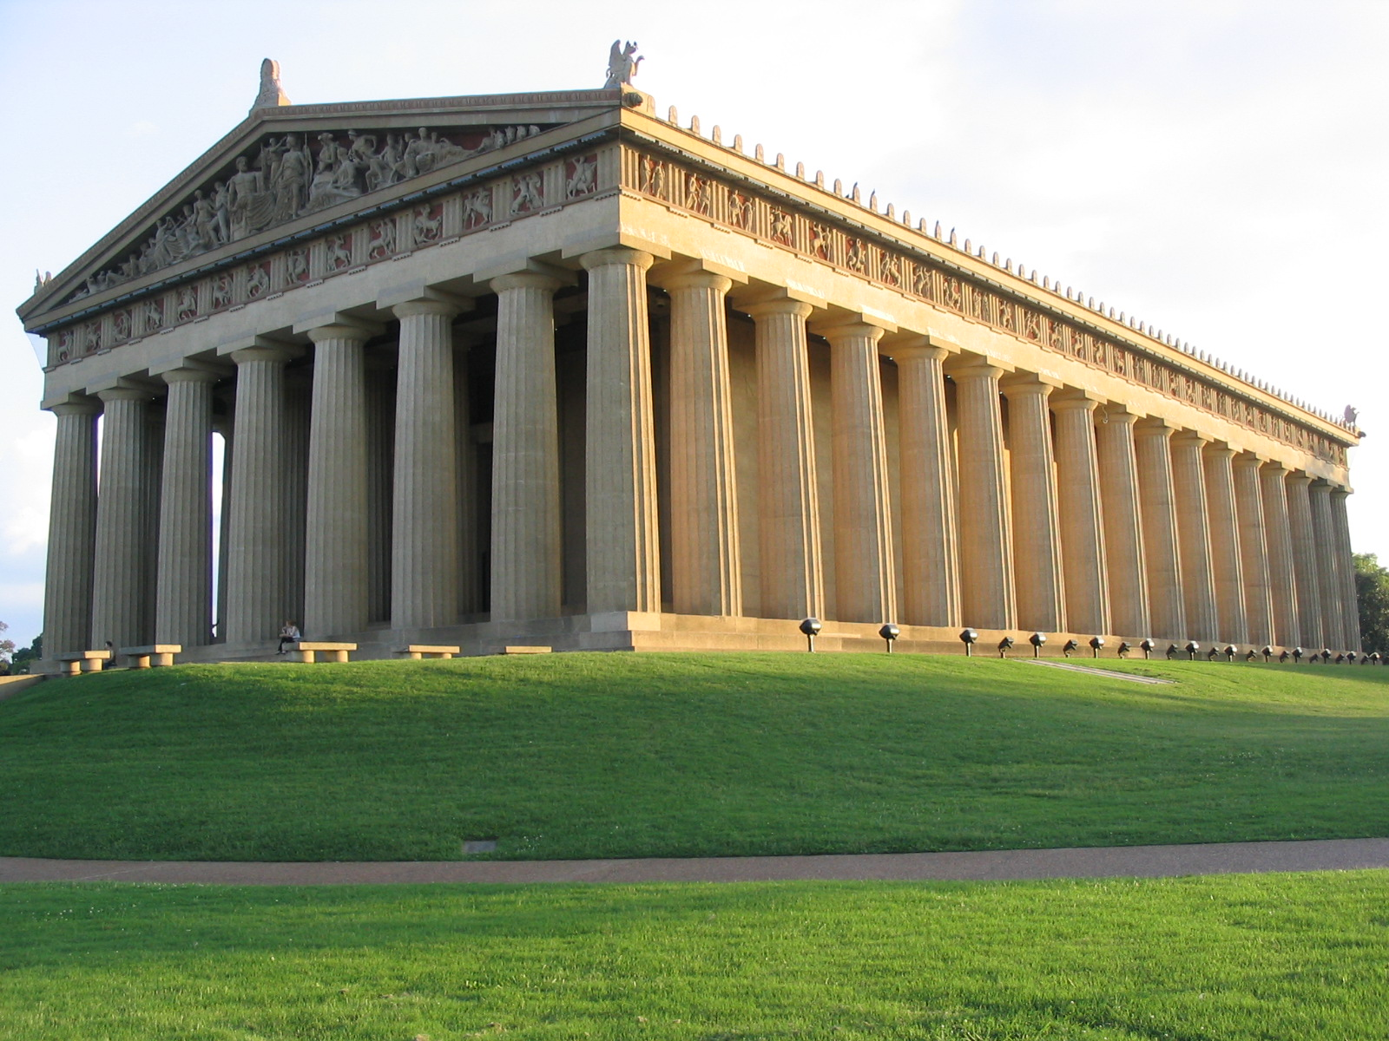
Reconstruction of the Parthenon, Nashville, Tennessee

Slide 8
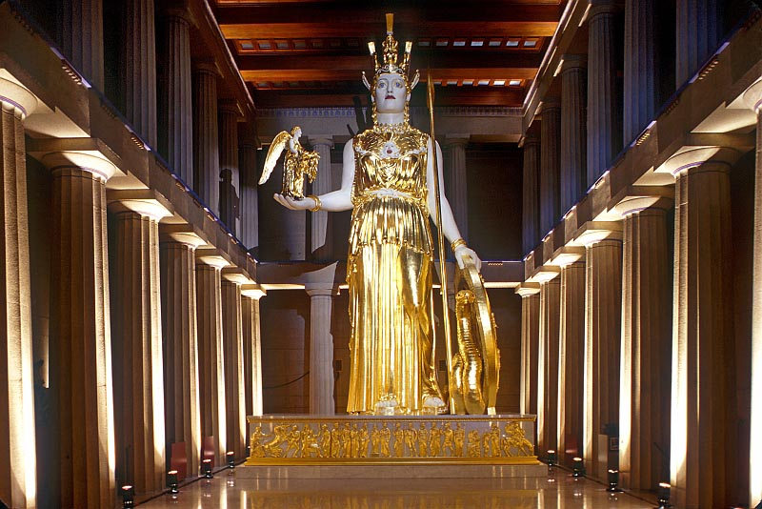
Reconstruction of Phidias’ Athene Parthenos, Nashville, Tennesee

Slide 9
ATHENIAN FESTIVALS
PANATHENAEA
CITY DIONYSIA

Slide 10
XENOPHANES (c.600 BCE)
If a horse or lion or a slow ox
had agile hands for paint and sculpture,
the horse would make his god a horse,
the ox would sculpt an ox.
Our gods have flat noses and black skins
say the Ethiopians. The Thracians say
our gods have red hair and hazel eyes.

Slide 11
THEAGENES
(525 BCE)
ALLEGORY

Slide 12
ANAXAGORAS
SOCRATES
PLATO

Slide 13
EUHEMERUS
c. 300 BCE
gods were actually men
deified for their great deeds
EUHEMERISM

Slide 14
EXTERNALIST THEORIES 1: NATURE MYTHS

Slide 15
“Jupiter of Smyrna” (mid 2nd c. CE, restored)

Slide 16
Poseidon, cup found in Etruria (ca. 410 BC - ca. 405 B.C.E.)

Slide 17
Proto-Indo-European sky god: Dieus-phiter
Sanskrit: Dyaus Pita
Linear B Greek: Di-we
Classical Greek: Zeus, Dios
Latin: Jupiter (Dieu + pater)

Slide 18
EXTERNALIST THEORIES 2: THE RITUALISTS’ SCHOOL

Slide 19
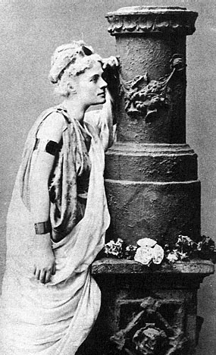
Myth and ritual: Frazer & Harrison
J.G. Frazer The Golden Bough:
A Study in Comparative Religion
(1890 onwards)
Jane Harrison Prolegomena
to the Study of Greek Religion
(1903)
Jane Harrison as Alcestis

Slide 20
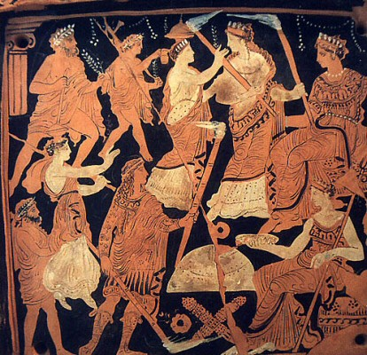
The Eleusinian Mysteries on the Ninnion Tablet (ca. 370 B.C.E.)

Slide 21
EXTERNALIST THEORIES 3: CHARTER THEORY OF MYTH

Slide 22
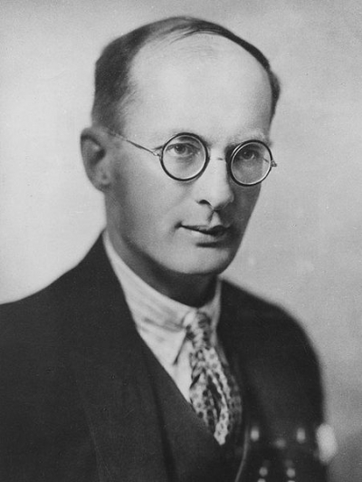
Bronislaw Malinowski

Slide 23
Bronislaw Malinowski: Argonauts of the Western Pacific: An account of native enterprise and adventure in the Archipelagoes of Melanesian New Guinea (1922)
Myths validate social institutions, customs, beliefs

Slide 24
EXTERNALIST THEORIES 4: ETIOLOGY (AITION)

Slide 25
INTERNALIST THEORIES 1: PSYCHOLOGY

Slide 26
Sigmund Freud

Slide 27
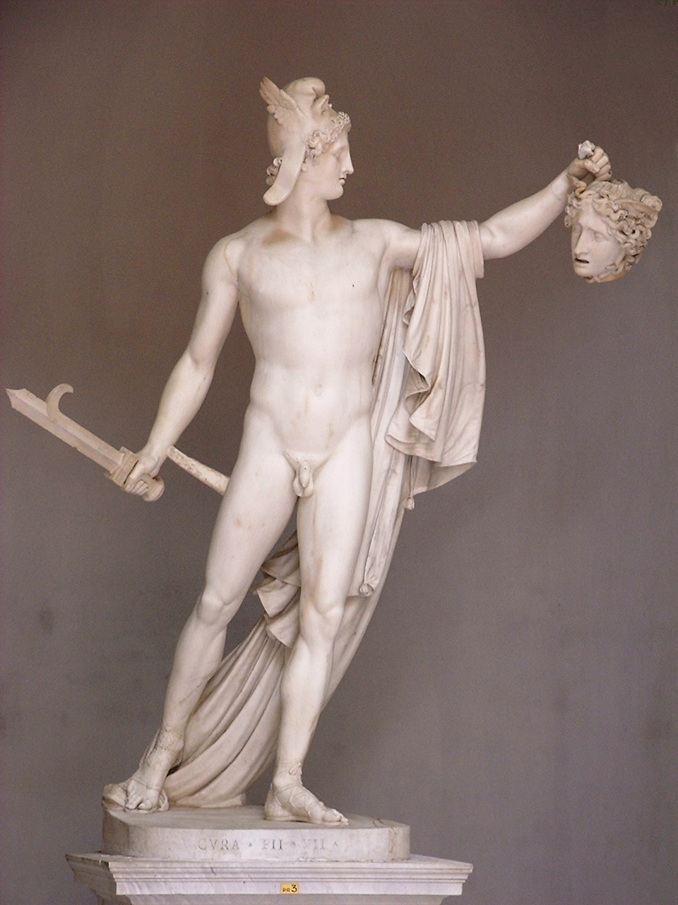
Statue of Perseus holding Medusa's head by Antonio Canova (ca. 1800)

Slide 28
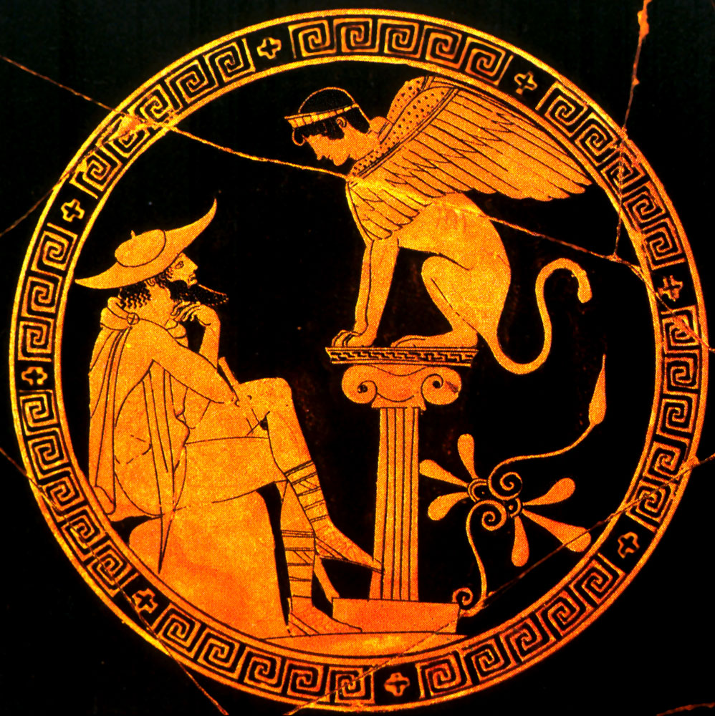
"Oedipus and the Sphinx" (c. 470 B.C.E.)

Slide 29
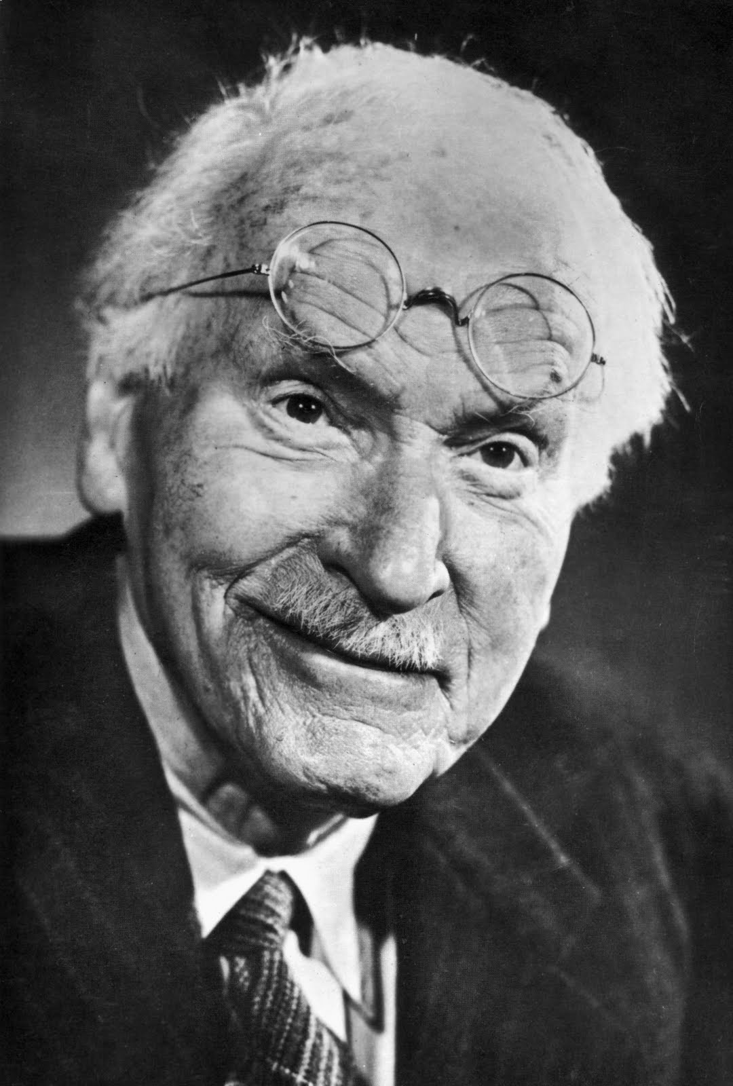
Carl Jung

Slide 30
MYTHIC ARCHETYPES
COLLECTIVE UNCONSCIOUS

Slide 31
ZEUS
PROMETHEUS
HERA
ARTEMIS
HERMES
ATHENE
APHRODITE

Slide 32
INTERNALIST THEORIES 2: STRUCTURALISM CLAUDE LEVI-STRAUSS

Slide 33
INTERNALIST THEORIES 3: NARRATOLOGY VLADIMIR PROPP MIEKE BAL

Slide 34
INTERNALIST THEORIES 4: FEMINISTIC INTERPRETATIONS CAROL GILLIGAN FROMA ZEITLIN

Slide 35
INTERNALIST THEORIES 5: NEUROLOGICAL INTERPRETATION

Slide 36
Myths of Prometheus and Pandora
PRO-METHEUS = FORE-THOUGHT
EPI-METHEUS = AFTER-THOUGHT

Slide 37
Πανδώρα
Pandora
All-Gifted
(or Giver of All?)

Slide 38
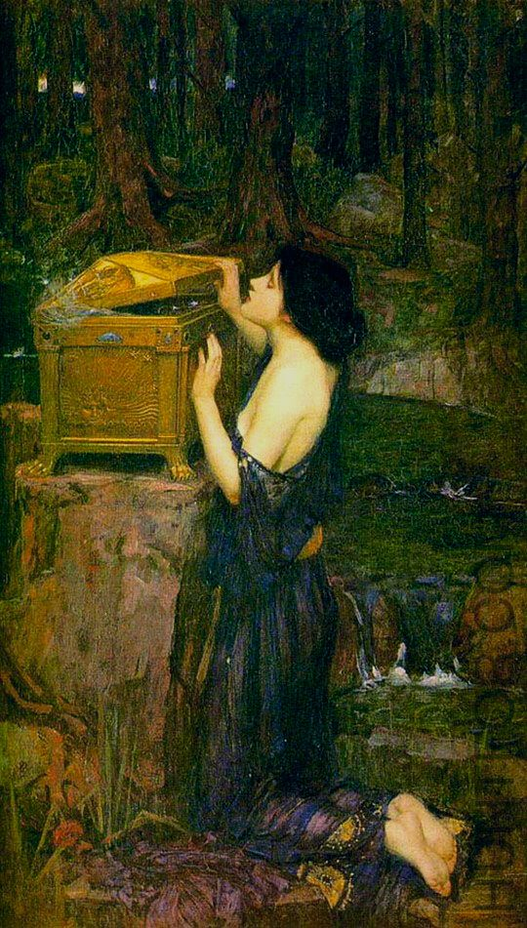
Pandora
John William Waterhouse
1869

Slide 39
Pandora’s Box. Andrew Jung. 2007

Slide 40
Pandora Cartoon. Mark Parisi. 1999.

Slide 41
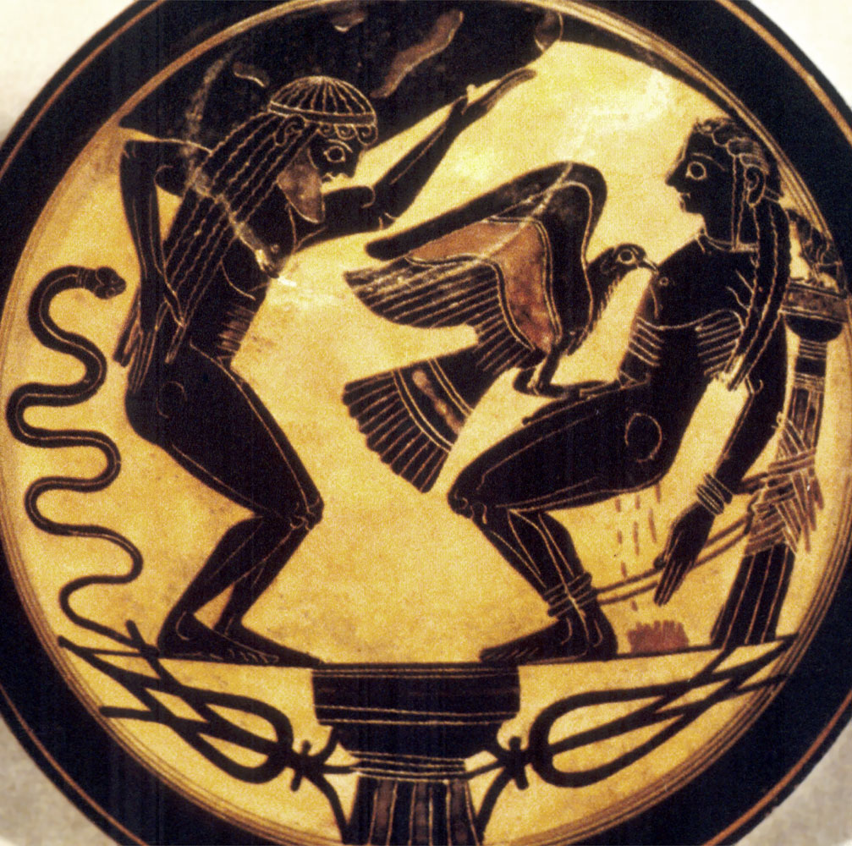
Prometheus and the Eagle, Laconian Kylix, 6th C BCE

Slide 42
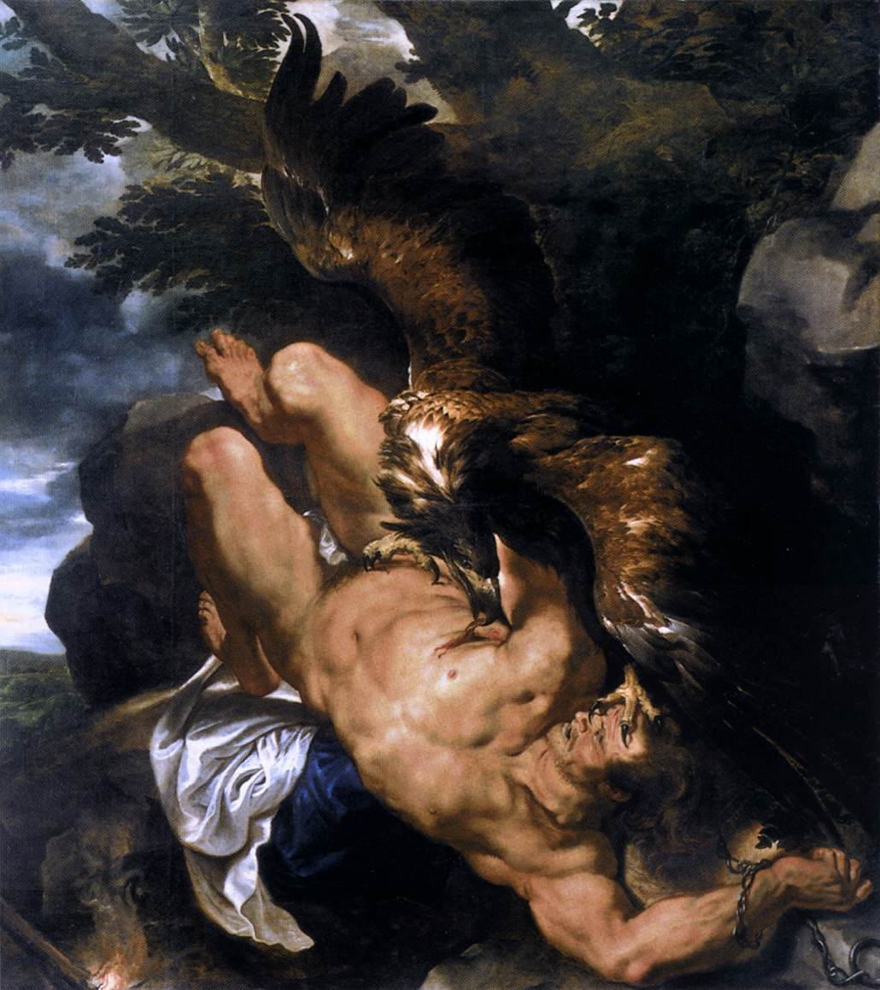
Prometheus Bound, Rubens and Snyders (1611-18)

Slide 43
Emery George Prometheus
from Nina Kossman Gods and Mortals: Modern Poems on Classical Themes (Oxford, 2001)

Slide 44
FOR NEXT TIME:
PRODUCTS MARKETED WITH NAMES FROM CLASSICAL MYTHOLOGY

